Slide 1
An introduction to Seq2Seq & Attention
Zheda Mai
Data-Driven Decision Making Lab (D3M)
University of Toronto

Slide 2
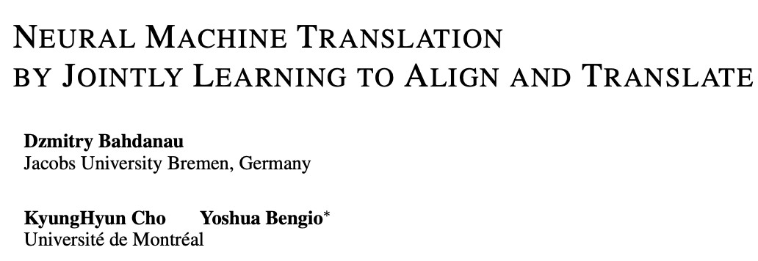
Paper covered

Slide 3
Agenda
Seq2Seq
Attention
Transformer
Attentive Collaborative Filtering(If time permits)

Slide 4
Background
Sequence-to-sequence models are deep learning models that have achieved a lot of success
machine translation
text summarization
image captioning
Google Translate started using such a model in production in late 2016.

Slide 5
Sequence to Sequence Learning with Neural Networks
Notes:
A sequence-to-sequence model is a model that takes a sequence of items (words, letters, features of an images…etc) and outputs another sequence of items.
Amazon transaction history, output can be the recommendation
We may be wondering how does everything work under the hood.
The encoder processes each item in the input sequence, it compiles the information it captures into a vector (called the context). After processing the entire input sequence, the encoder sends the context over to the decoder, which begins producing the output sequence item by item.

Slide 6
Basic elements
context vector
Size of the vector is basically the number of hidden units in the encoder RNN
Word embedding
Transform a word into a vector
Pre-trained or train on our dataset
Typical size: 200, 300
Notes:
I use a vector of size 4 for easier visualization, but in real world applications the context vector would be of a size like 256, 512, or 1024.

Slide 7
Recap the mechanics of an RNN
The next RNN step takes the second input vector and hidden state #1 to create the output of that time step.
Notes:
- How many people are familiar with RNN
RNN contains a bunch of small basic blocks.
Each block will take two inputs and create two outputs.
Input #1 is the word we send to the RNN.

Slide 8
Seq2Seq-step by step

Slide 9
Seq2Seq-step by step
The decoder also maintains a hidden states that it passes from one time step to the next.
Notes:
That's basically the general idea of the paper Seq2Seq

Slide 10
Key points
1. Use two different LSTMs
Encoder and decoder
2. Deep LSTM significantly outperforms shallow LSTMs
3. Reverse the order of the words of the input sentence
The ground true mapping: a,b,c -> x,y,z
LSTM is asked to map c,b,a->x, y, z
Don’t have complete explanation, may be caused by the introduction of many short term dependencies to the dataset

Slide 11
Let’s Pay Attention Now
The context vector turned out to be a bottleneck for these types of models. It made it challenging for the models to deal with long sentences.
Bahdanau et al., 2014 and Luong et al., 2015 introduced and refined a technique called “Attention”
Attention allows the model to focus on the relevant parts of the input sequence as needed.
Notes:
The context vector turned out to be a bottleneck for these types of models. It made it challenging for the models to deal with long sentences. Because when the sentence is long, it ‘s harder to encode all the information. Also, the context vector may pay more attention to the recent words than the words at the beginning of the sentence.
But when human beings communicate, we may pay different attention to different parts of the sentence based on what we more to focus on.

Slide 12
High level idea
This ability to amplify the signal from the relevant part of the input sequence makes attention models produce better results
Notes:
At time step 7, the attention mechanism enables the decoder to focus on the word "étudiant" ("student" in french) before it generates the English translation. This ability to amplify the signal from the relevant part of the input sequence makes attention models produce better results than models without attention.

Slide 13
High level idea
The encoder passes a lot more data to the decoder
2. Attention decoder does an extra step to make the model focus on the relevant part of the input
Notes:
An attention model differs from a classic sequence-to-sequence model in two main ways:
First, the encoder passes a lot more data to the decoder. Instead of passing the last hidden state of the encoding stage, the encoder passes all the hidden states to the decoder:
Second, an attention decoder does an extra step before producing its output. In order to focus on the parts of the input that are relevant to this decoding time step,

Slide 14
Attention
Notes:
the decoder does the following:
Look at the set of encoder hidden states it received – each encoder hidden states is most associated with a certain word in the input sentence
Give each hidden states a score (let’s ignore how the scoring is done for now)
Multiply each hidden states by its softmaxed score, thus amplifying hidden states with high scores, and drowning out hidden states with low scores

Slide 15
Whole decoder
Notes:
This scoring exercise is done at each time step on the decoder side
Let us now bring the whole thing together in the following visualization and look at how the attention process works:
The attention decoder RNN takes in the embedding of the <END> token, and an initial decoder hidden state.
The RNN processes its inputs, producing an output and a new hidden state vector (h4). The output is discarded.
Attention Step: We use the encoder hidden states and the h4 vector to calculate a context vector (C4) for this time step.
We concatenate h4 and C4 into one vector.
We pass this vector through a feedforward neural network (one trained jointly with the model).
The output of the feedforward neural networks indicates the output word of this time step.
Repeat for the next time steps

Slide 16
Example
Notes:
Note that the model isn’t just mindless aligning the first word at the output with the first word from the input. It actually learned from the training phase how to align words in that language pair (French and English in our example).
You can see how the model paid attention correctly when outputing "European Economic Area". In French, the order of these words is reversed ("européenne économique zone") as compared to English. Every other word in the sentence is in similar order.

Slide 17
Attention is all you need-Transformer
Architecture of Transformer
Unrolled view of architecture of Transformer

Slide 18
Transformer
Self-attention layer – a layer that helps the encoder look at other words in the input sentence as it encodes a specific word.
The exact same feed-forward network is independently applied to each position.
The decoder has both those layers, but between them is an attention layer that helps the decoder focus on relevant parts of the input sentence

Slide 19
Transformer-detail
Each word is embedded into a vector of size512
There are dependencies between each input in the self-attention layer
We can run FFNN in parallel
All inputs share the same FFNN in the same encoder

Slide 20
Self-Attention at a high level
Example:
”The animal didn't cross the street because it was too tired”
Analogy
RNN
Use hidden state to incorporate information of previous words with the current one
Transformer
Use self-attention to incorporate information of relevant words with the current one

Slide 21
Self-Attention in detail
Create three vectors from each of the input
Multiplying the embedding by three matrices that we trained during the training process.
All inputs share the same W^{Q}, W^{K}, W^{V}
q, k, v have the same length d_{k}

Slide 22
Detail: calculate score
Score each word of the input sentence against “Thinking”
The score determines how much focus to place on other parts of the input sentence as we encode a word
Dot product of q_{i} with the k_{j}

Slide 23
Normalization
Divide the score by ($\sqrt{d_{k}}$) for more stable gradients
Softmax

Slide 24
Weighted sum
Multiply each value vector by the Softmax score
Sum up the weighted value vector to get the output of the self-attention layer at this position

Slide 25
Matrix calculation of self-attention

Slide 26
Multi-head Attention
multiple sets of Q/K/V weight matrices
after training, each set is used to project the input embeddings into a different representation subspace.

Slide 27
Multi-head Attention
Do the same self-attention, we have 8 z values.
Concatenate them and multiply with a weight matrix to get the final z

Slide 29
Example

Slide 30
Representing The Order of The Sequence Using Positional Encoding

Slide 31
The Residuals

Slide 32
Decoder
Decoders have two attentions
Self-attention
Encoder-decoder attention
Self-attention layer is only allowed to attend to earlier positions in the output sequence.
Encoder-Decoder Attention layer works just like multiheaded self-attention
Queries matrix from decoder
K &V from encoder

Slide 33
Final Layer

Slide 34
Attentive collaborative filtering

Slide 35
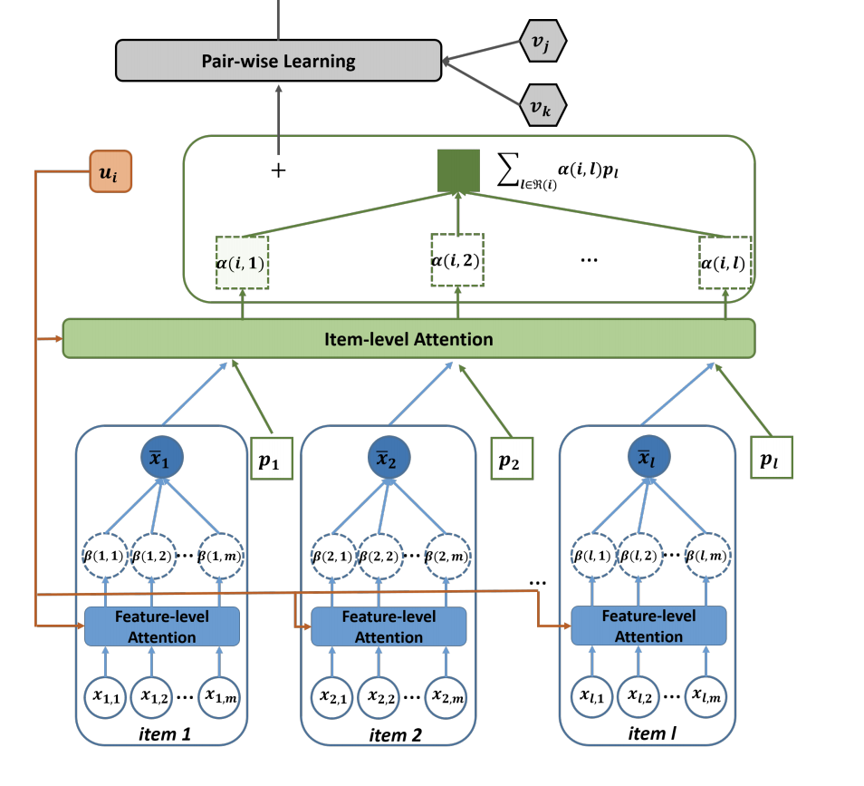
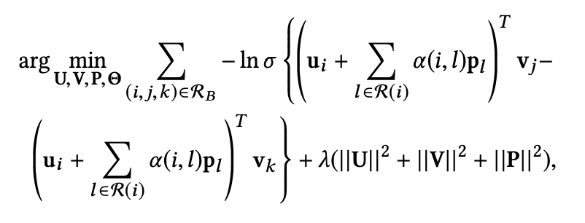
Two level attention
Feature level
Item level

Slide 36
Reference
1. Sequence to Sequence Learning with Neural Networks
https://papers.nips.cc/paper/5346-sequence-to-sequence-learning-with-neural-networks.pdf
2. Attention Is All You Need
https://arxiv.org/pdf/1706.03762.pdf
3. Attentive Collaborative Filtering
https://www.comp.nus.edu.sg/~xiangnan/papers/sigir17-AttentiveCF.pdf
Most GIFs and images are borrowed from:
https://jalammar.github.io/visualizing-neural-machine-translation-mechanics-of-seq2seq-models-with-attention/
http://jalammar.github.io/illustrated-transformer/

