Slide 1
Frustratingly Easy Transferability Estimation
Zheda Mai

Slide 2
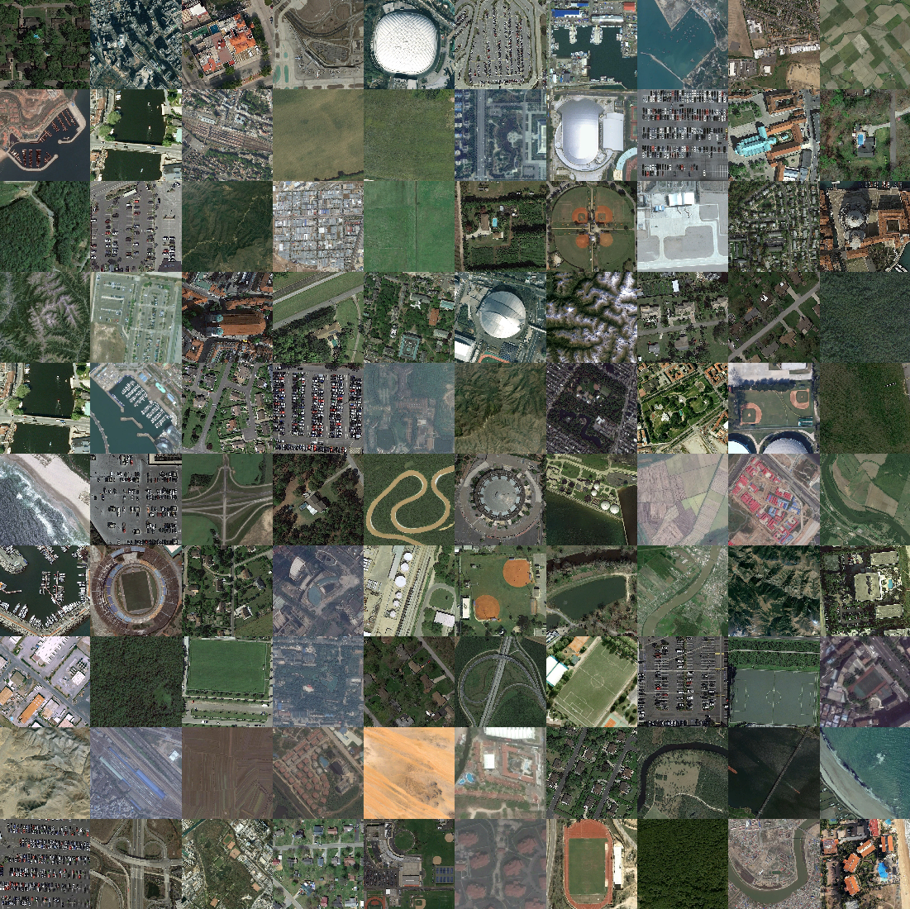
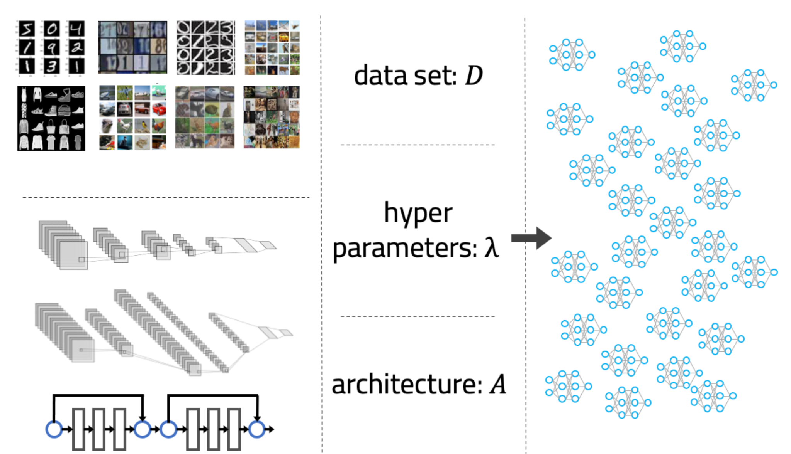
Background
downstream data
pretrained model zoo
which model to finetune?

Slide 3
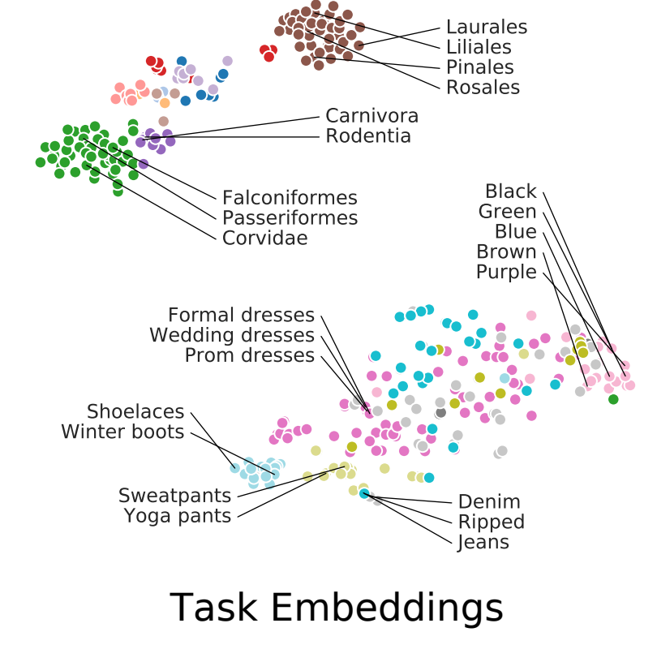
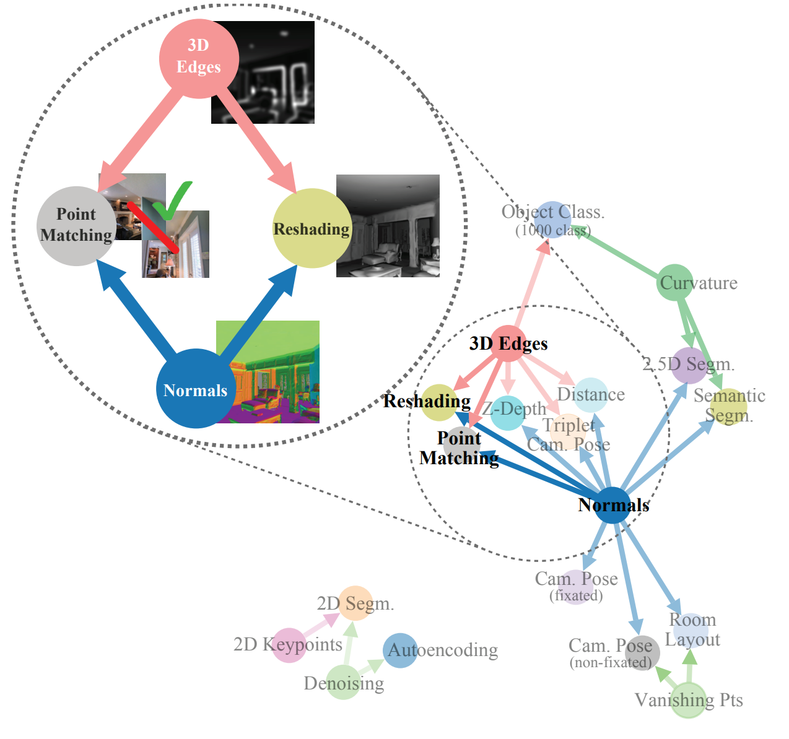
Background
Measure source and target data similarity
Taskonomy, CVPR18
Task2Vec, CVPR19
Drawbacks:
access to source data
training on target data
Computationally efficient transferability measures
No source data access
No training on target data
Limited optimization effort

Slide 4
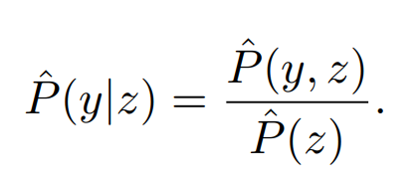
Background
Drawback: classification model only
LEEP: Log Expected Empirical Prediction, ICML20
Target data D = (X, Y),
Feed X to a pre-trained model, get the predicted distribution over Z, the label of source data
Compute the empirical conditional distribution of the target label y given the source label z
LEEP score: prediction using relationship between Y and Z

Slide 5
Frustratingly Easy Transferability Estimation
ICML, 2022
No source data access
No training on target data
No optimization effort
Apply to any pre-trained model

Slide 6
Statistic & Information Theory Review
Mutual Information (MI)
Entropy
Relationship between MI and entropy
Determinant of covariance matrix

Slide 7
Mutual Information (MI)
measures how much information one random variables tells us about another
High MI
a large reduction in uncertainty about one variable given another
a strong dependency between two variable
Low MI:
a small reduction in uncertainty about one variable given another
a weak dependency between two variable
0 MI -> independent.

Slide 8
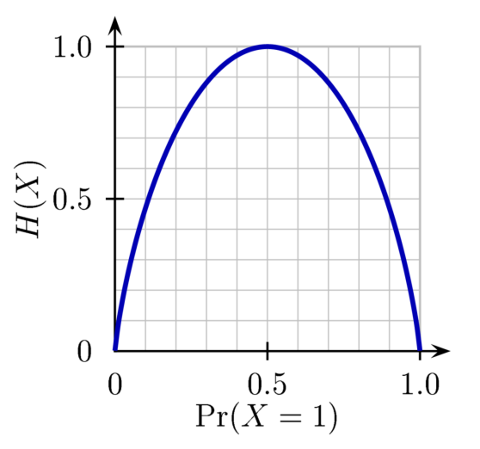
Entropy
a measure of uncertainty – the higher the entropy, the more uncertain one is about a random variable.

Slide 9
Relationship between MI and entropy

Slide 10
Determinant of covariance matrix
PCA
find the top n largest eigenvalues of covariance matrix
large eigenvalues mean the variances of the corresponding eigenvectors are large
Determinant(A) = product of eigenvalues of A
Determinant of covariance matrix
measure the spreadness of a data distribution.
volume occupied by the data distribution in the feature space

Slide 11
Definitions
g: frozen feature extractor
w: head of the target task (prediction layer + last layers to finetune)
z_{i}: g(x_{i}) the feature
T_{s}: source task
T_{t}: target task
optimal model

Slide 12
TransRate
Assumption: the MI between extracted features and the target task labels is a strong indicator for the finetune performance
Y: target labels
Z: g(X) extracted features
h: differential entropy
H: entropy for discrete random variable
: quantized features
It’is still hard to compute MI efficiently

Slide 13
Approximation
Rate distortion (Binia et al.,1974): minimal number of binary bits to encode Z with an expected decoding error less than ε
Coding rate (Ma et al., 2007): efficient and accurate empirical estimation to rate distortion
d: feature dimension
n: number of features

Slide 14
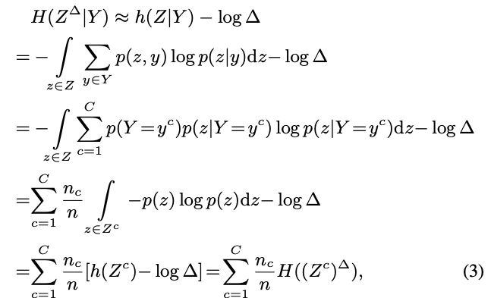
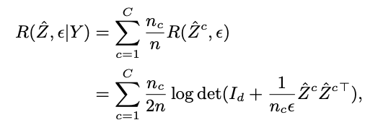
TransRate

Slide 15
TransRate: summary

Slide 16
What exactly does coding rate measure
Determinant of covariance matrix
measure the spread of a data distribution.
Log determinant of covariance matrix
measure the spreadness of features
max R(Z): features for all classes should be as diverse as possible
min R(Z|Y): features given Y should be as compact as possible

Slide 17
Illustration
Axes: two dimension of features
Color: classes
Log determinant of covariance matrix
measure the spreadness of features
max R(Z): features for all classes should be as diverse as possible
min R(Z|Y): features given Y should be as compact as possible

Slide 18
Experiment
Fullfine tuning
Metric: correlation between the fine-tune test acc and the Transferability measures
Pearson correlation coefficient
Kendall’s τ and its variant

Slide 19
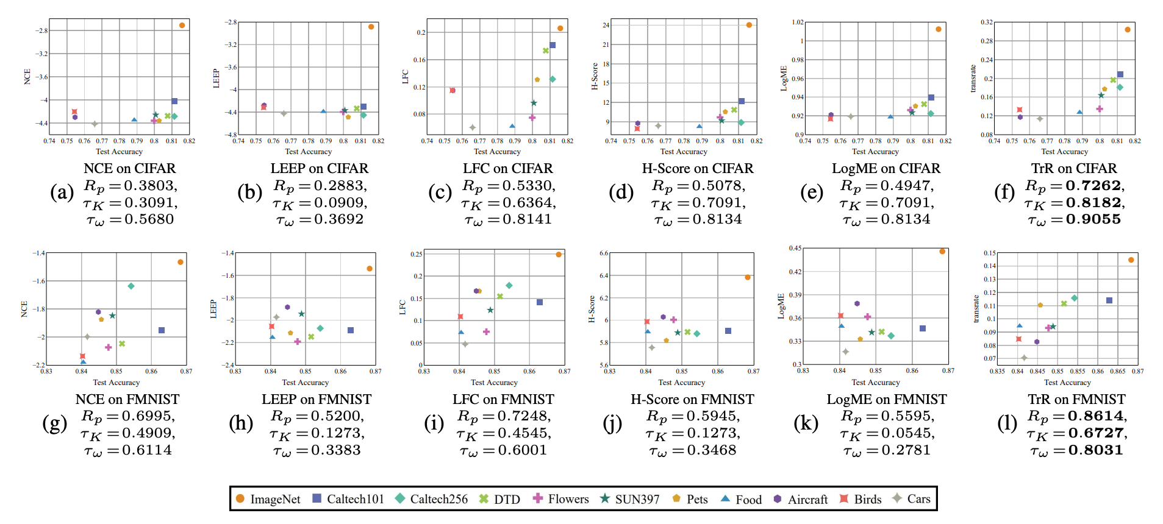
Source Selection
Potential pitfalls in this figure:
ranking is more important than correlation
it seems ranking is similar for multiple methods
if we rescale other methods’ scores, the correlation score will change
x axis: test acc
y axis: different transferability score
ResNet 18

Slide 20
Model architecture selection
ImageNet -> Cifar100
Potential pitfalls in this figure:
Model parameter is a better score

Slide 21
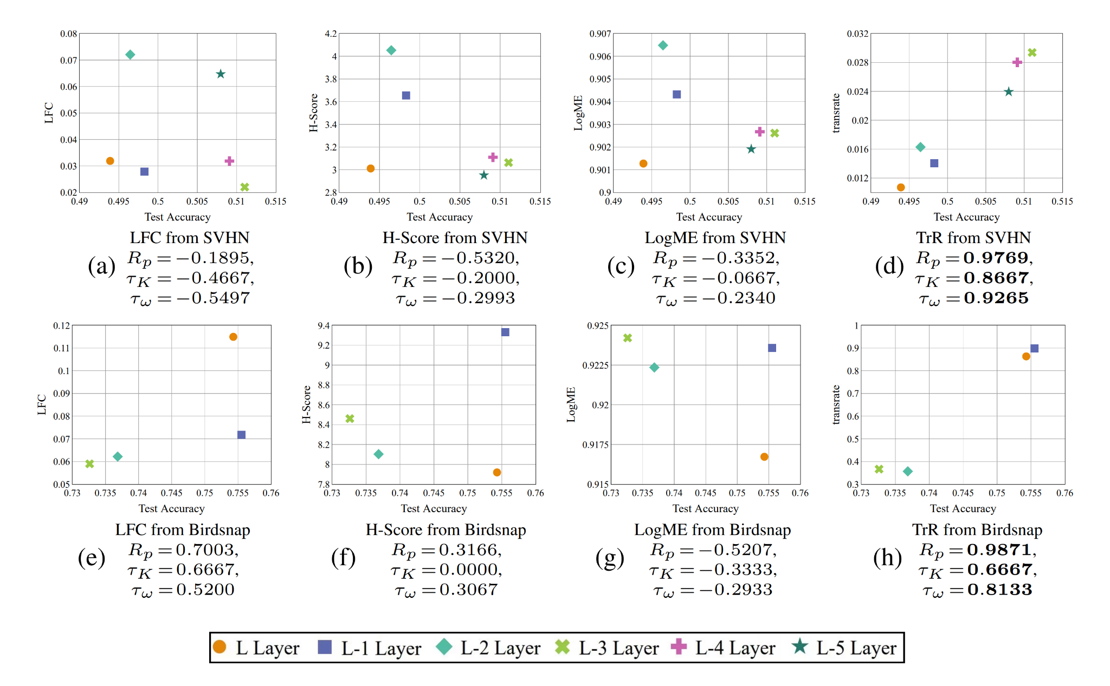
Layer Selection
ResNet-18(SVHN) Candidates (9, 11, 13, 15, 17, 19)
ResNet-20 (Birdsnap) Candidates (11, 13, 15, 17)
Transferability is estimated with features extracted by the first K-th layer.
When K is not the last layer, use average pooling function on the features

Slide 22
Questions about this paper
Tradeoff between two terms: which is more important and why?
What are the fundamental reasons for negative transferring?
problem specific constant
expected error for source and target domain
domain divergence
Domain divergence.
Transfer algorithm
Source data quality/ model quality
Target data quality
[1] Shai Ben-David, etc. “A theory of learning from different domains”, Machine Learning, 2010
[2] Overcoming negative transfer: A survey, TAI, 2020
Notes:
A theory of learning from different domains

Slide 23
Potential ideas
These metrics focus on finding the best model. Can we find multiple models, merge them and then finetune? How to merge model to achieve good transferability?
Can we leverage Transformer’s internal mechanism to provide better transferability measure?
Previous papers assume the best way for transfer learning is linear probing or finetune the last few blocks, which have been shown that they underperform PETL for ViT. If we know we will use PETL, can we provide better estimate?

