Slide 1
Robustness
in Deep Learning
Zheda Mai

Slide 2
Agenda
Robustness to adversarial data
Robustness to distribution shift
Robustness to spurious correlations

Slide 3
Adversarial Robustness

Slide 4
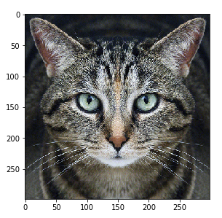
Cat
Adversarial
Distortion
Guacamole
Carefully crafted noise
The adversarial distortion is optimized to cause the (undefended, off-the-shelf) neural network to make a mistake
But now models can be defended against such imperceptible distortions

Slide 5
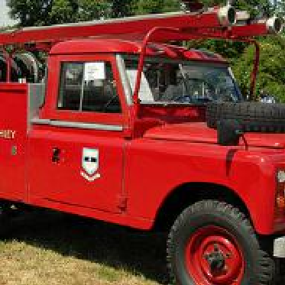
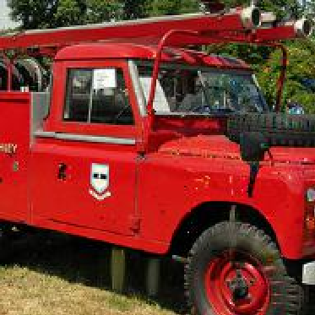
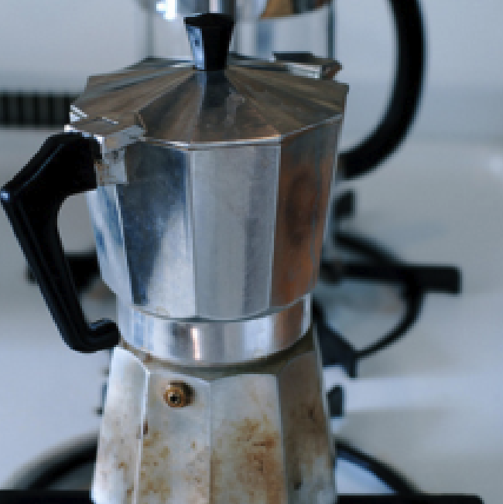
Modern Adversarial Examples
Perceptible
Perceptible
Here, the adversary made changes to the image that are perceptible to the human eye, yet the category is unchanged
Modern models can be made robust to imperceptible distortions, but they are still NOT robust to perceptible distortions

Slide 6
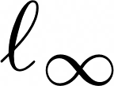
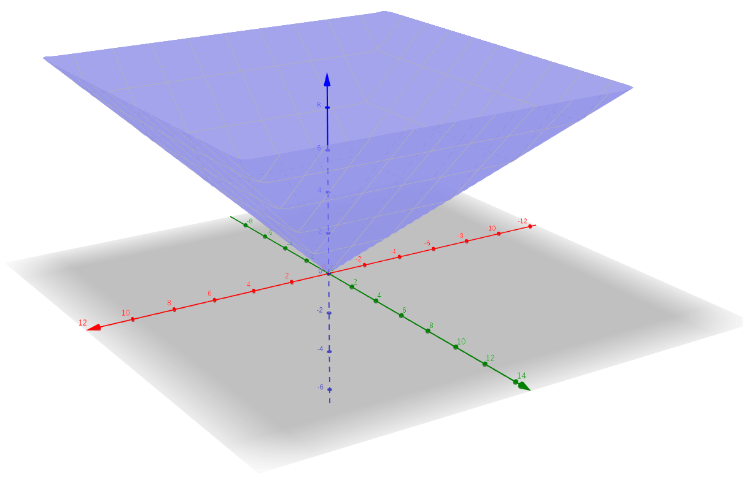
Refresher: Metric
Dan Hendrycks
Introduction to ML Safety
Notes:
\| v \|_{\infty} = \max\{|v_1|, |v_2|, \cdots, |v_n|\}

Slide 7
Fast Gradient Sign Method (FGSM)
How do we generate adversarial examples algorithmically?
A simple adversarial attack is the FGSM attack:
This performs a single step of gradient ascent to increase the loss,
and it obeys an attack budget
This attack is “fast” because it uses a single step
This is no longer a strong attack and is easy to defend against
Notes:
why not directly use the gradient, because some larger that epison and some smaller, here, we use all the budget

Slide 8
Projected Gradient Descent (PGD)
Unlike the single-step FGSM attack, the PGD attack uses multiple gradient ascent steps and is thus far more powerful
Pseudocode for PGD subject to an budget:
For more diverse examples, the first step randomly initializes gradient ascent
for t = 1, ..., T:
For CIFAR-10, T is often 7

Slide 9
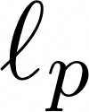
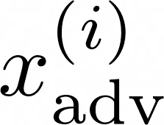
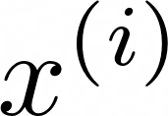
Adversarial Training (AT)
The best-known way to make models more robust to adversarial examples is adversarial training
As follows is a common adversarial procedure:
sample minibatch from the dataset
For adversarial training to be successful, is from a multistep attack such as PGD
create from for all
optimize the loss
Currently, AT can reduce accuracy on clean examples by 10%+

Slide 10
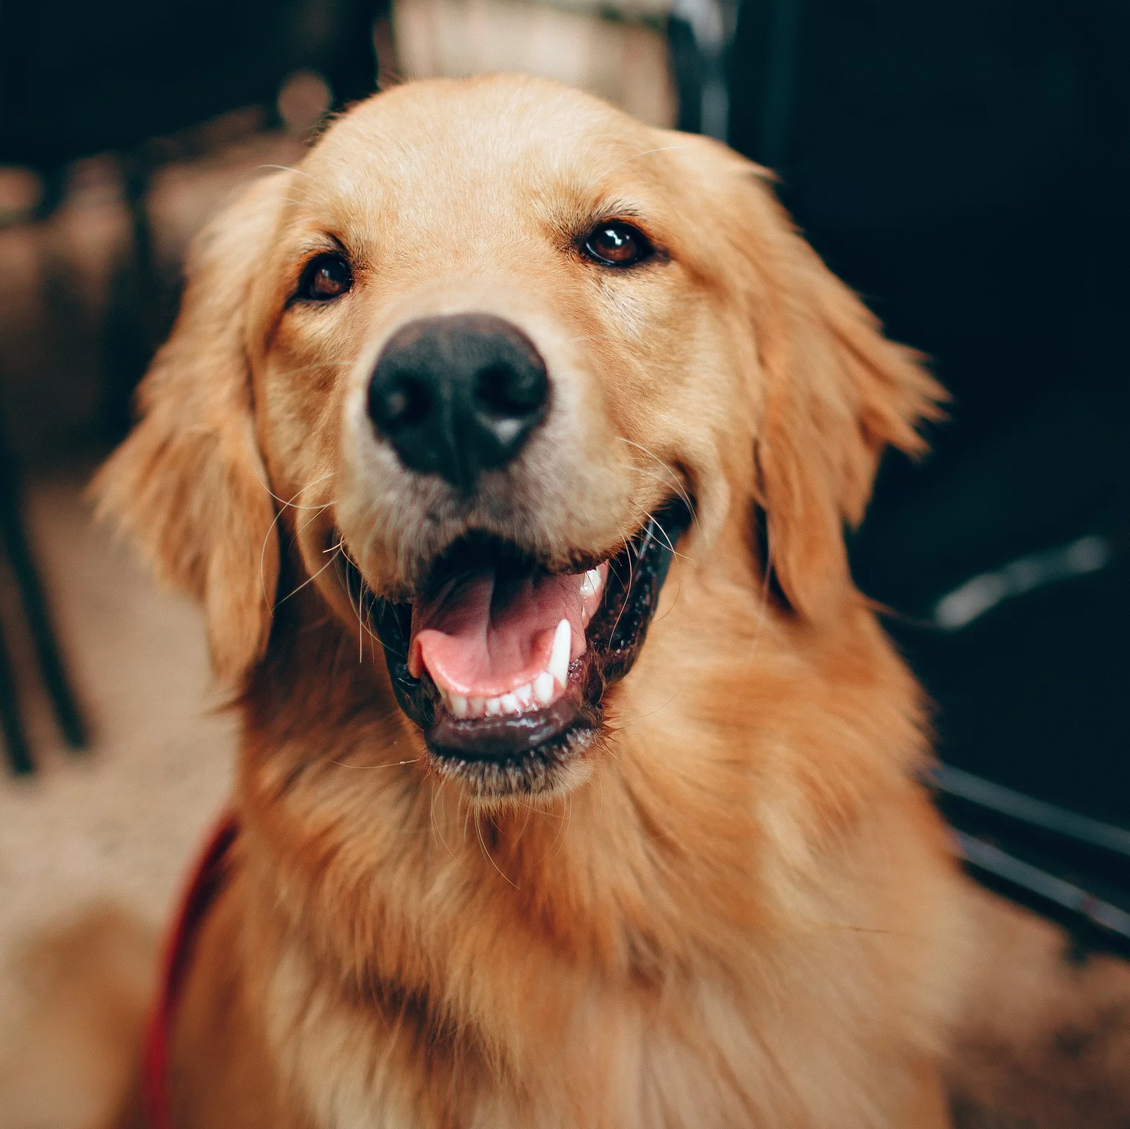
Untargeted vs Targeted Attacks
An untargeted attack maximizes the loss, whereas a targeted attack optimizes examples to be misclassified as a predetermined target
Untargeted attacks for AT are standard for CIFAR, but targeted attacks for AT are standard for ImageNet since it has many similar classes
Original
Untargeted adversary
Targeted adversary
: great_white_shark
Labrador Retriever
Golden Retriever
Great White Shark

Slide 11
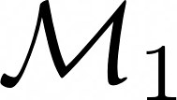
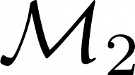
Transferability
An adversarial example crafted for one model can be used to attack many different models
Given models and , designed for sometimes gives
a high loss, even if is a different architecture
Even though transfer rates can vary widely, transferability demonstrates that adversarial failure modes are somewhat shared across models
Consequently, an attacker does not always need access to a model’s parameters or architectural information to attack it

Slide 12
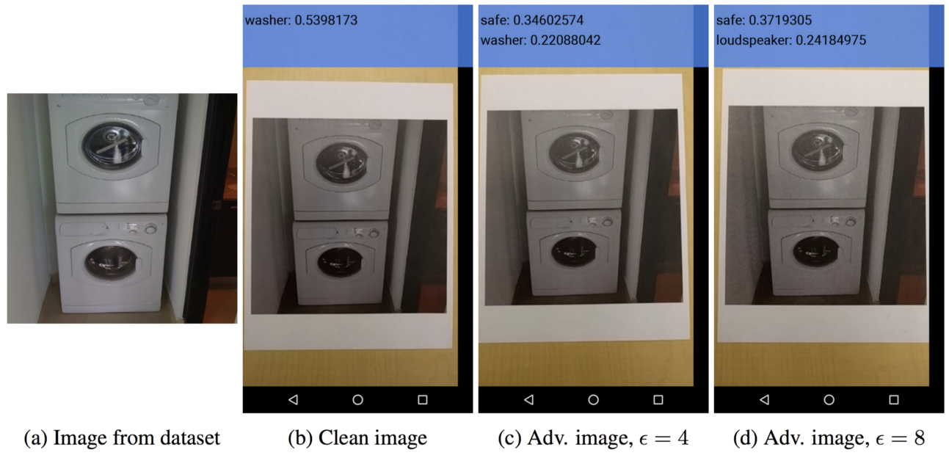
Transferability in the Real World
Adversarial examples can be robust enough to withstand real-world instantiation noise (printer imperfections) and sensor noise (camera)
For example, this model has not undergone adversarial training and is susceptible to an example that’s printed on paper and photographed

Slide 13
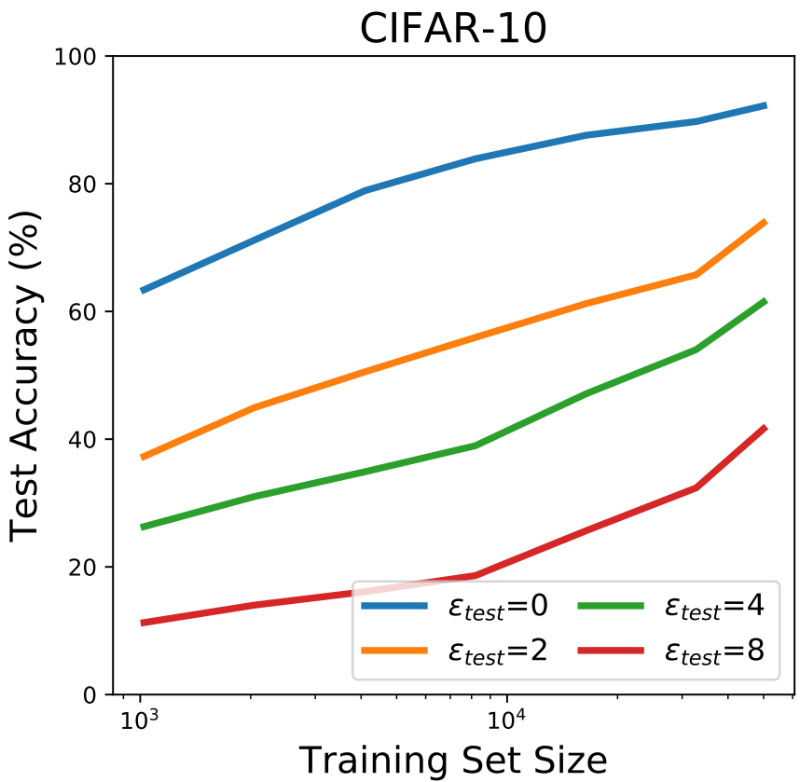
Improving Robustness With Data
Adversarial robustness scales slowly with dataset size
One can adversarially pretrain using adversarially distorted data for larger tasks
E.g., for CIFAR-100 , first adversarially pretrain on ImageNet
adversarial robustness is NOT just memorization, learn more generalizable, robust features that can transfer to other datasets.
Notes:
this suggests that adversarial robustness is not just for one specific dataset.
the adversarial robustness is not just memorization but actually learns some generalizable more robust features which can transfer over to other datasets.

Slide 14
Data Augmentation
Beyond using more data, models can also squeeze more out of the existing data using data augmentation
data augmentation techniques + adversarial training
Original Mixup Cutout CutMix

Slide 15
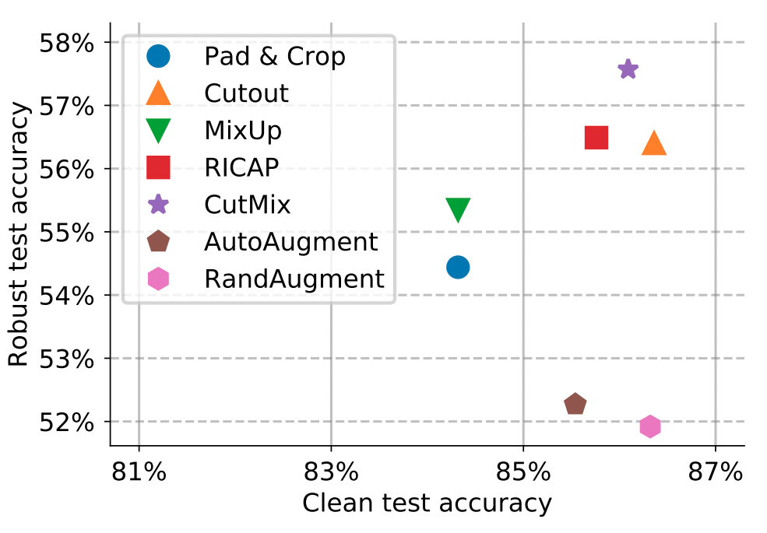
Data Augmentation Results and Caveat
CutMix
The parameter exponential moving average is needed for data augmentation to be beneficial
Given parameters , at each iteration the model is updated with an exponential moving average

Slide 16
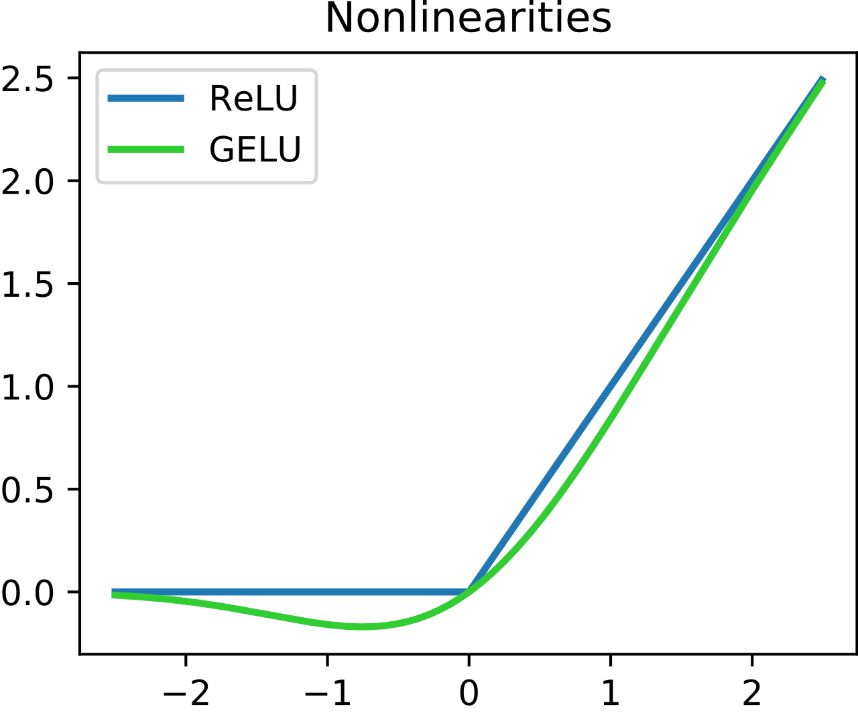
Smooth Activations
Sharp activation functions such as ReLUs makes adversarial training less effective
By improving gradient quality for either the adversarial attacker or the network optimizer,
smooth activations improve adversarial training
Model | ImageNet Adversarial Accuracy
ResNet-50 with ReLUs | 26.41%
ResNet-50 with GELUs | 35.51%

Slide 17
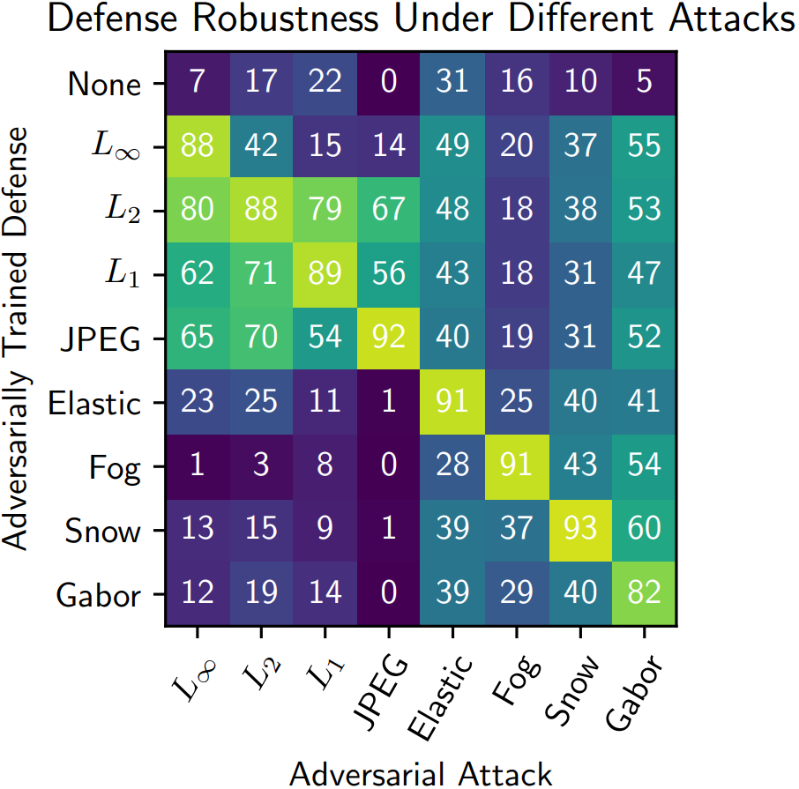
Unforeseen Adversaries
In practice, attackers could use unforeseen or novel attacks, whose specifications are not known beforehand
Models are far less robust to attacks they have not trained against
To estimate robustness to unforeseen attacks, measure robustness to multiple attacks not encountered during training
Dan Hendrycks
Introduction to ML Safety
17

Slide 18
Robustness to
Distribution Shift

Slide 19
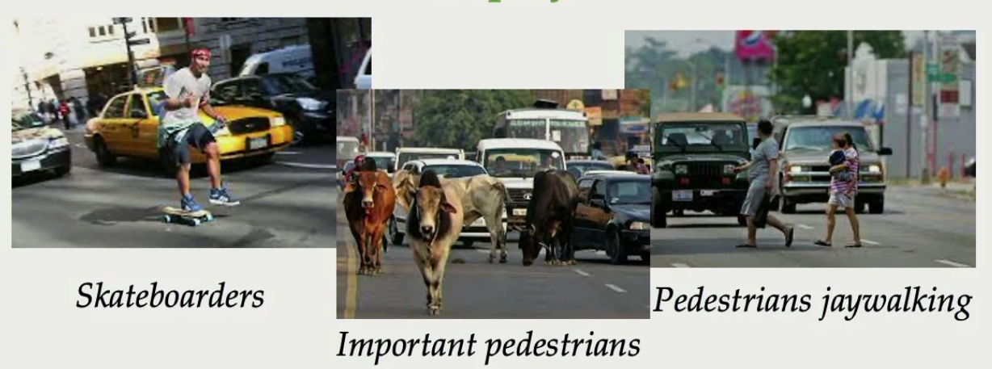
Distribution Shift is everywhere in modern ML
Train
Deploy

Slide 20
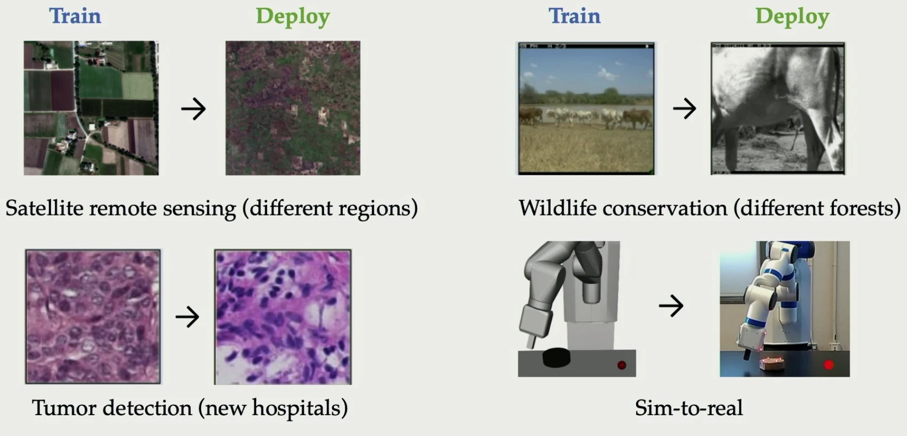
Distribution Shift is everywhere in modern ML

Slide 21
Is Robustness To
Distribution Shift Still A Problem
With Foundation Models ?

Slide 22
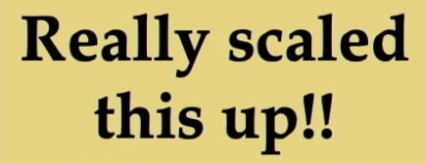
Notes:
pretrained when we have enough data, everything is in-distribution

Slide 23
Goal
Giving a pre-trained model M_{pre}
Reference distribution data D_{ref} and shifted distribution data D_{shift}
The model M_{pre} fine-tuned on D_{ref} should perform well on the test sets of both D_{ref} and D_{shift}

Slide 24
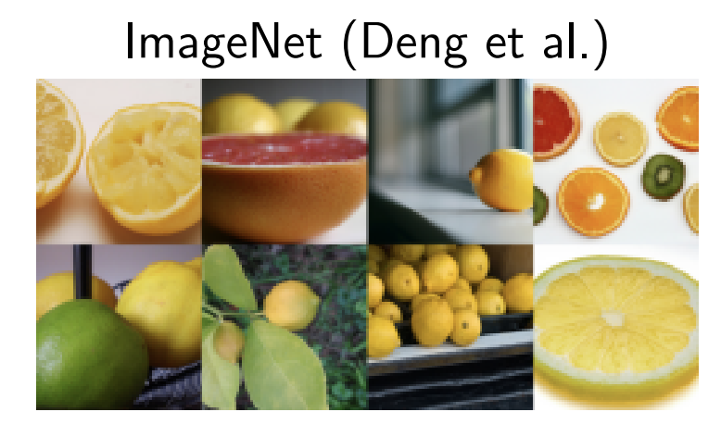
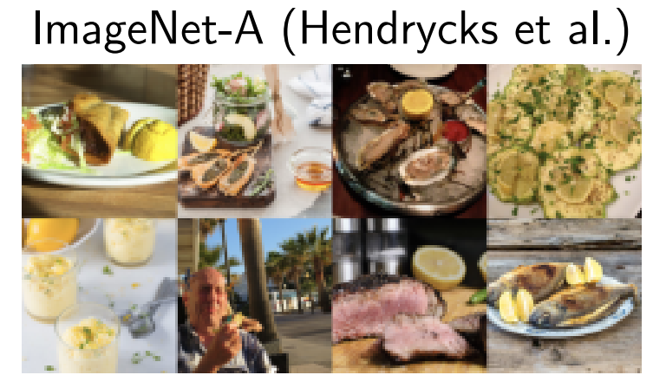
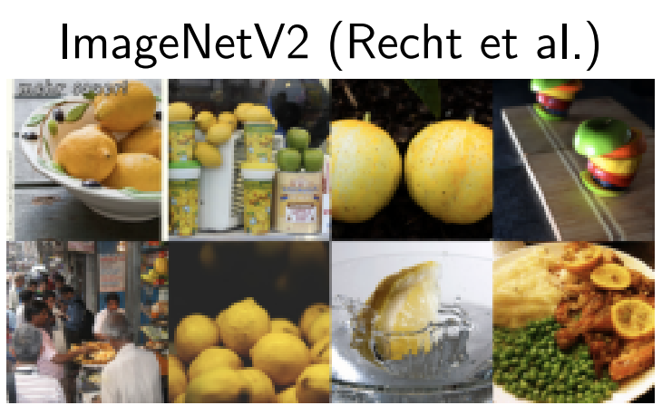
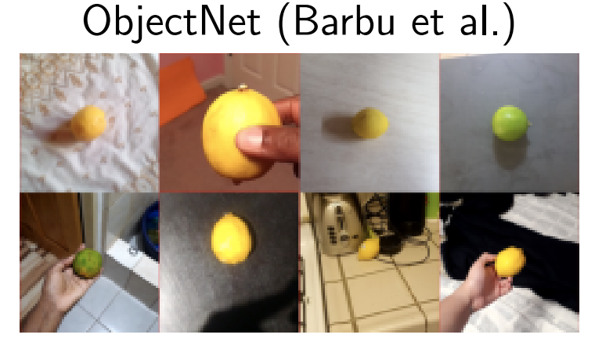
Common Benchmark - ImageNet (Domain Shift)
D_{ref}
D_{shift}
D_{shift}
1000 classes
natural images
1000 classes
50 images / class, sketch images
200 classes, 7.5k images
natural images wrongly classified by a ResNet-50
D_{shift}
D_{shift}
D_{shift}
1000 classes
10 images / class, natural images independent of original ImageNet
200 classes, 30k images
art, cartoons, graphics, paintings, patterns, plastic objects, sculpture, tattoos, toys, video game
113 classes, ~18k images
objects in various scenes

Slide 25
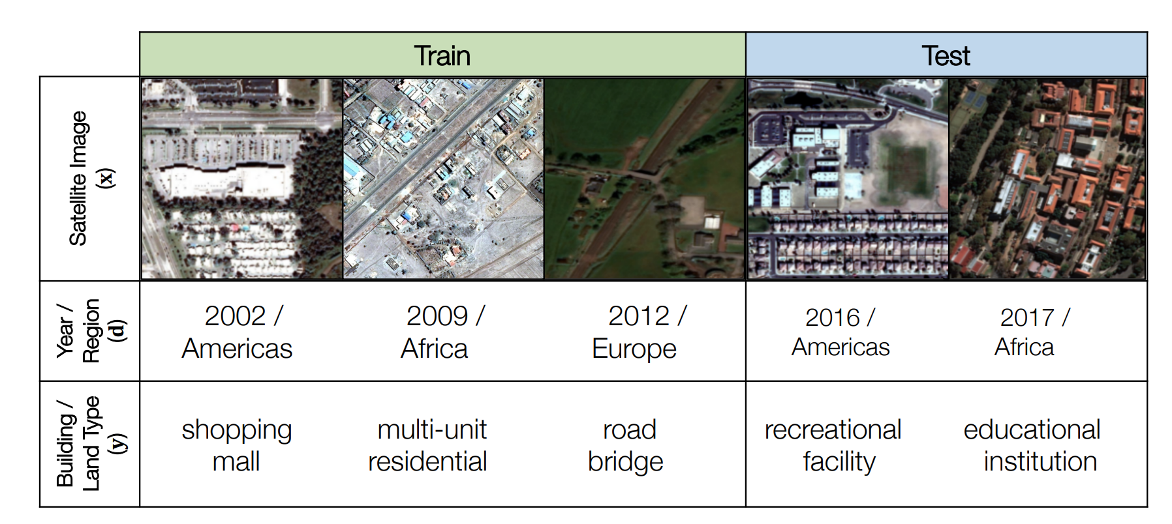
Common Benchmark: Functional Map of the World (FMoW)
Distribution shift: years and locations
label: one of 62 building or land use categories

Slide 26
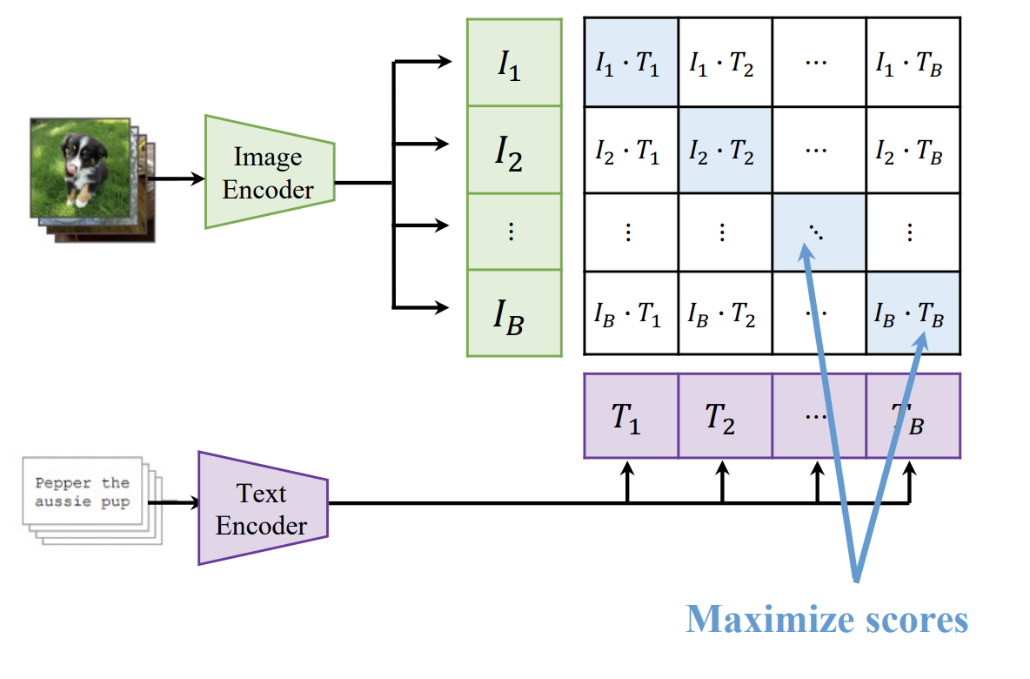
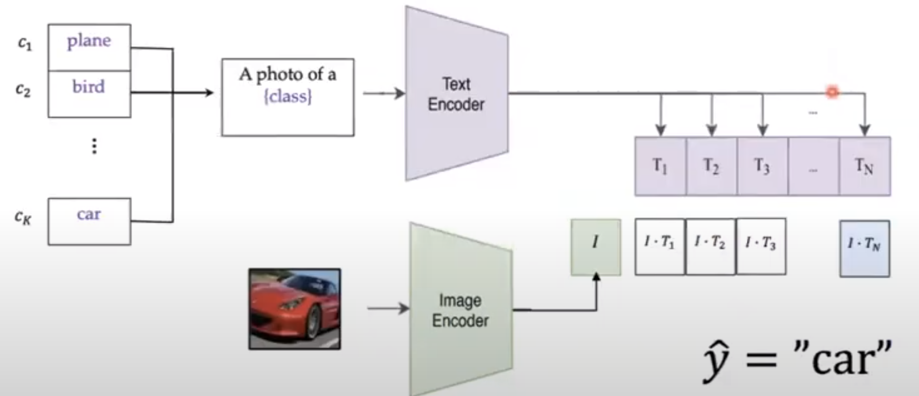
Fine-tuning of zero-shot models
CLP contrastive pretraining
Amazing zero-shot performance

Slide 27
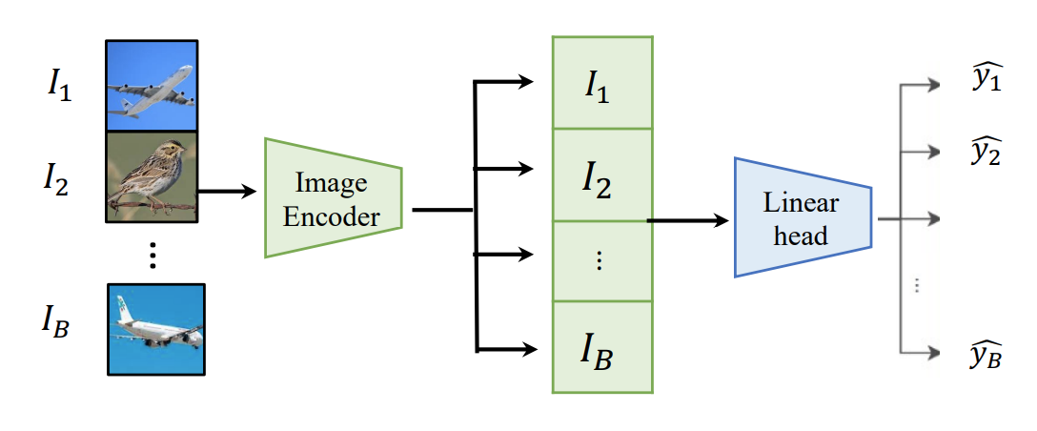
Standard fine-tuning of zero-shot models
Linear probing (LP) fine-tuning
Full fine-tuning (FFT)
Linear head
random initialized head
text embeddings initialized head
cross-entropy loss
Amazing zero-shot performance

Slide 28
Robust fine-tuning of zero-shot models
ICML 2018
finetuned weights are regularized towards the pretrained weights
pre-trained model
newly introduced parameters
fine-tune model

Slide 29
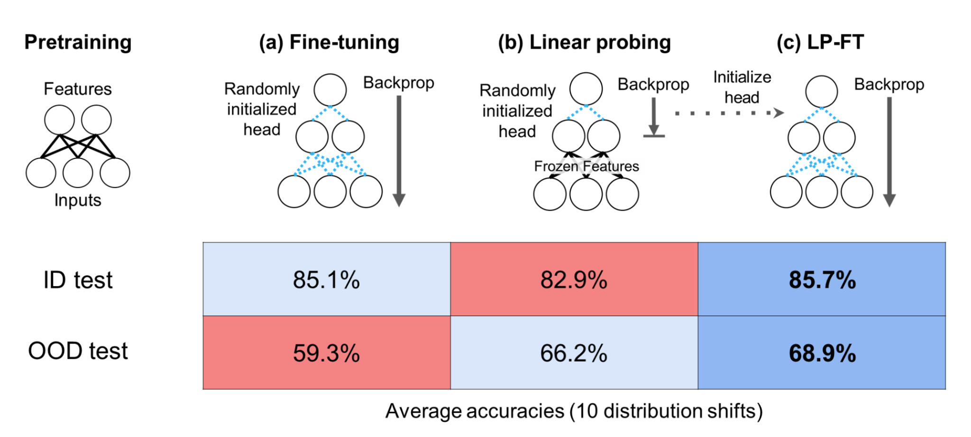
ICML 2022
two-stage finetuning:
linear probing (random init)
full finetuning with classifier initialized in the first stage

Slide 30
CVPR 2022
fine-tuned model
linear head initialized by text embeddings
pretrained model

Slide 31
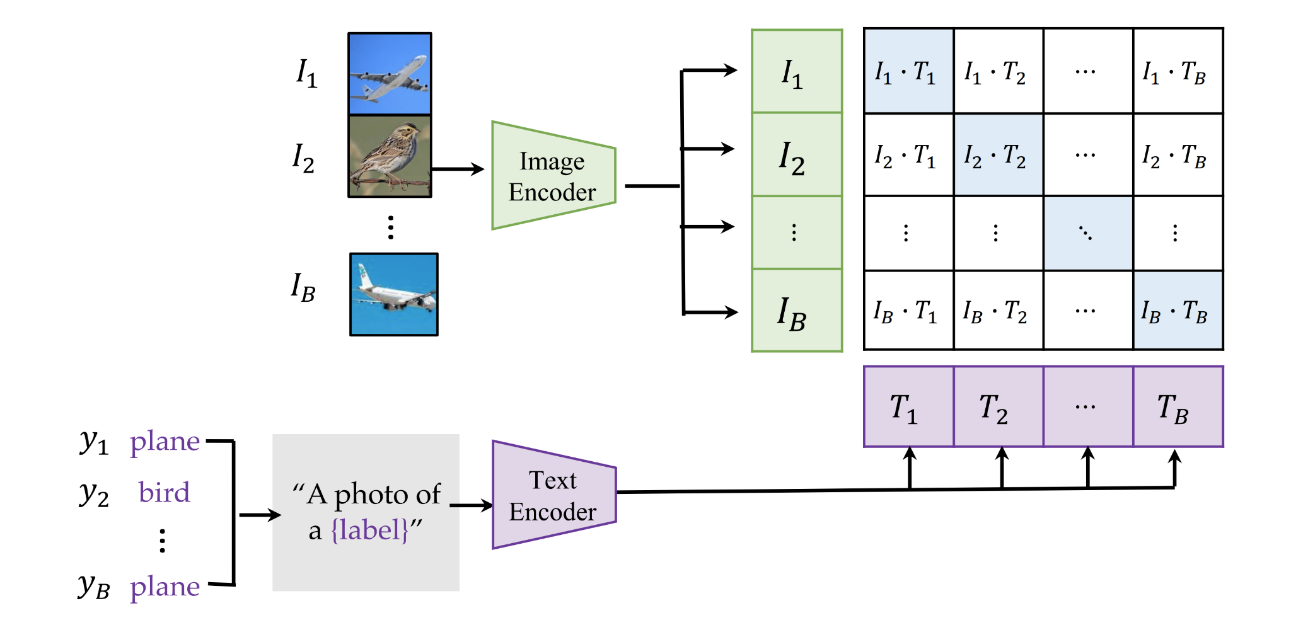
CVPR 2023
continue pre-training with D_{shift}
contrastive loss
update vision and language branch
D_{shift}

Slide 32
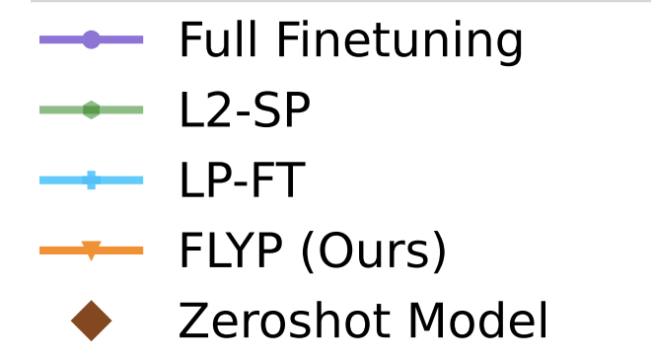
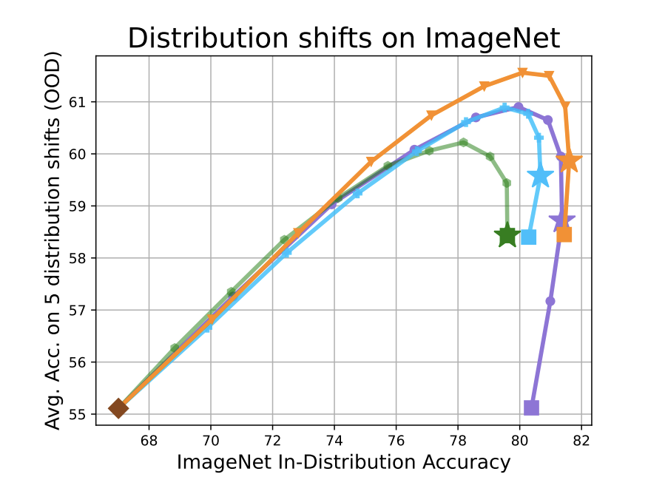
Results

Slide 33
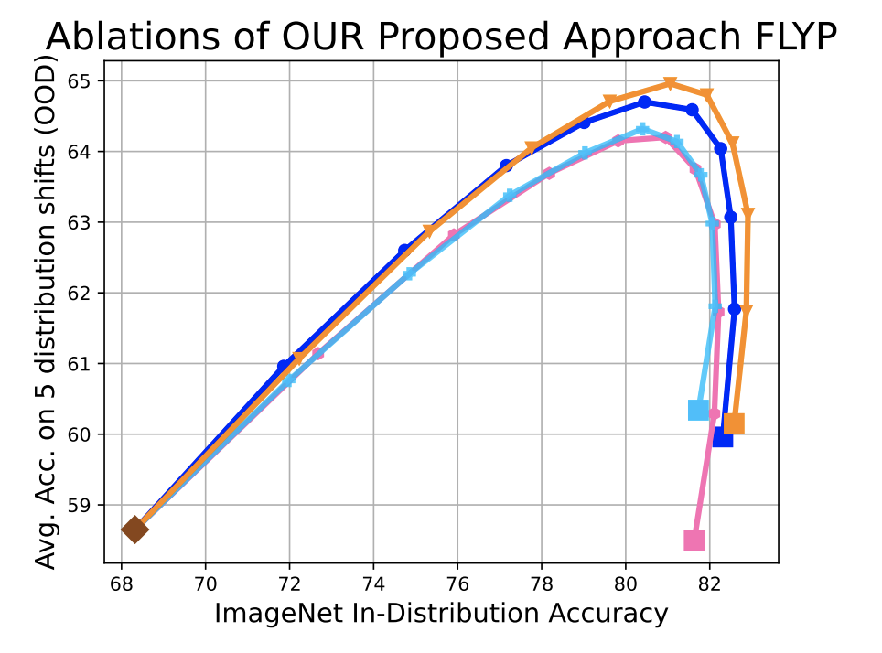
Ablation of FLYP
continue pre-training with D_{shift}
contrastive loss
update vision and language branch
Which one is more important?

Slide 34
Robustness to
Spurious Correlations

Slide 35
Common benchmark - Spurious Correlations
y: label, a: spurious features

Slide 36
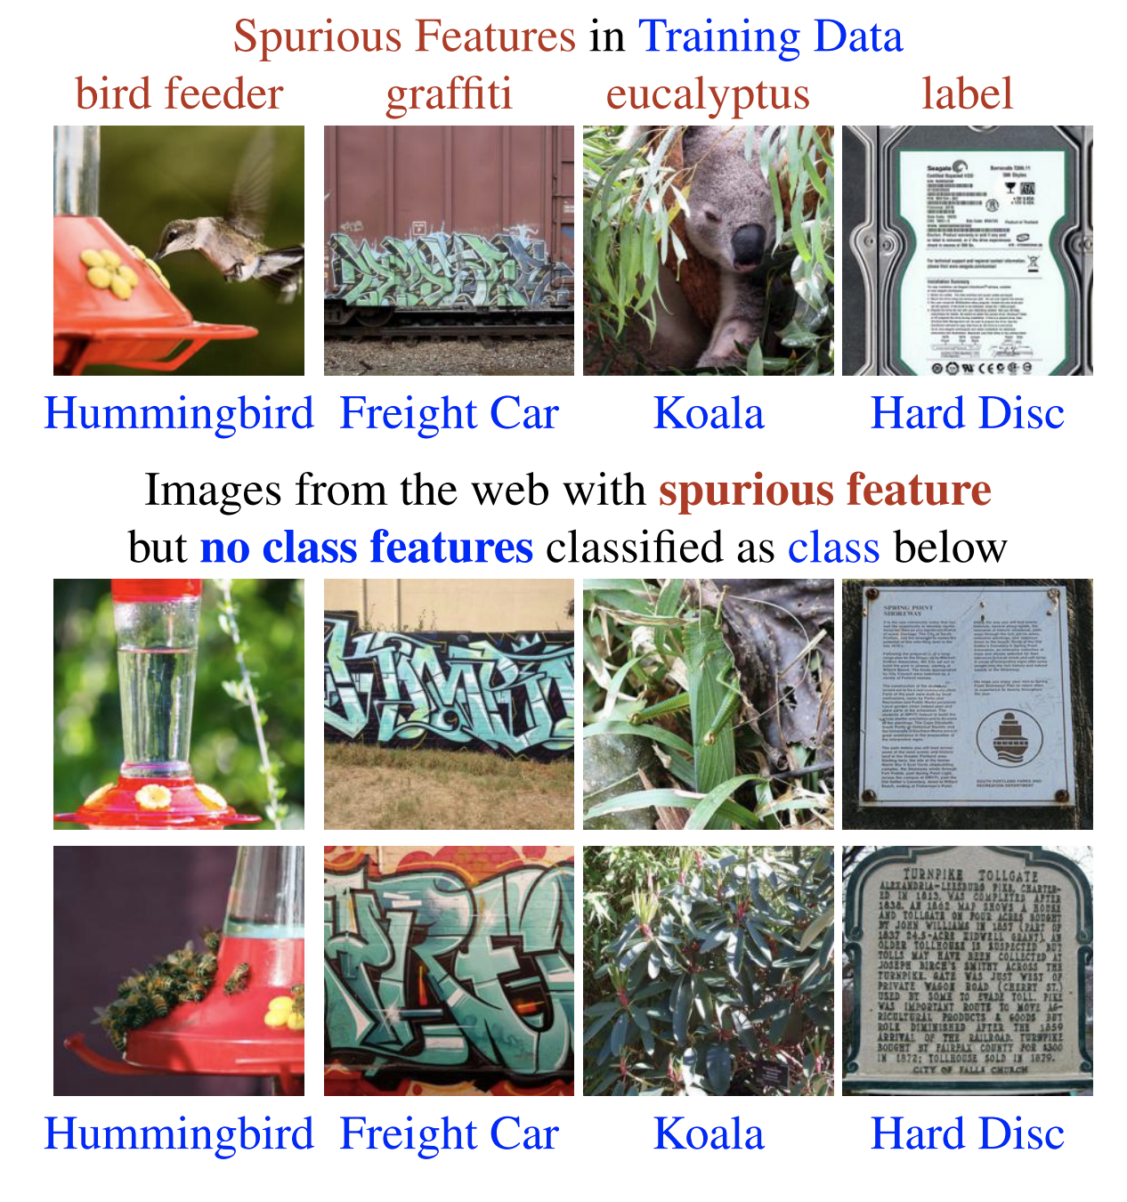
Common benchmark - Spurious Correlations
ICCV 2023

Slide 37
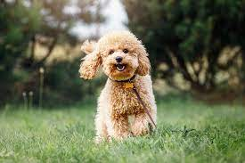
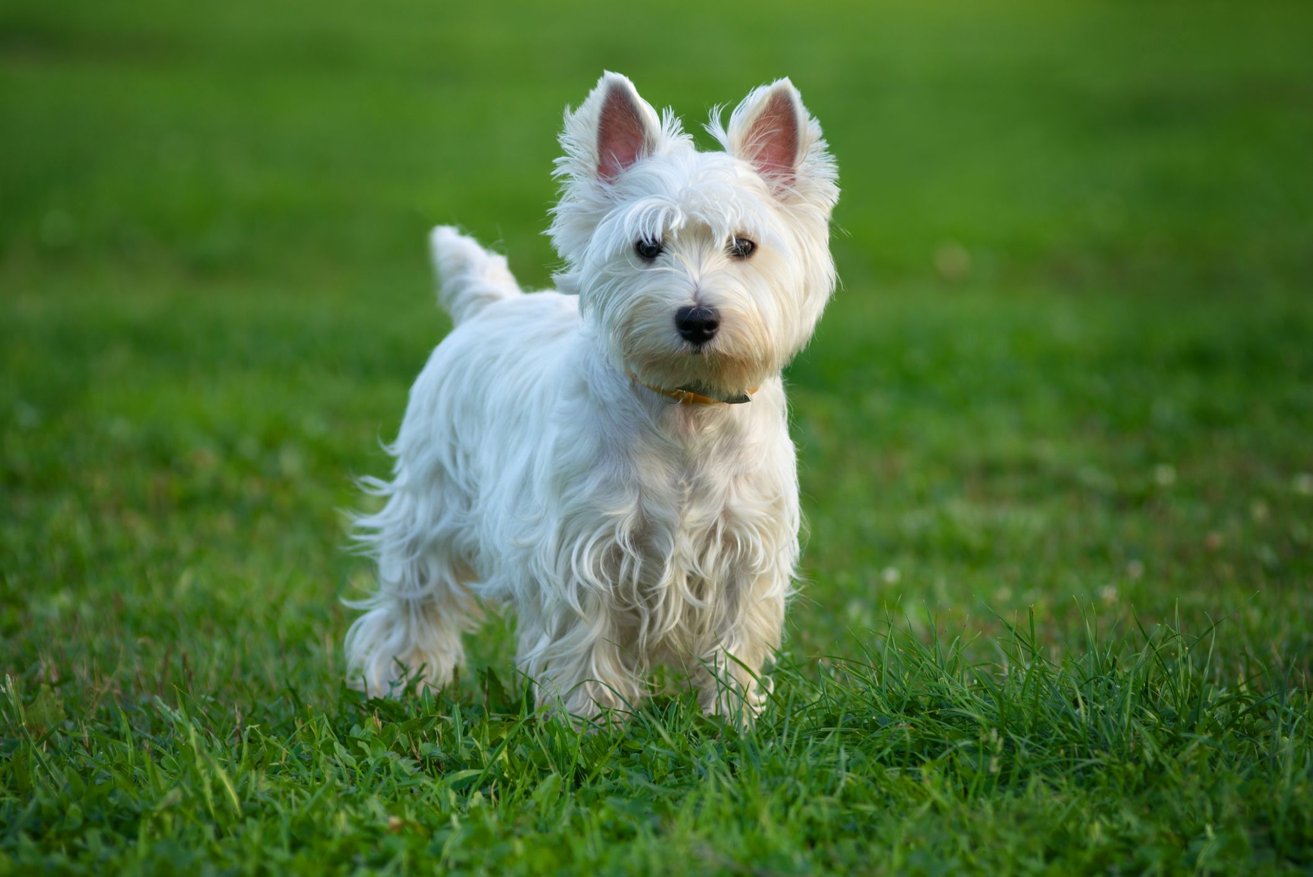
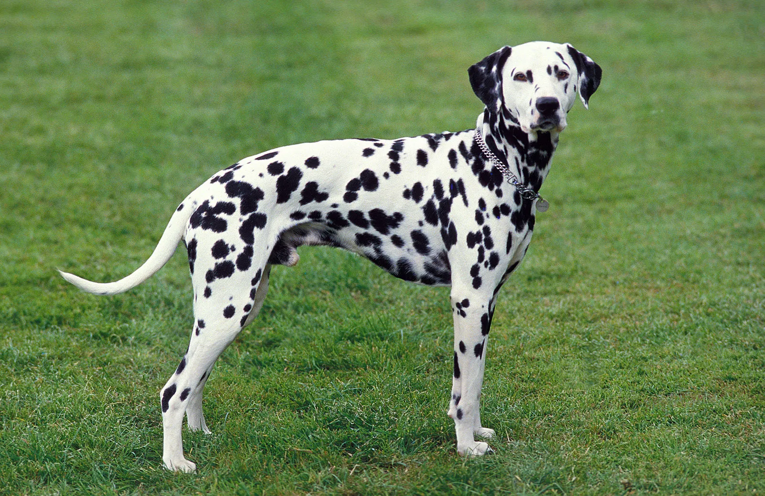
Common Benchmark - BREEDS
Subpopulation shift: the ability to generalize to novel data subpopulations that were NOT observed during training
dog-training
dog-testing
poodles
terriers
dalmatians

Slide 38
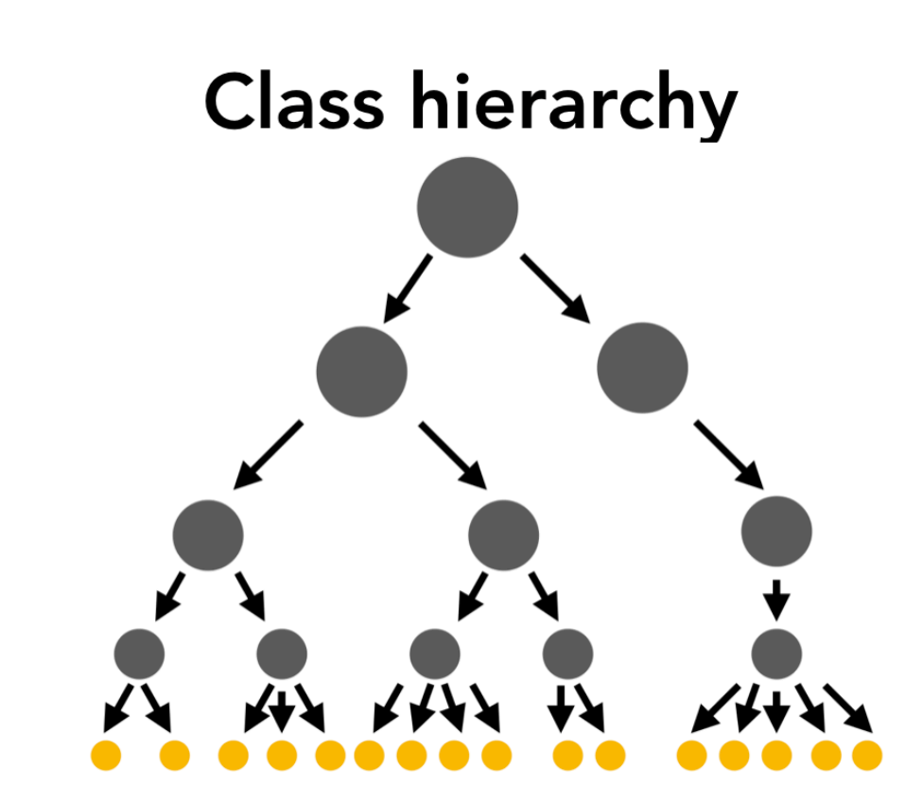
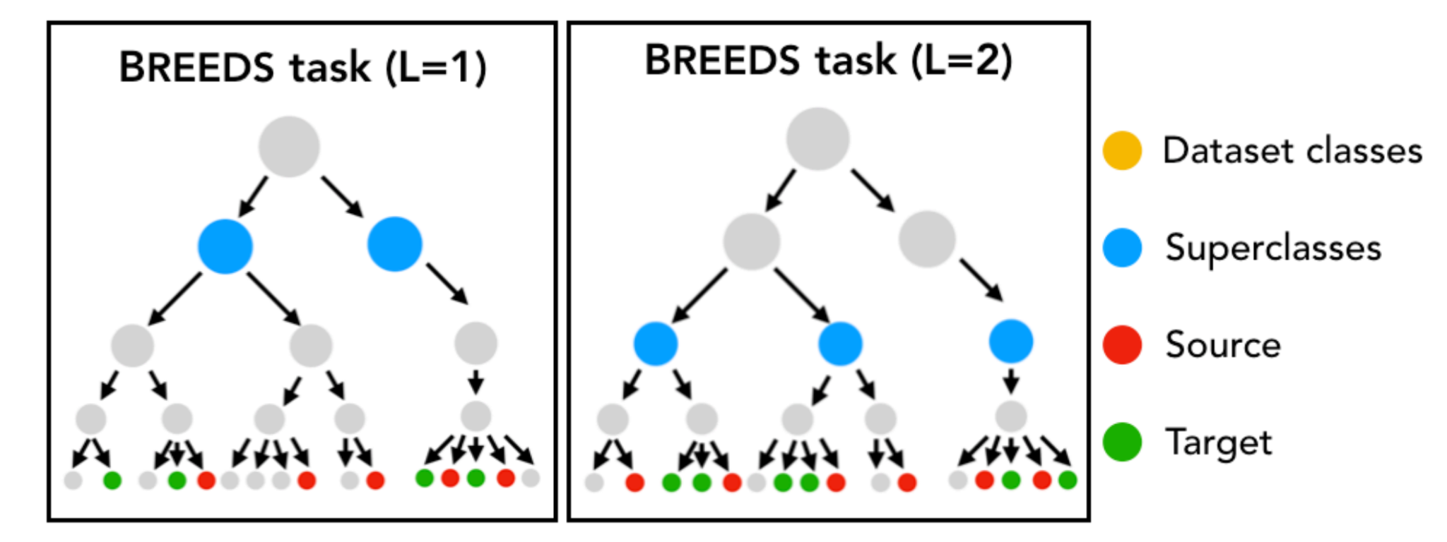
Common Benchmark - BREEDS
The goal is classifying superclasses using source subpopulations but can perform well on both source and target subpopulations

Slide 39
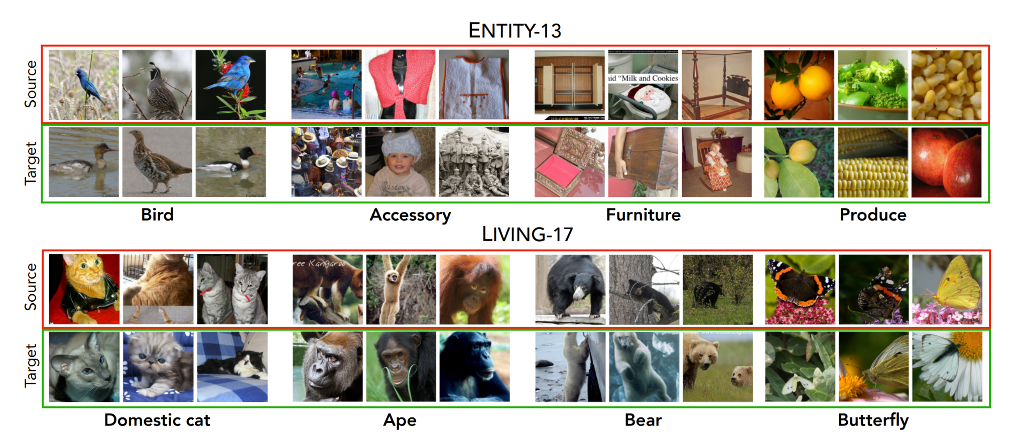
Common Benchmark - BREEDS

Slide 40
Zero-shot CLIP suffers Spurious Correlations too
ICML 2023

Slide 42
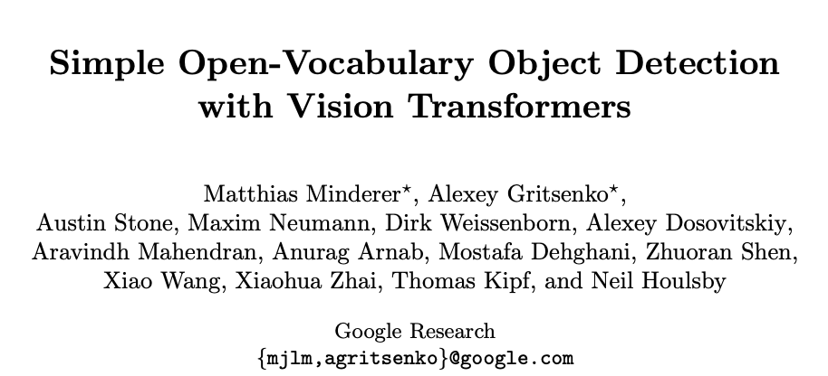
open-vocabulary object detection
synsets of object names in Visual Genome
High accuracy discrepancy indicates high possibility of spurious features
62%

Slide 43
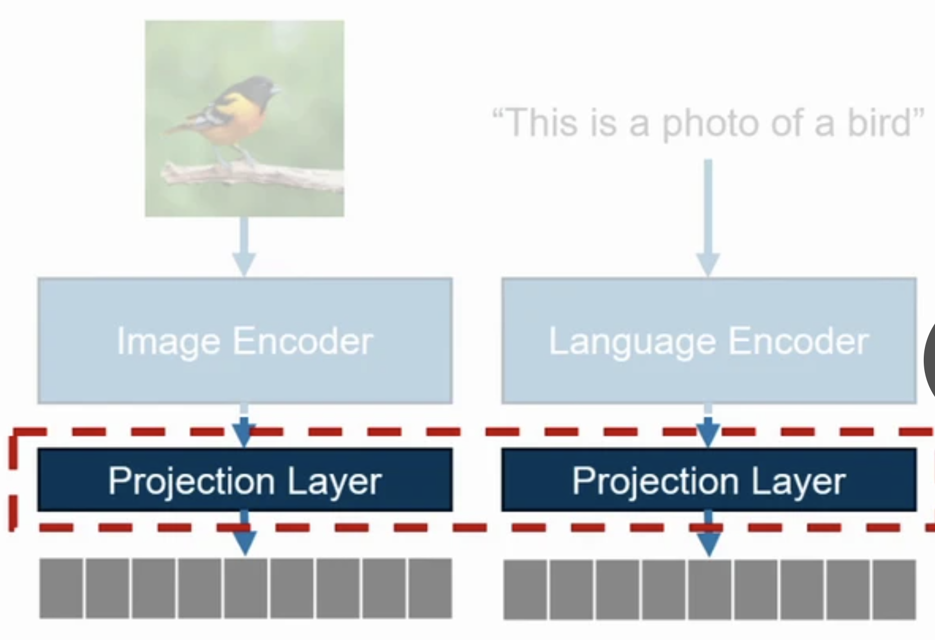
Finetune CLIP
5 loss terms
CLIP loss
Class level contrastive loss: pull same class data , push different class data
Contrastive image loss
Contrastive language loss
Group level contrastive loss: pull same group data, push different group data
Spurious image loss
Spurious language loss

Slide 44
ICLR 2024
scores: 8-8-6
latent space contains (unknown) concept set
the data point x =
the embedding for two classes
partition the concept vectors into three groups

Slide 45
Example
Z_{water} = - Z_{land}
Z_{waterbird} = -Z_{landbird}
c_{waterbird}= 0.4Z_{water} + 0.6Z_{waterbird}
c_{landbird}= 0.4Z_{water} + 0.6Z_{landbird}
test sample of landbird with water background x = 0.7Z_{water}+ 0.3Z_{landbird}
x^{T}c_{waterbird} = 0.1 > x^{T}c_{landbird}=-0.1
Because presence of harmful components (caused by seeing too many images with water described as waterbirds)

Slide 46
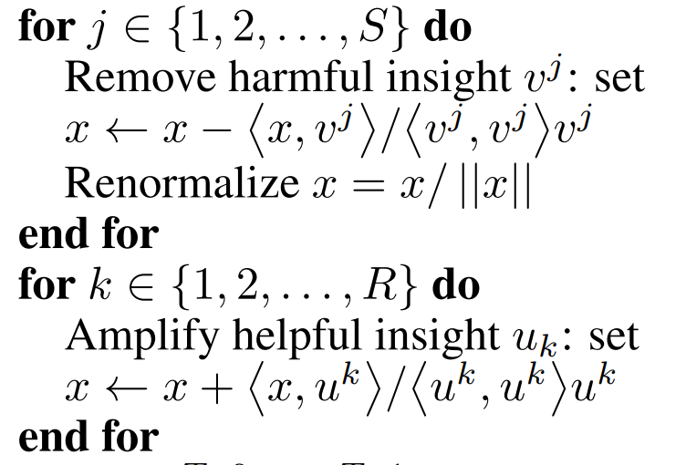
s1
s2
calculated similarly
g: text encoder
spurious feature direction vector
useful feature direction vector
project x to a harmful direction and remove the portion
project x to a helpful direction and amplify the portion

Slide 47
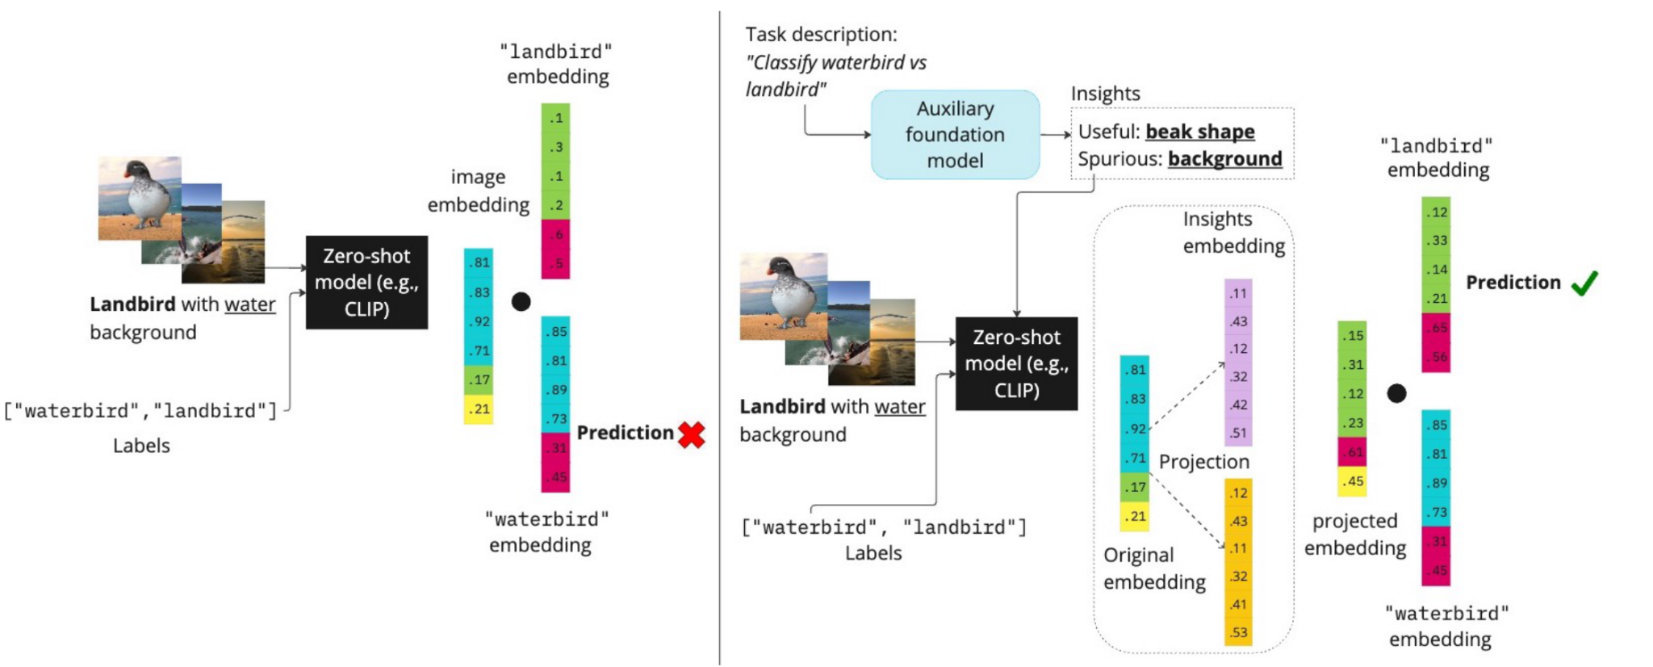
remove spurious parts and amplify helpful parts

Slide 48
Group Robustness
group label: don’t observe during training
group robust: small gap between its average error and worst-group error
Dataset
Group Shift
Spurious confounders:
input features predictive for some, but not all groups in a class
Subclass variance:
different fine-grained subclasses
Data source variance:
Combine CIFAR10 and 10.2

Slide 49
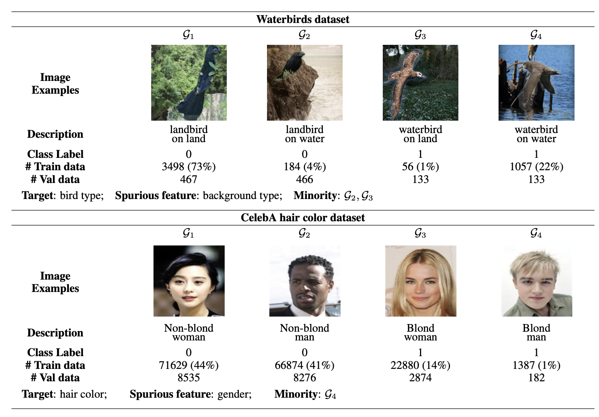
Group Robustness
group idx
imbalance

Slide 50
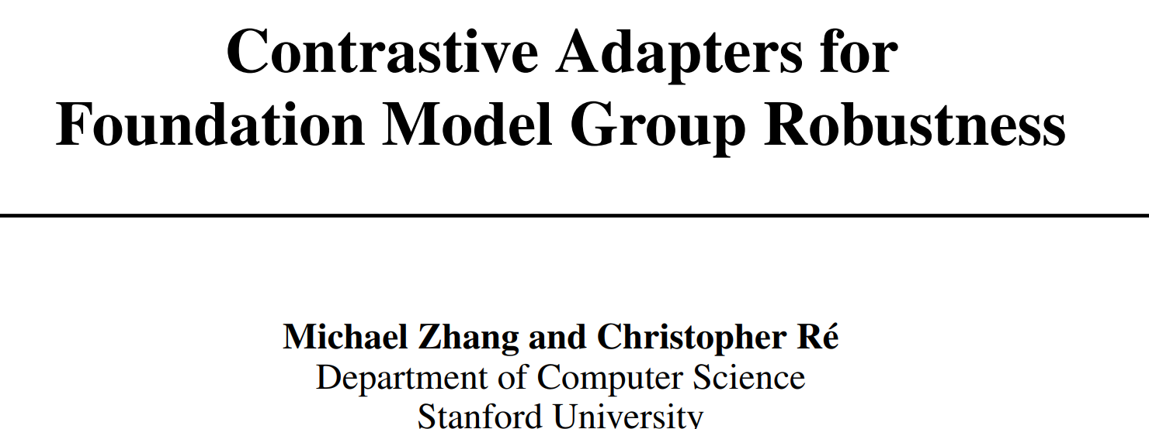
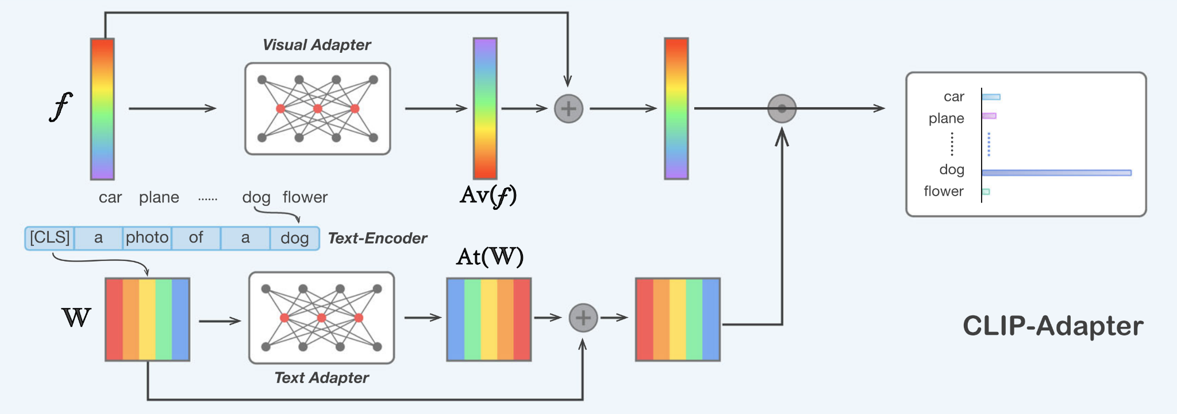
NeurIPS 2022
IJCV 2022
CLIP Adapter
CLIP

Slide 51
worst-group
gap between avg and wg is high
measures the pairwise cosine similarity between sample embeddings in the same class but different groups
good robustness ~= good similarity between sample embeddings from different groups but the same class

Slide 52
Contrastive Adapting
For each class
Anchor sample : incorrect zero-shot prediction
Positive samples: correct zero-shot prediction
Negative samples: nearest samples to the anchor sample in different classes
anchor
positive
positive
Final loss = contrastive loss + cross entropy loss

Slide 53
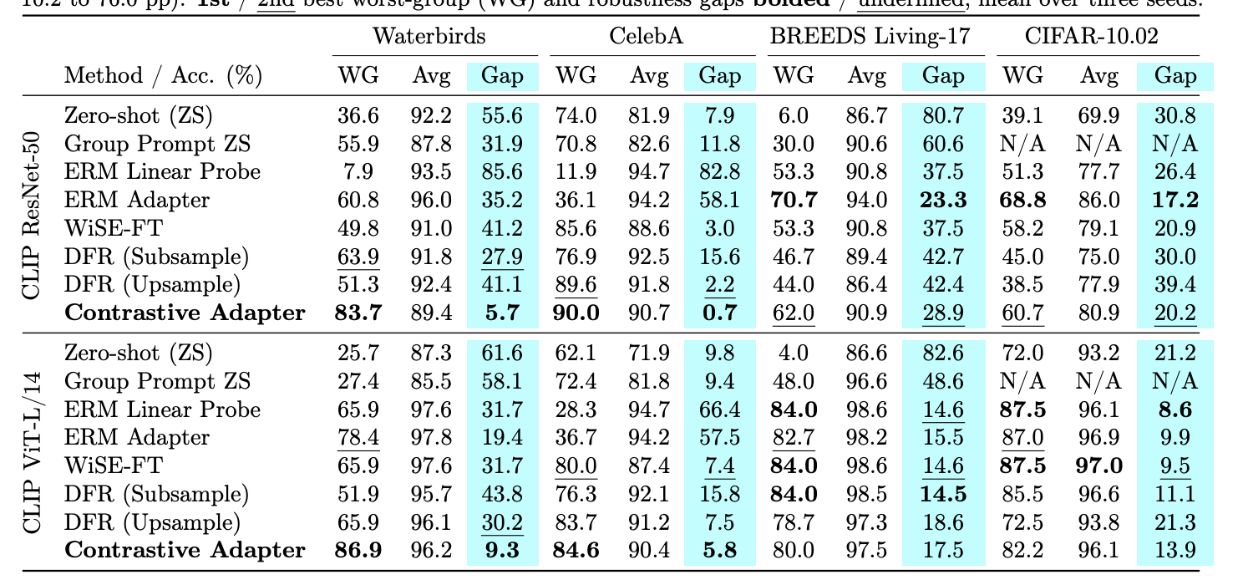

Slide 54
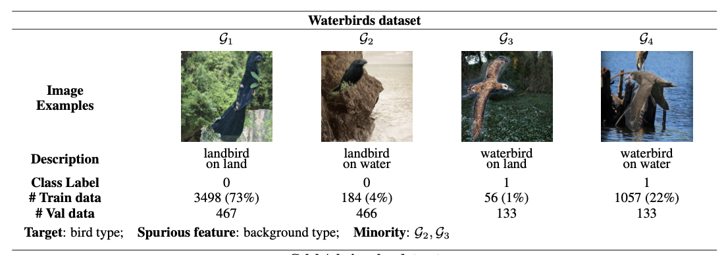
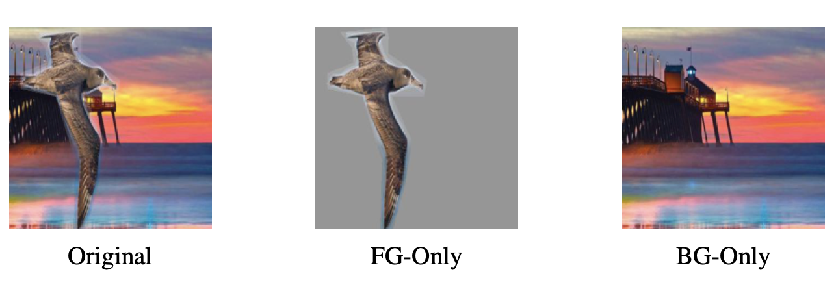
ICLR 2023
50% (Balanced dataset), by replacing background
95% (as in Sagawa et al. (2019))
100% (no minority group examples in the train dataset)

Slide 55
Feature analysis
model heavily relies on BG for prediction
thus, worst group acc is bad
surprisingly, if we only feed FG-only test data, the performances are good even 100% spurious correlation
The model learns useful features to classify birds (FG) but decide not to use it.

Slide 56
Simplicity Bias
optimal acc: train and eval on cifar only
100%: all car images are combined with 0 and all truck images with 1
95%: only 95% car images are with 0, etc
original data acc: minist+cifar
core only acc: black+cifar
use minis+cifar feature and train a logistic regression with group-balanced val set
training on 95% correlation data can learn complex features, but the model prefers using simple feature

Slide 57
group-balanced dataset

Slide 58
this simple method is competitive
finetuned more layers does not help

