Slide 1
Mixture-of-Experts (MoE)
Zheda Mai

Slide 2
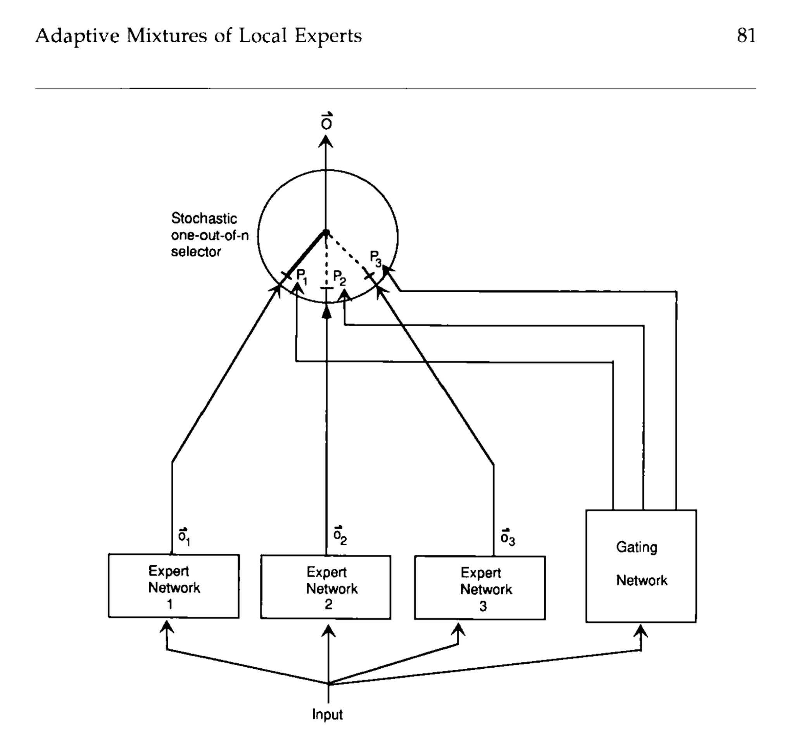
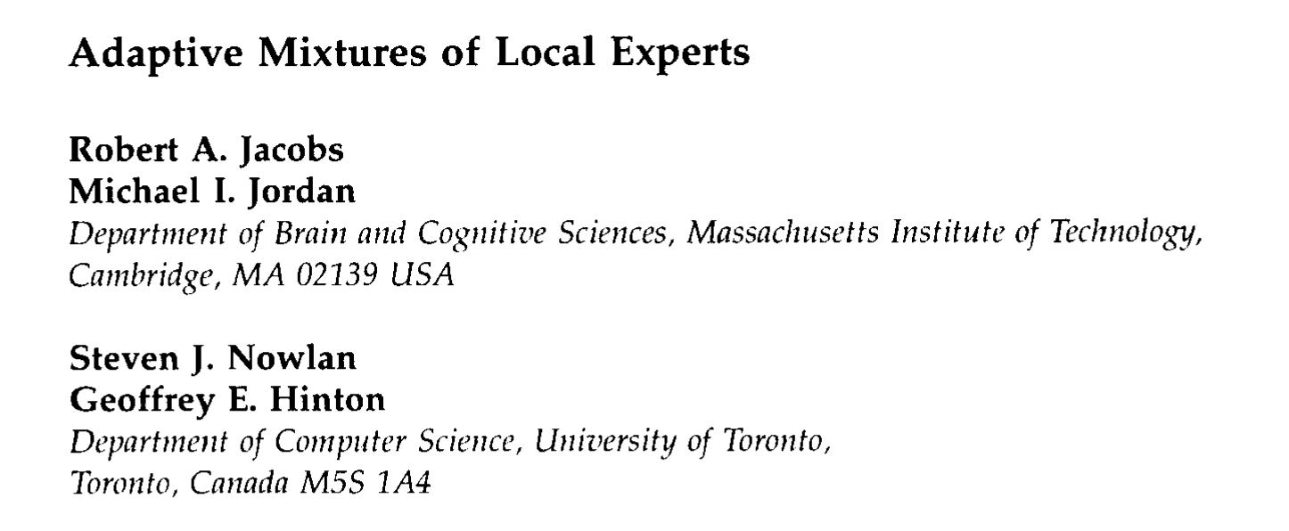
MoE has a long history since 1991

Slide 3
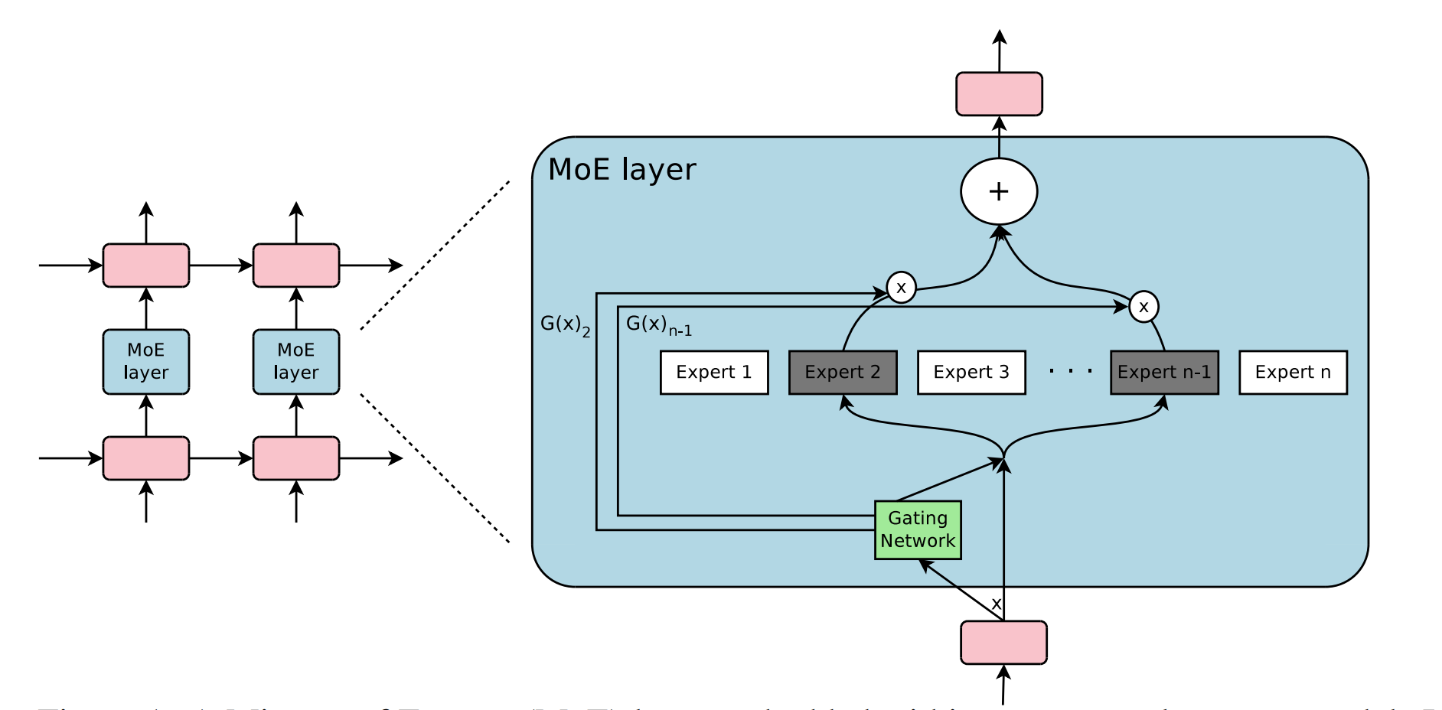
Outrageously large neural networks: The sparsely-gated mixture-of-experts layer (ICLR- 2017)
How can we increase model capacity without a proportional increase in computation?
Solution: Rather than activating the whole network for every single input, different parts of the model are activated for different inputs.
Language model with 137 billion parameters in 2017

Slide 4
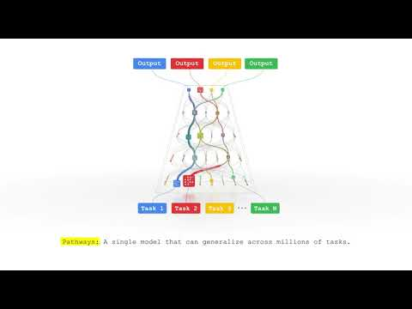
Google is a Big fan of MoE
Language Model:
Switch Transformer
Task-MoE
GLaM
Vision Model:
ViMoe (Vision MoE)
LiMoE

Slide 5
Scaling Vision with Sparse Mixture of Experts (NeurIPS-21)

Slide 6
Scaling Vision with Sparse Mixture of Experts

Slide 7
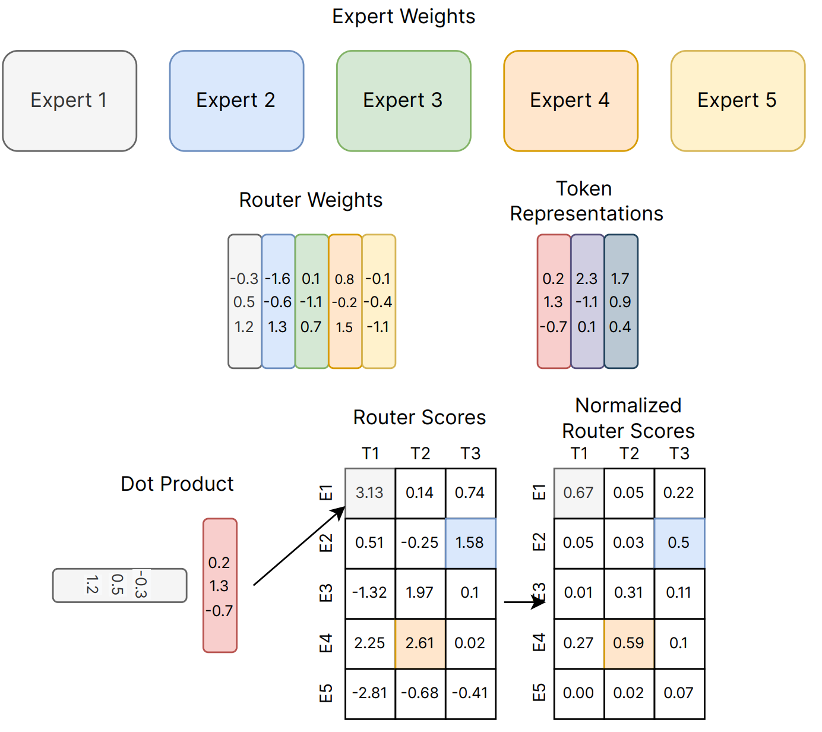
Scaling Vision with Sparse Mixture of Experts
g(x) is the gating function
K = 1 or 2
e(x) is a MLP

Slide 8
Technical challenges
During training, sparse models may favor only a small set of experts. This common failure mode can cause two problems.
First, statistical inefficiency: in the limit of collapse to a single expert, the model is no more powerful than a dense model.
Second, computational inefficiency: imbalanced assignment of items to experts may lead to poor hardware utilization.

Slide 9
Solution
fix the buffer capacity of each expert (the number of tokens that each expert processes)
train our model with auxiliary losses that encourage load balancing.
Buffer capacity depended on
N: batch size
P: num of tokens / image
k: num of experts / token
E: num of experts
C: capacity ratio

Slide 10
Solution
If the router assigns more than B_e tokens to a given expert, only B_e of them are processed.
The remaining tokens are not entirely ‘lost’ as their information is preserved by residual connections
If an expert is assigned fewer than B_e tokens, the rest of its buffer is zero-padded.

Slide 11
Solution
We use the capacity ratio C to adjust the capacity of the experts.
With C > 1, a slack capacity is added to account for a potential routing imbalance.
This is typically useful for fine-tuning when the new data might come from a very different distribution than during upstream training.
With C << 1, the router is forced to ignore some assignments.

Slide 12
Solution
fix the buffer capacity of each expert (the number of tokens that each expert processes)
train our model with auxiliary losses that encourage load balancing.
The importance of expert i for a batch of images X
the normalized routing weight corresponding to expert i summed over images
W is the layer-specific weight matrix for the router
Minimize the variation of the importance distribution over experts
Avg
0.33 | 0.33 | 0.33

Slide 13
Auxiliary losses
Ideally, we would like to also explicitly balance the number of assignments. This quantity is discrete; therefore it is not differentiable, and we need to rely on a proxy.
For each token x, we define the score threshold above which experts were selected
this is simply the k-th maximum score
The intuition of minimizing this loss is
If I resample the noise, I don’t want this token to choose this expert

Slide 14
Design Choices
Number of MoE layers
V-MoE Every-2
V-MoE Last-n
fewer MoE layers decreases the number of parameters of the model
it has typically little impact on quality and can speed up the models significantly, since less communication overhead is incurred.
Number of selected experts k
Use k = 2 with E = 32
Buffer capacity C
Pretrain uses C=1.05
For a given trained model, the latter two (k & C) can be adjusted without further training

Slide 15
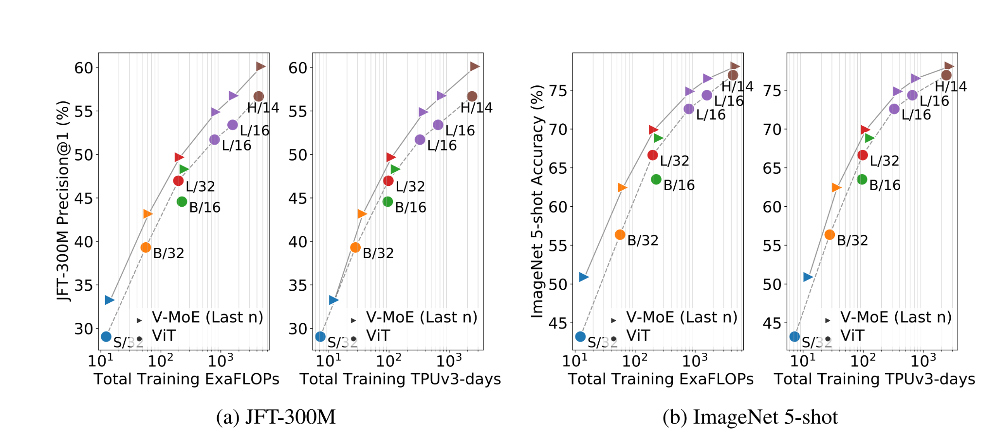
Results

Slide 16
Batch Prioritized Routing (BPR) to favour “most important” tokens
priority score function
g(x)_t,i: routing weight for t-th token and the i-th expert
maximum routing weight
sum of TOP-k weights

Slide 17
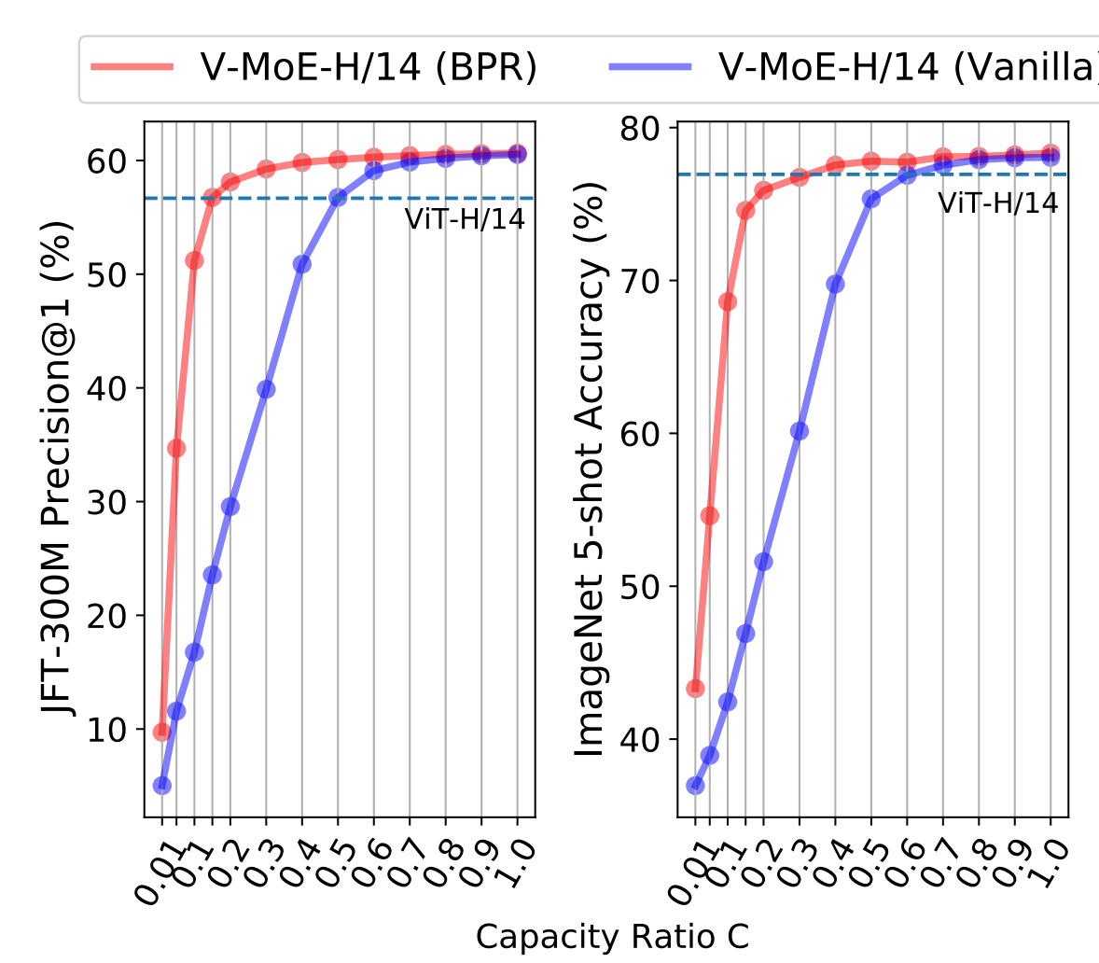
Result
Dropping the right tokens turns out to be essential to deliver high-quality and more efficient inference predictions.
When the expert capacity decreases, performance quickly decreases with the vanilla routing mechanism.
Conversely, BPR is much more robust to low capacities.

Slide 18
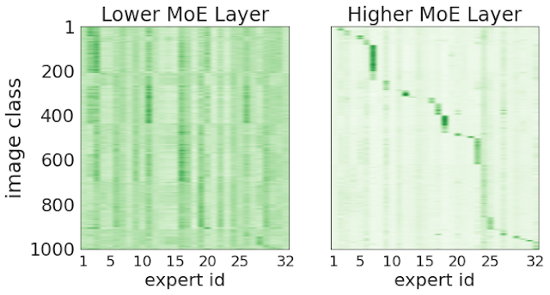
Internal workings of sparse networks
One hypothesis is that routers would learn to discriminate and assign tokens to experts based on some semantic grounds (the “car” expert, the “animal” experts, and so on).
In the early layers there is little correlation
later in the network, each expert receives and processes tokens from only a handful of classes.
Therefore, we can conclude that some semantic clustering of the patches emerges in the deeper layers of the network.

Slide 19
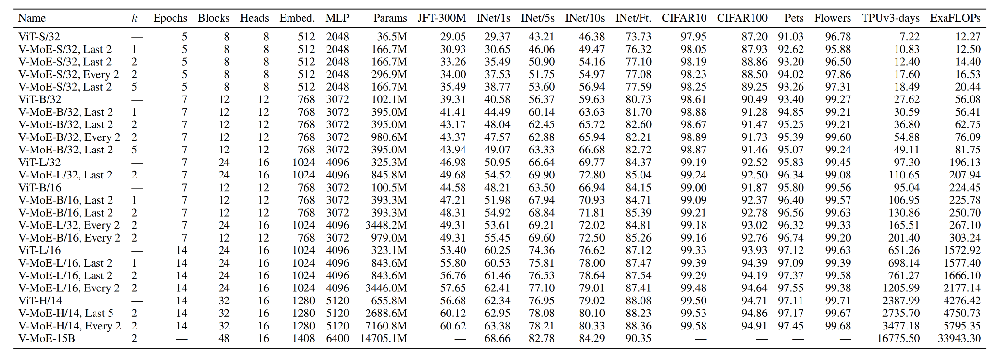
How much does it cost to train the V-MoE
$1.00/TPU core hour X 24 hours X 16775 days = $400K for V-MoE-15B

Slide 20
Learning to Route by Task for Efficient Inference (EMNLP-21)
While training massive models on large amounts of data can almost guarantee the improved quality, there are two factors affecting their practicality and applicability:
(1) training efficiency
(2) inference efficiency.
Sparse MoE improves training efficiency but it fails to meet the requirement of inference efficiency

Slide 21
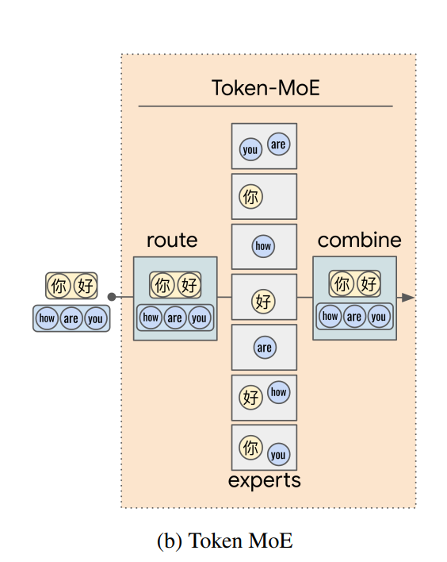
Sparse MoE: inference efficiency
To perform inference for a long sequence of tokens:
each token spans several experts.
it becomes prohibitive
the model parameters in these large models are beyond the memory limit of a single accelerator device
require model parallelism across a cluster of devices.
the token would be dynamically routed to different experts allocated to different devices.
further adds communication cost across devices

Slide 22
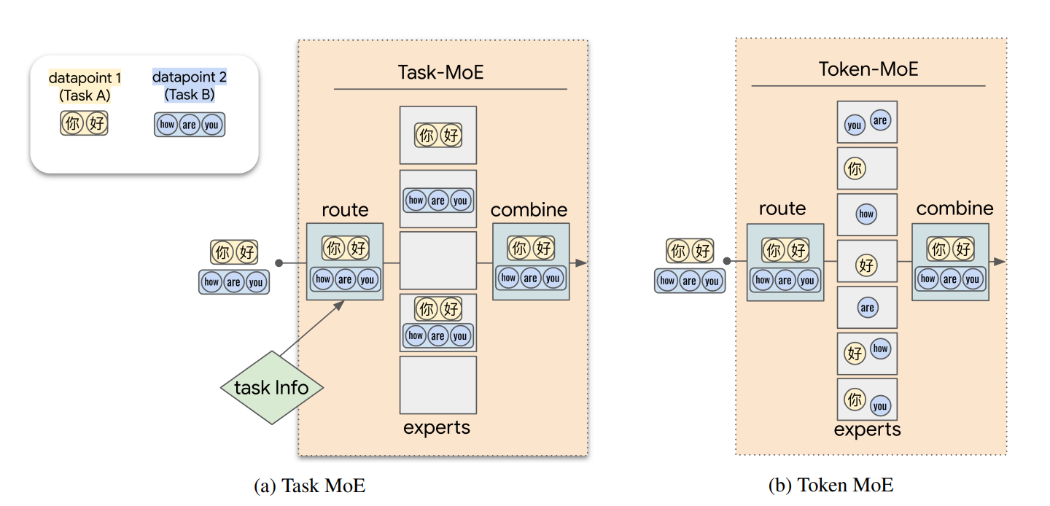
Solution: provide task-information

Slide 23
Solution: provide task-information

Slide 24
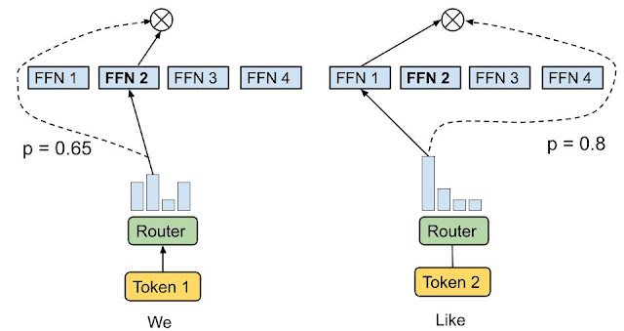
Mixture-of-Experts with Expert Choice Routing (NeurIPS-22)
Previous works apply Token Choice Routing
The routing algorithm picks the top-1/2 experts with highest affinity scores for each token.
Issues
Imbalanced load of experts and under/over-utilization
Allocate a fixed number of experts to each token, regardless of the relative importance of different tokens

Slide 25
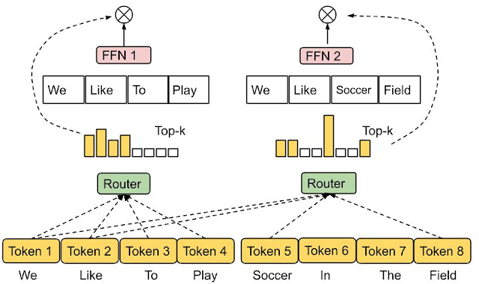
Expert Choice Routing
Instead of having tokens select the top-k experts, the experts with predetermined buffer capacity are assigned to the top-k tokens
Produces a token-to-expert score matrix that is used to make routing decisions. The score matrix indicates the likelihood of a given token in a batch of input sequences being routed to a given expert.
Advantages
different tokens are received by a variable number of experts, conditioned on token importance or difficulty.
even load balancing
achieves substantial gains in training efficiency and downstream performance.

Slide 26
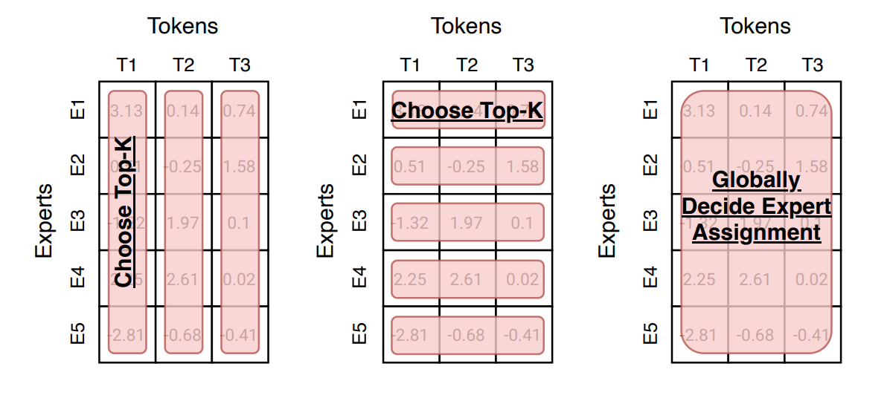
Routing function summary
Each token chooses the top-k experts.
Each expert chooses the top-k tokens
Globally determine what tokens should go to each expert.
Static routing.
A review of sparse expert models in deep learning (Google & Open AI)

Slide 27
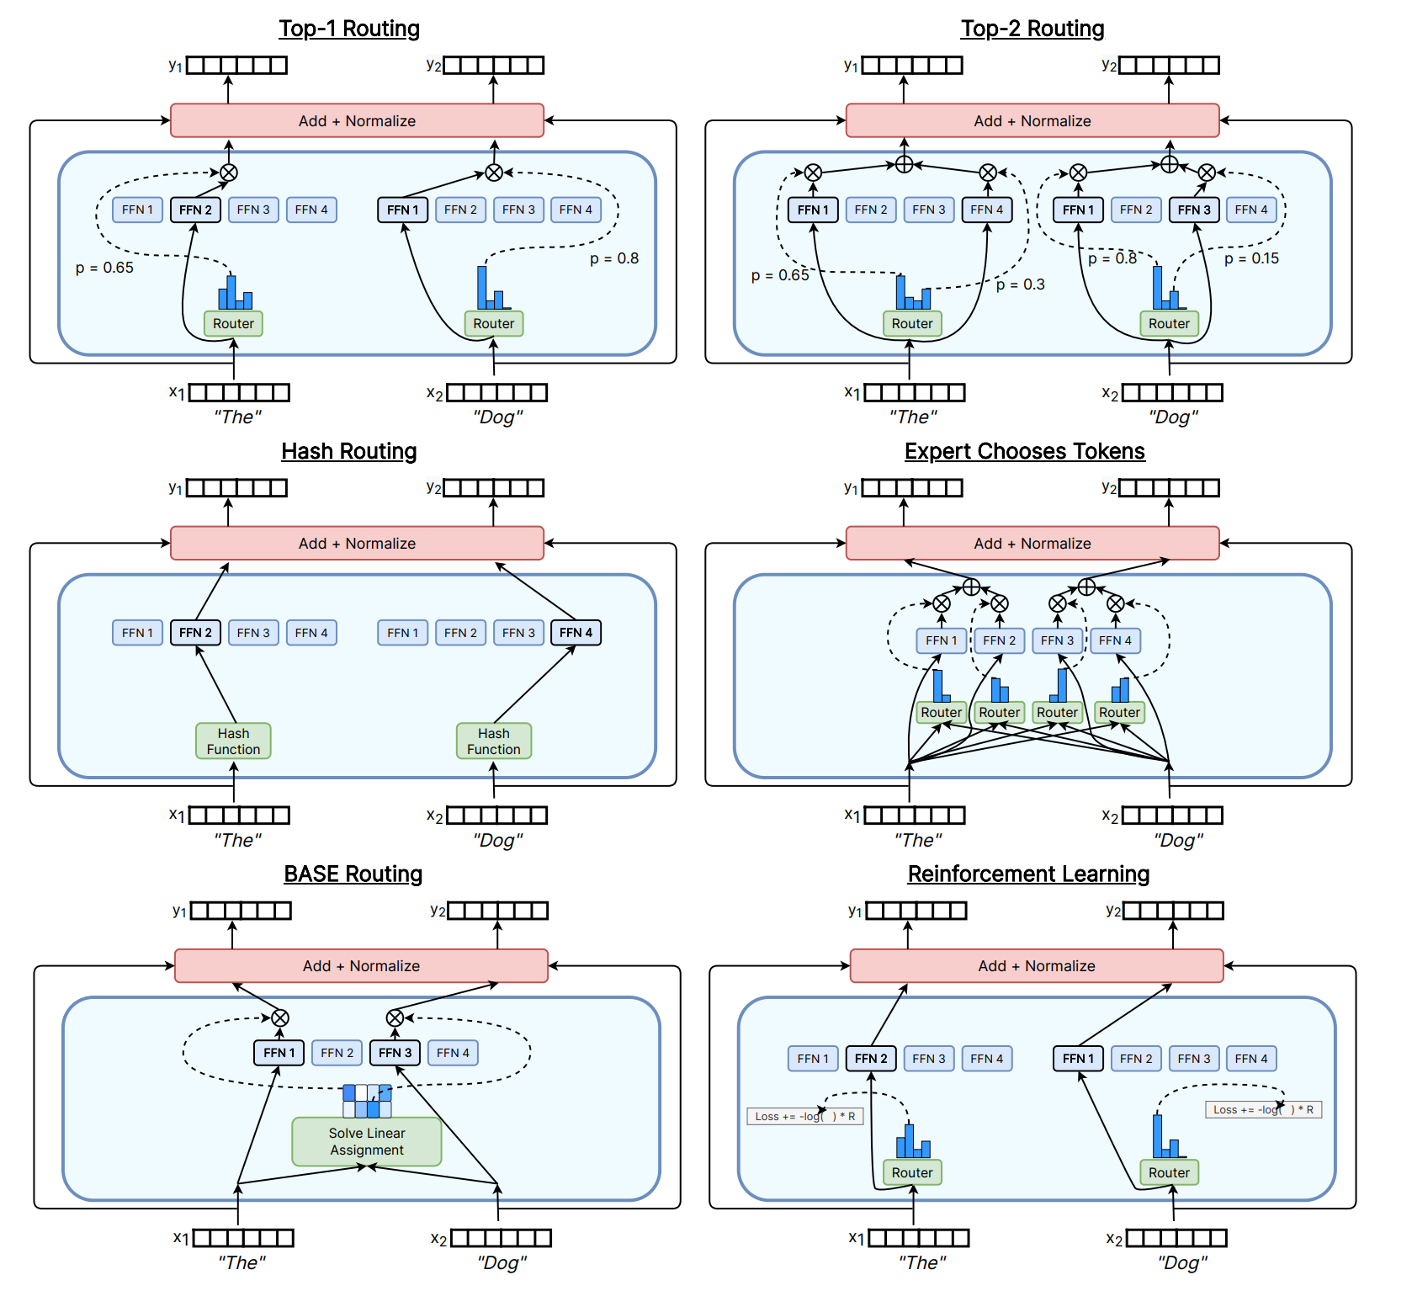
Routing function summary
A review of sparse expert models in deep learning (Google & Open AI)

Slide 28
Multimodal Contrastive Learning with LIMoE: the Language Image Mixture of Experts (NeurIPS-22)
The LIMoE architecture contains many experts and routers decide which tokens go to which experts. After being processed by expert layers and shared dense layers, a final output layer computes a single vector representation for either an image or a text.

Slide 29
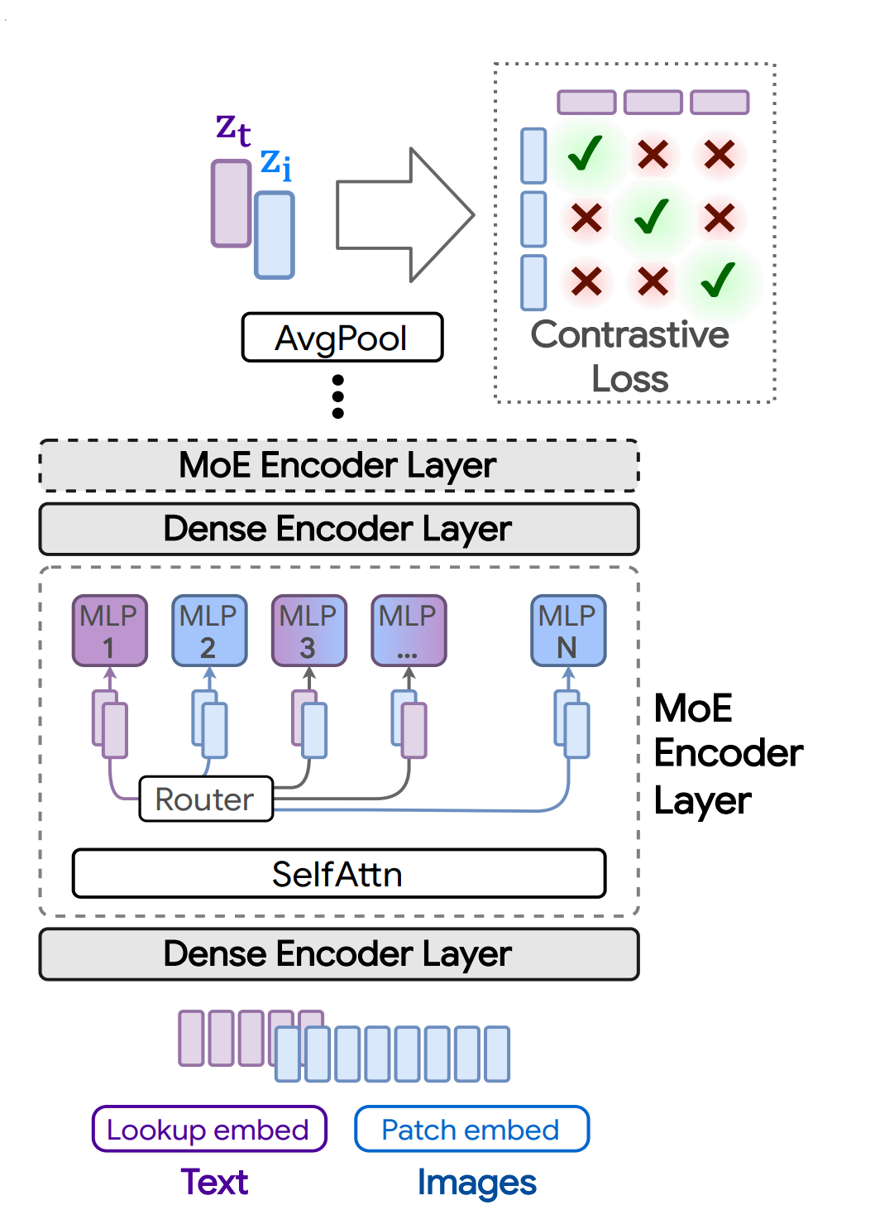
Architecture LiMoE (one tower) Vs CLIP (two tower)

Slide 30
Technical challenges
If capacity is exceeded, some tokens are “dropped”; they are not processed by the expert, and the expert output is all zeros for those tokens.
The rate at which tokens are successfully processed (that is, not dropped) is referred to as the “success rate”.
It is an important indicator of healthy and balanced routing and often indicative of training stability.

Slide 31
Technical challenges
Without intervention, Top-K MoEs tend to “collapse”, thus using only one expert. This causes most tokens to be dropped and leads to poor performance
In multimodal settings, new challenges arise
modality misbalance, 3 − 17× more image tokens than text tokens
all of the tokens from the minority modality get assigned to a single expert, which runs out of capacity
Solutions:
Design new auxiliary losses (local entropy loss & global entropy loss)
Priority routing (V-MoE)

Slide 32
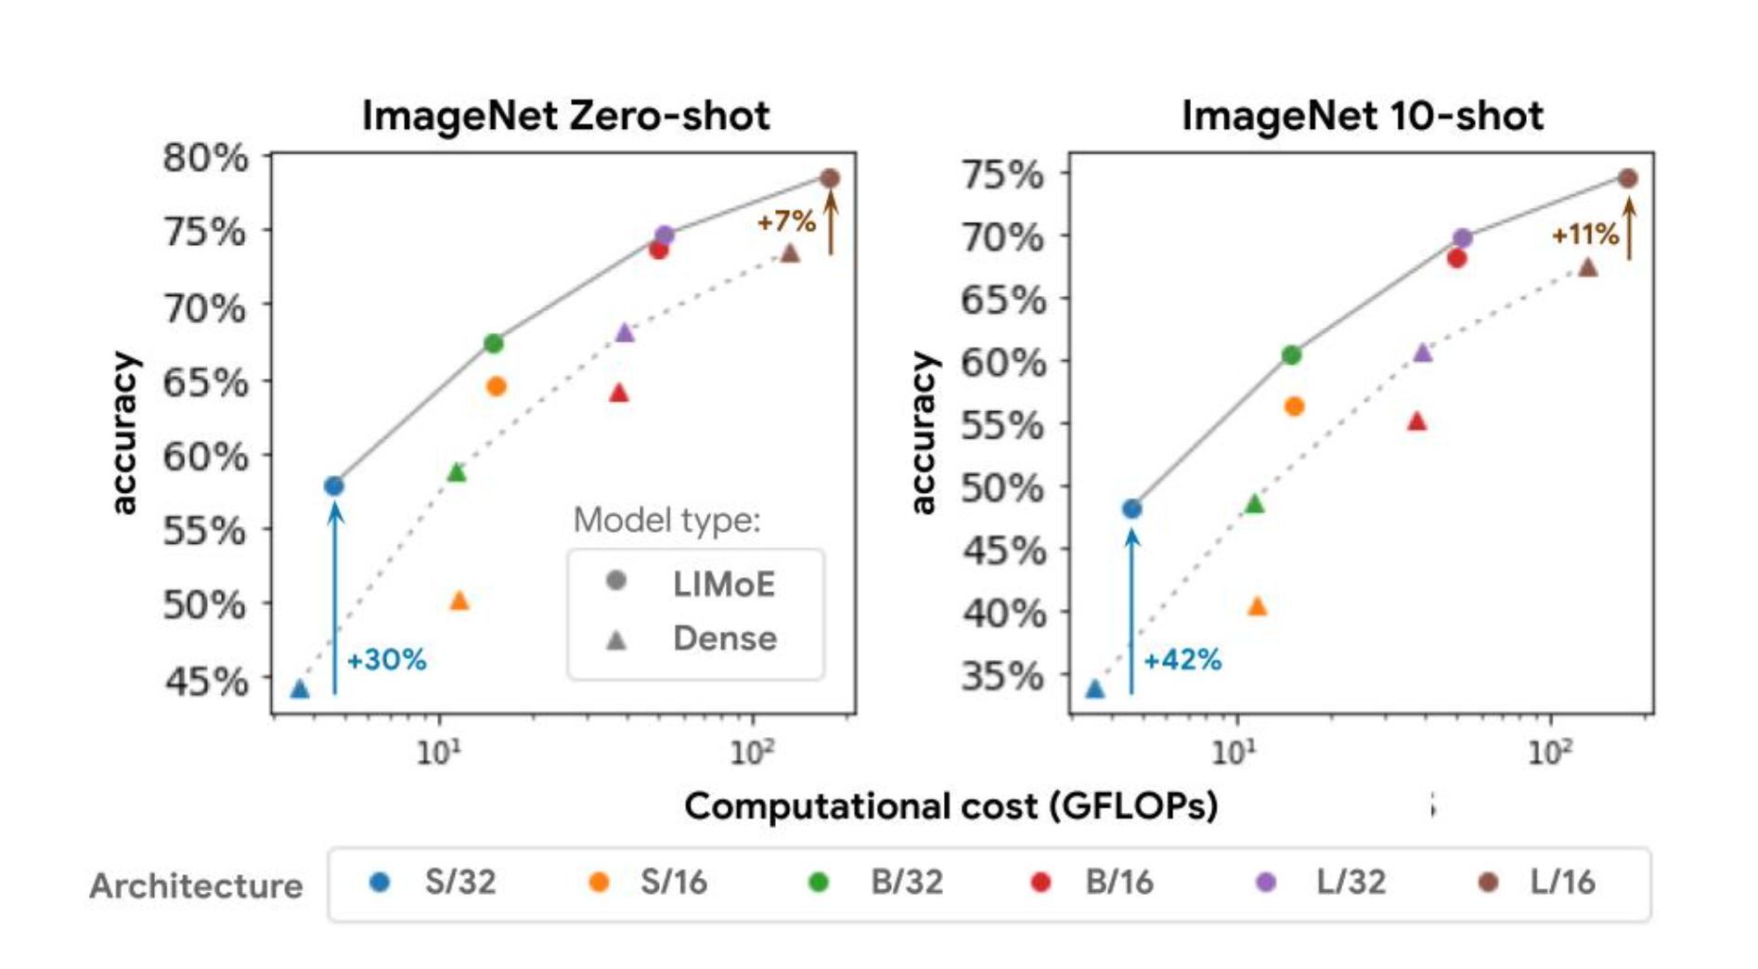
Results
For a given compute cost (x-axis), LIMoE models (circles, solid line) are significantly better than their dense baselines (triangles, dashed line).
S (small), B (base), and L (large) refer to model scale. The number refers to the patch size, where smaller patches imply a larger architecture.

Slide 33
Results zero-shot
LIMoE works better than CLIP and is comparable with the SOTA, COCA (Contrastive Captioners are Image-Text Foundation Models): image-text encoder-decoder foundation model jointly with contrastive loss and captioning loss,

Slide 34
Results
The new auxiliary losses (LIMoE aux) and routing prioritization (BPR) stabilized and improved overall performance (left) and increased the success rate of routing behavior (middle and right).
A low success rate means the router does not use all the experts available and drops many tokens due to individual expert capacity being reached, which usually indicates the sparse model is not learning well.

Slide 35
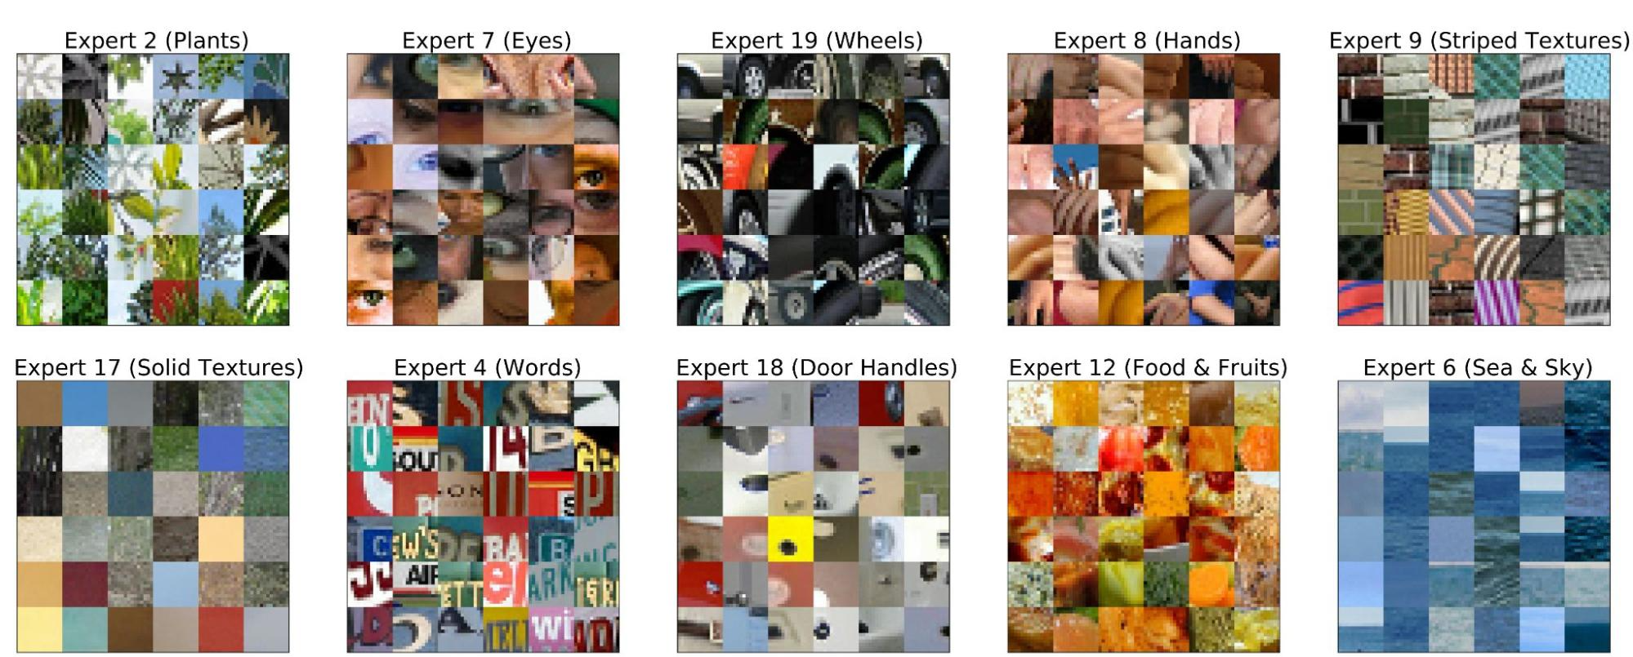
Specialized experts
LIMoE chooses an expert for each token.
Despite not being trained to do so, we observe the emergence of semantic experts that specialize in specific topics such as plants or wheels.
Here we show which image tokens go to which experts on the 18th encoder block –i.e. middle of the network–of LIMoE-H/14.

Slide 36
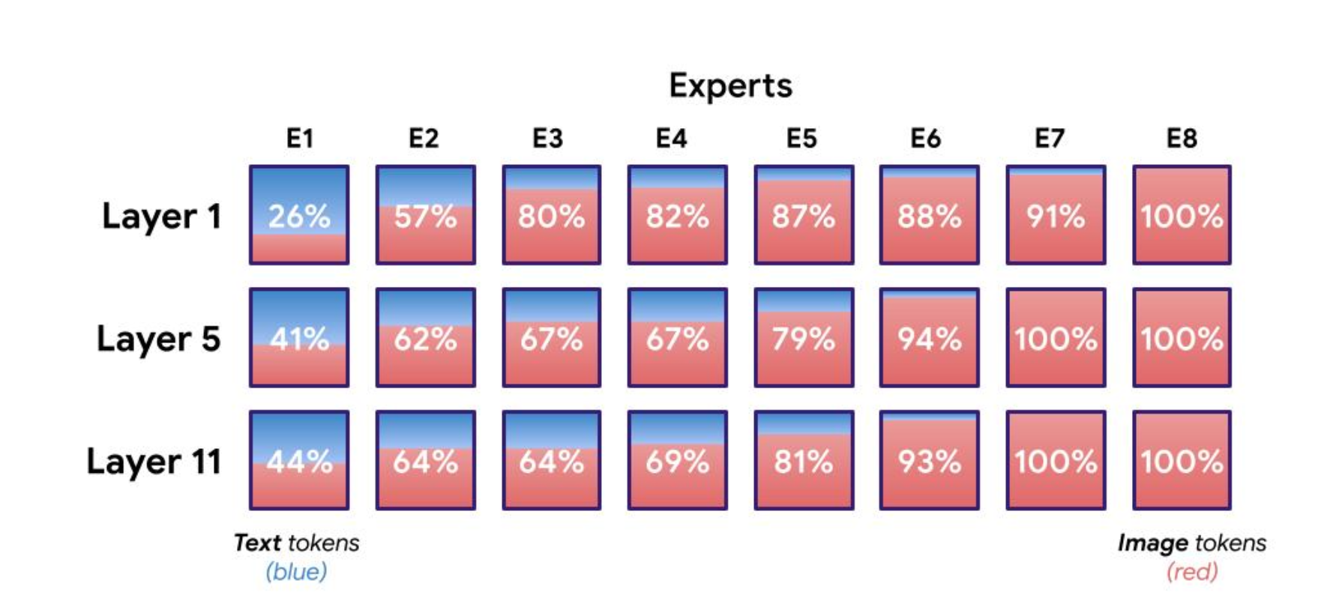
Distributions for an eight expert LIMoE
percentages indicate the amount of image tokens processed by the expert.
There are one or two experts clearly specialized on text,
usually two to four image specialists
the remainder are somewhere in the middle.

Slide 37
Towards Understanding the Mixture-of-Experts Layer in Deep Learning (NeurIPS-22)
The core questions to answer
Why do the experts in MoE diversify instead of collapsing into a single model?
How can the router learn to dispatch the data to the right expert?

Slide 38
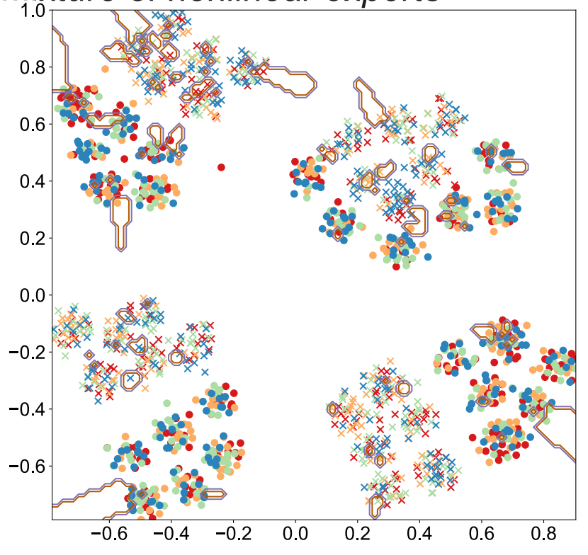
Synthetic dataset
Binary classification problem with intrinsic clustering structure that may be utilized to achieve better performance
t-SNE plot of the synthetic data
x and ○ represent the binary classes.
4 clusters and 4 experts
different colors denote router’s dispatch to different experts
lines denote the decision boundary of the MoE model
It is not difficult to show that the binary classification sub-problem in each cluster can be easily solved by an individual expert.
Can MoE learn this cluster structure from?

Slide 39
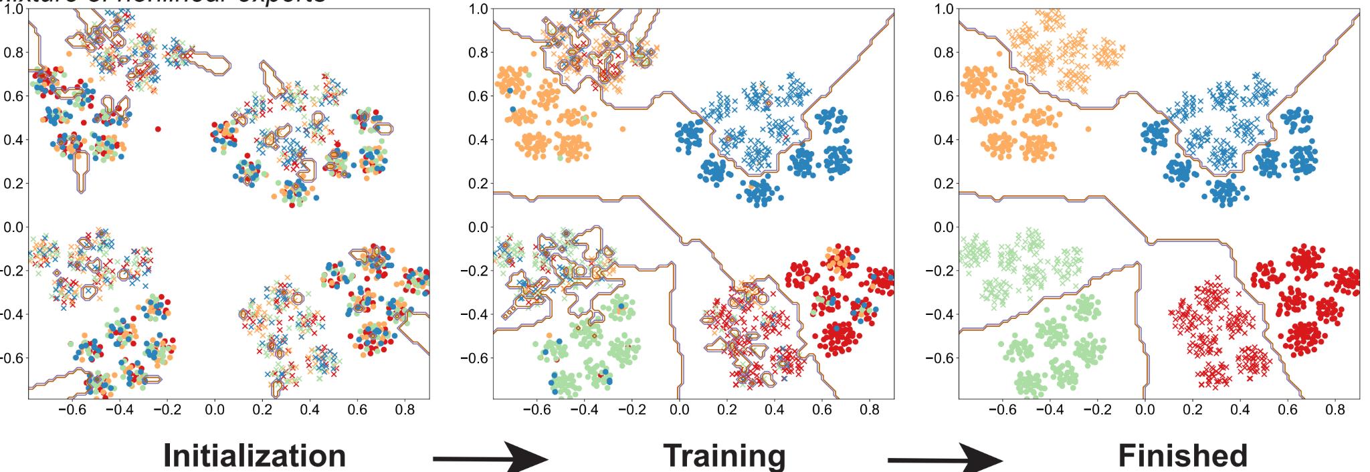
MoE learning this synthetic dataset
Empirically show and formally prove that
router learns the cluster structure and divide the problem into K simpler subproblems, each of which is associated with at least one cluster.
each cluster will be classified accurately by a subset of experts.
zero initialization of the gating network is important

Slide 40
Important insights
the cluster structure of the underlying problem and the non-linearity of the expert are pivotal to the success of MoE
the router can learn the cluster-center features, which helps divide the input complex problem into simpler classification sub-problems that individual experts can conquer.
the experts become specialized to some specific task only based on the initialization

Slide 41
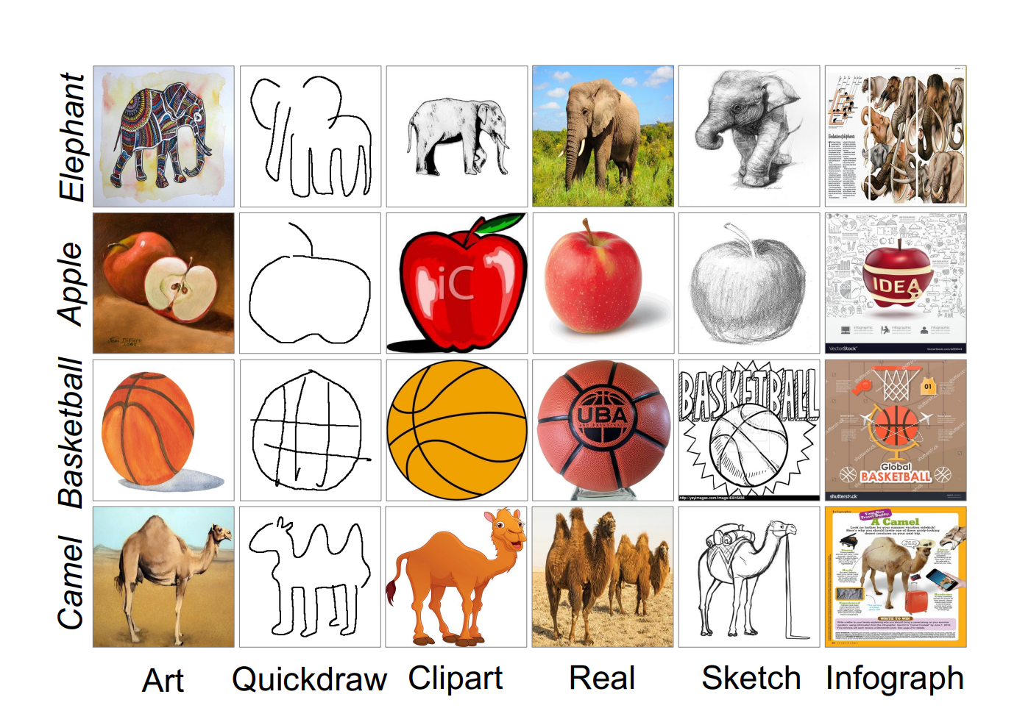
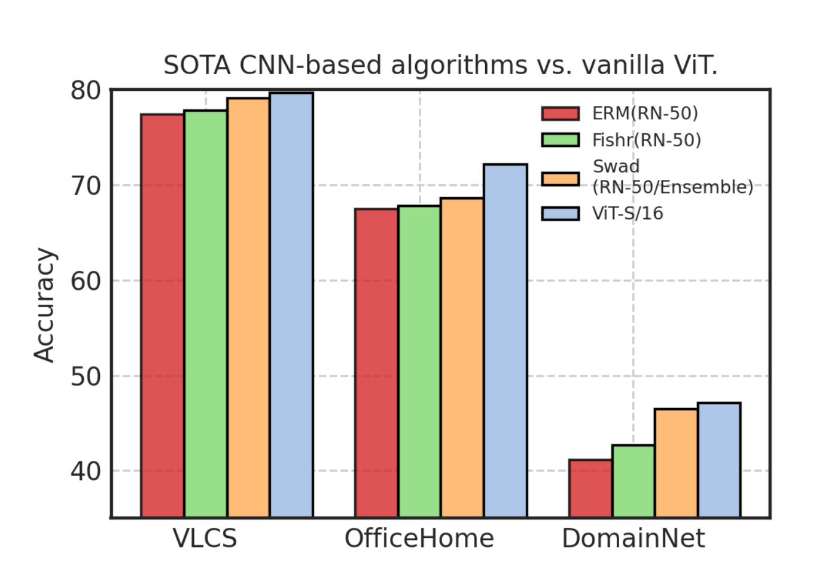
Sparse Mixture-of-Experts are Domain Generalizable Learners (ICLR-23)
ViT with ERM outperforms CNNs with SOTA DG algorithms
They discuss this in two perspectives
Theoretical: Algorithmic Alignment (Xu et al., 2020)
defines the difficulty of learning a function that can be decomposed into N sub-functions if your neural network can also decompose into similar subcomponents.
Mechanism of MHA
MHA are low-pass filters with a shape bias
convolutions are high-pass filters with a texture bias.
shape attribute is often an invariant correlation
texture attribute is often a spurious correlation
What can neural networks reason about? (Xu et al., 2020, ICLR-20)
How do vision transformers work? (Namuk Park and Songkuk Kim. 2022)

Slide 42
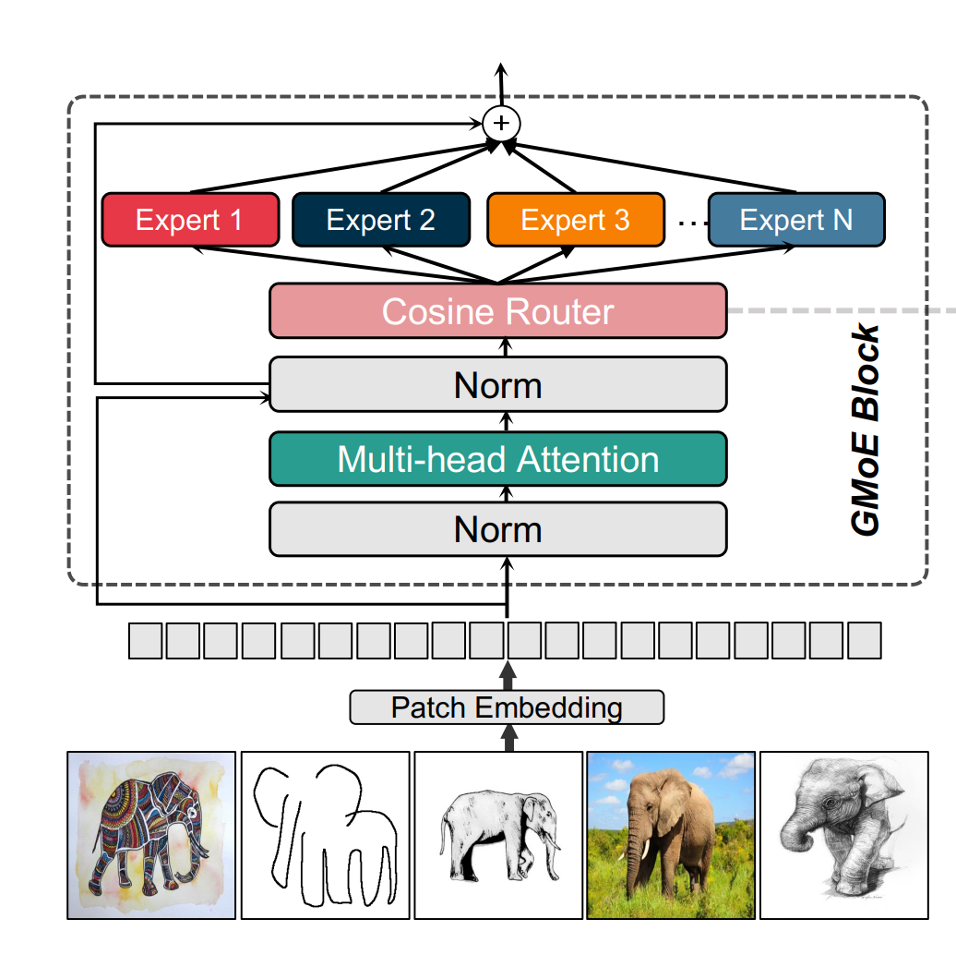
Generalizable Mixture-of-Experts (GMoE)
Embed the input onto a hypersphere
Use cosine similarity to match experts
Insert GMoE layer to the last two layers

Slide 43
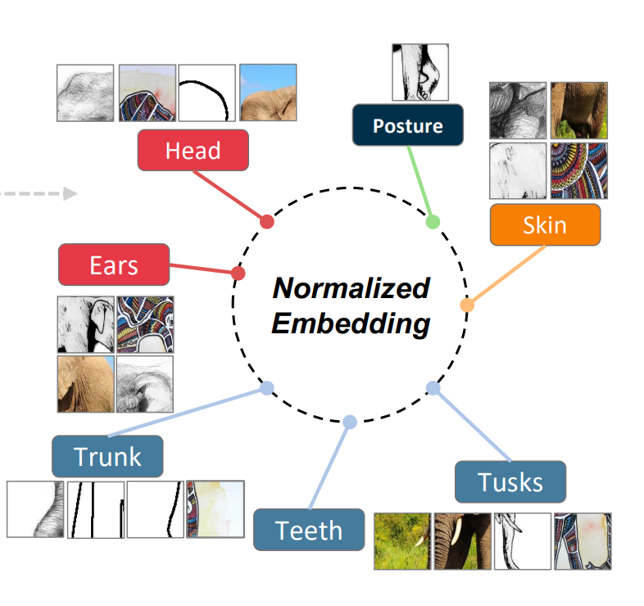
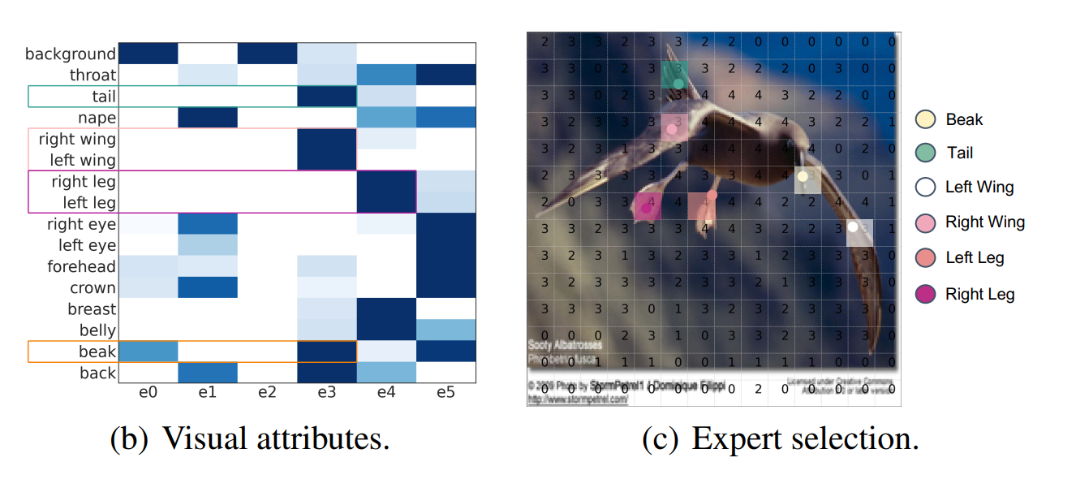
Expert selection
each expert focus on distinct visual attributes
similar attributes are attended by the same expert (e.g., the left wing and the right wing are both attended by e4).

Slide 44
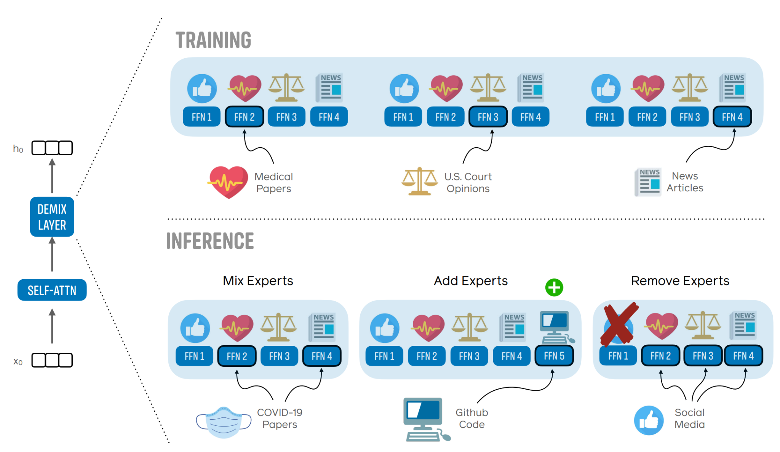
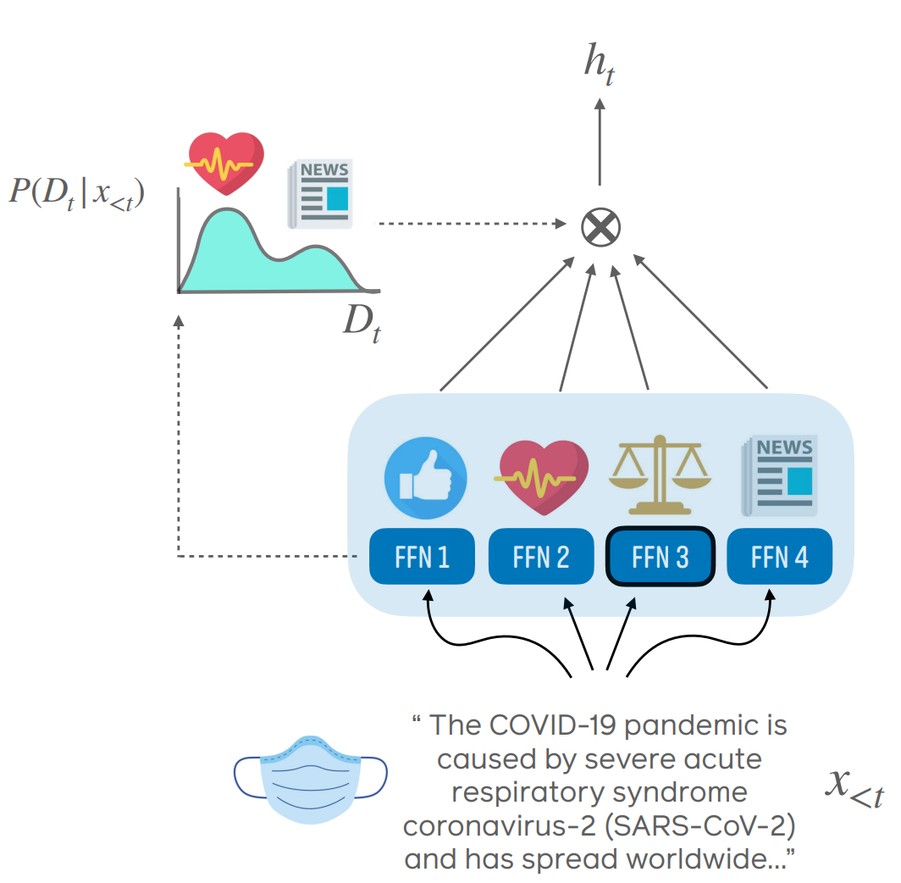
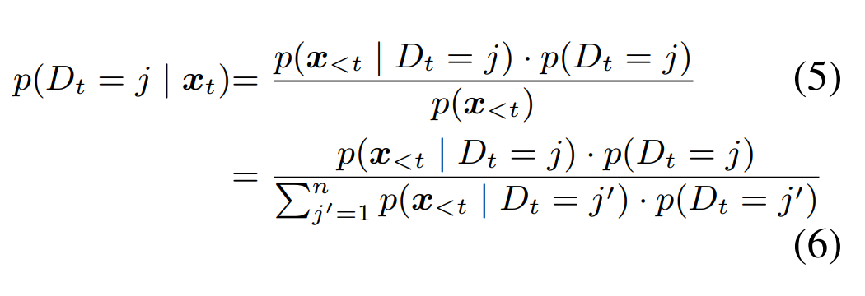
Can we explicitly force a module to learn a domain?
DEMIX Layers: Disentangling Domains for Modular Language Modeling (NAACL-22)
If we know the domain ID, we can easily do it.
What if we don’t know the domain ID at inference time?
Solution
For a given input text, estimate a posterior domain probabilities p(Dt |x), informed by a prior
prior is iteratively updated during inference
is precomputed and cached on held out data.
We use these probabilities in a weighted mixture of expert outputs to compute the hidden representation ht.
Bayes rule

Slide 45
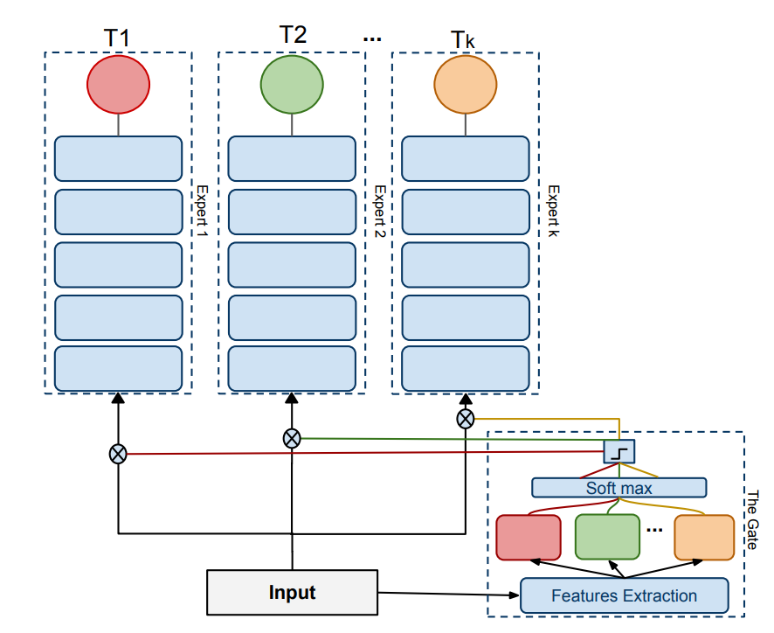
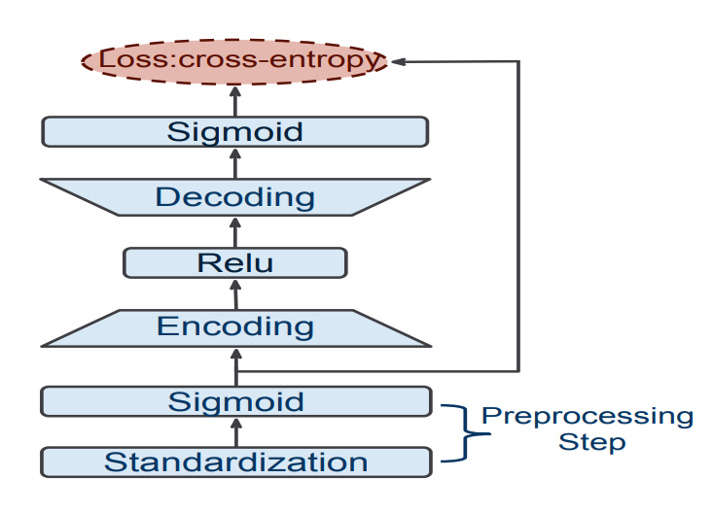
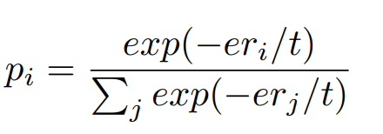
Can we explicitly force a module to learn a domain?
Solution
use pre-trained model to extract feature
train a autoencoder per domain
apply softmax on negative reconstruction loss to obtain the domain ID
the autoencoder can be used to calculate the domain relatedness
Expert Gate: Lifelong Learning with a Network of Experts (CVPR-17)

Slide 46
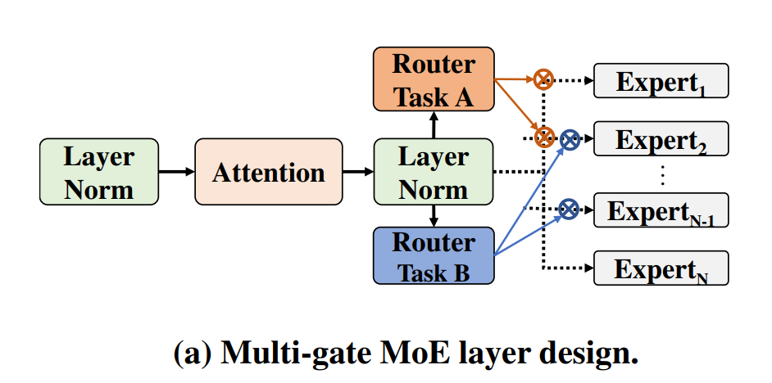
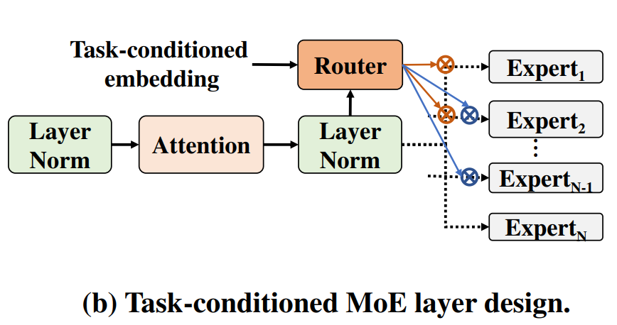
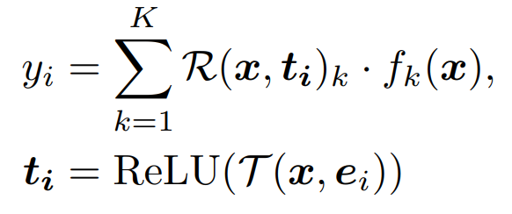
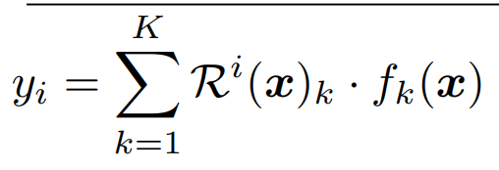
MoE for Multi-task Learning
M³ViT: Mixture-of-Experts Vision Transformer for Efficient Multi-task Learning with Model-Accelerator Co-design (NeurIPS-22)
one router per task
model parameter proportionally increase with more tasks
feed a one-hot task vector to a MLP to extract a task embedding
concatenate task embedding with token embedding to the router
model parameter don’t increase proportionally

Slide 47
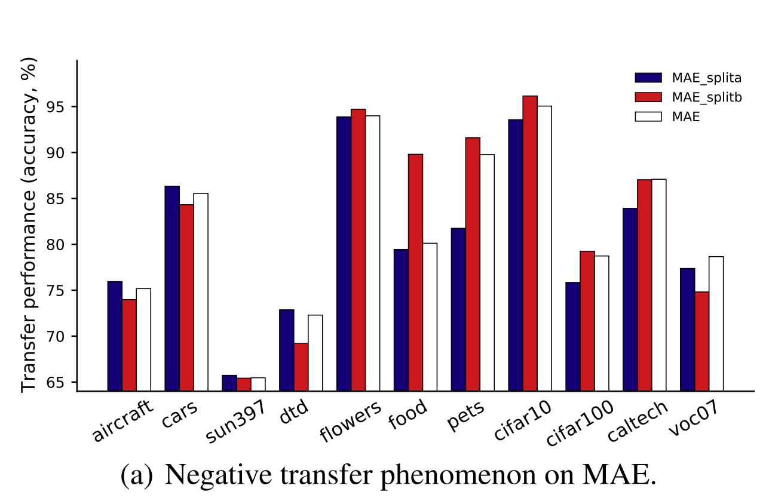
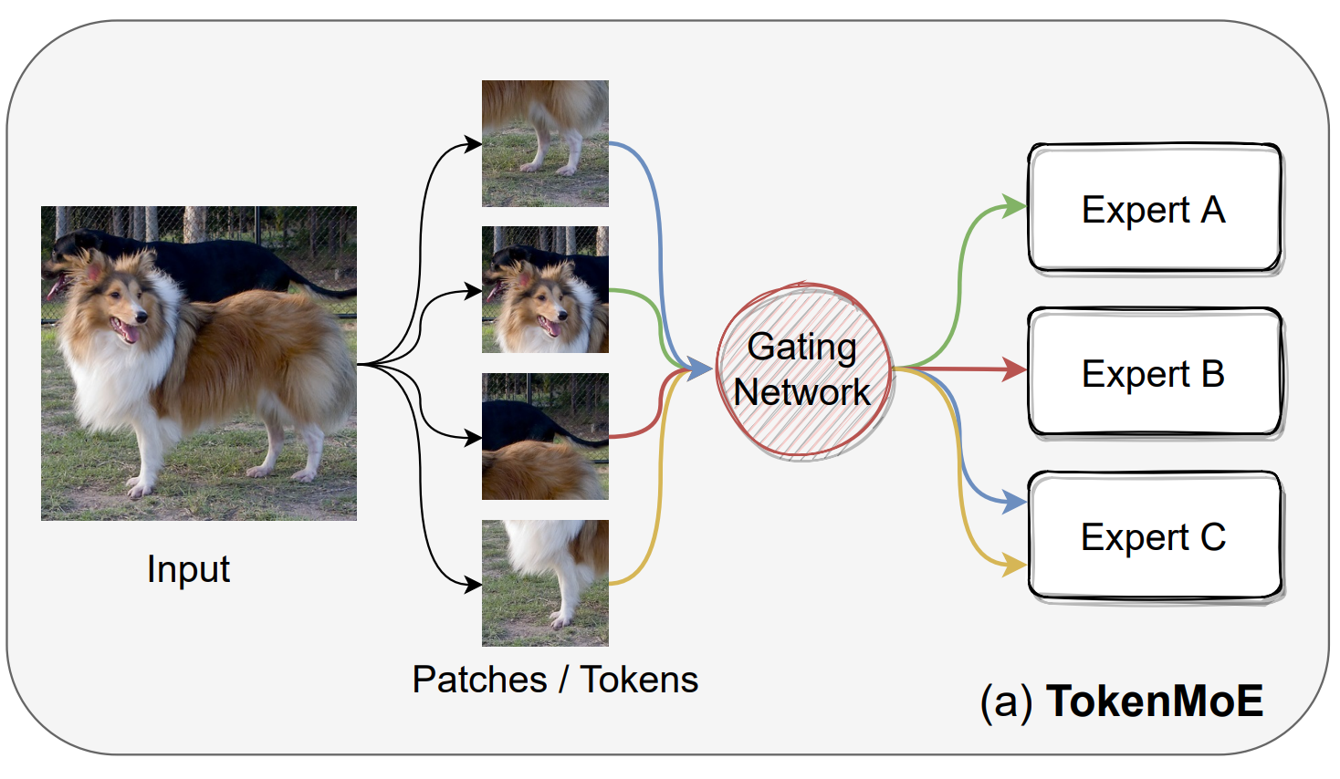
MoE for pre-training
Task-customized Masked Autoencoder via Mixture of Cluster-conditional Experts (ICLR-23)
separate ImageNet into two disjoint splits based on their label semantic dissimilarity in WordNet tree
Split A mainly contains inanimate objects, such as cars and airplanes,
Split-B primarily involves organisms, such as plants and animals.
the introduction of semantically irrelevant pre-training data might impede the transfer performance for specific downstream tasks.
it is difficult to train experts with diversity due to the lack of semantic labels used in supervised pre-training,

Slide 48
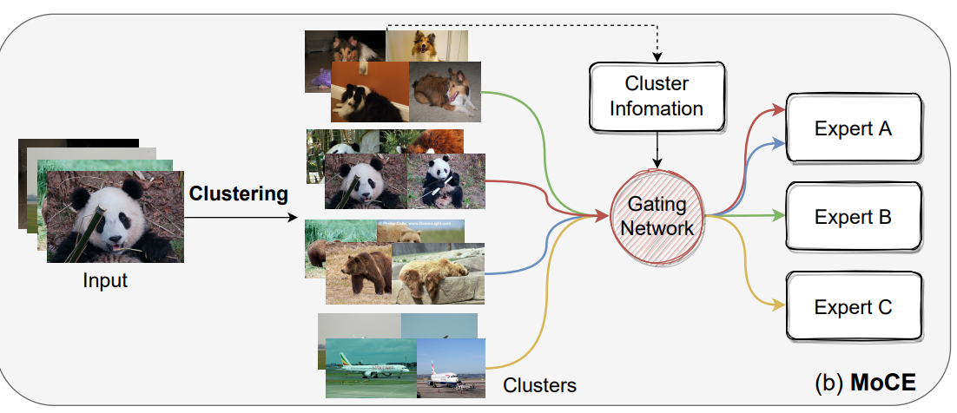
Mixture of Cluster-conditional Expert (MoCE)
Data clustering
extract image features with a pre-trained model
solve a data clustering problem with a fixed number of clusters and obtain cluster embeddings
train each expert with different clusters by routing tokens in the image based on the cluster embedding instead of token embedding
when the downstream tasks come,
extract downstream image features with the same pre-trained
use the cluster embeddings to assign downstream feature to clusters
choose cluster by majority vote
use the corresponding experts for fine-tuning

Slide 49
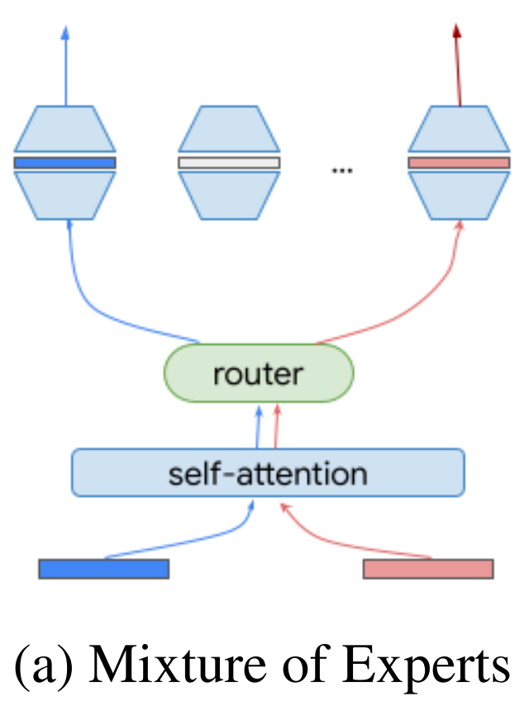
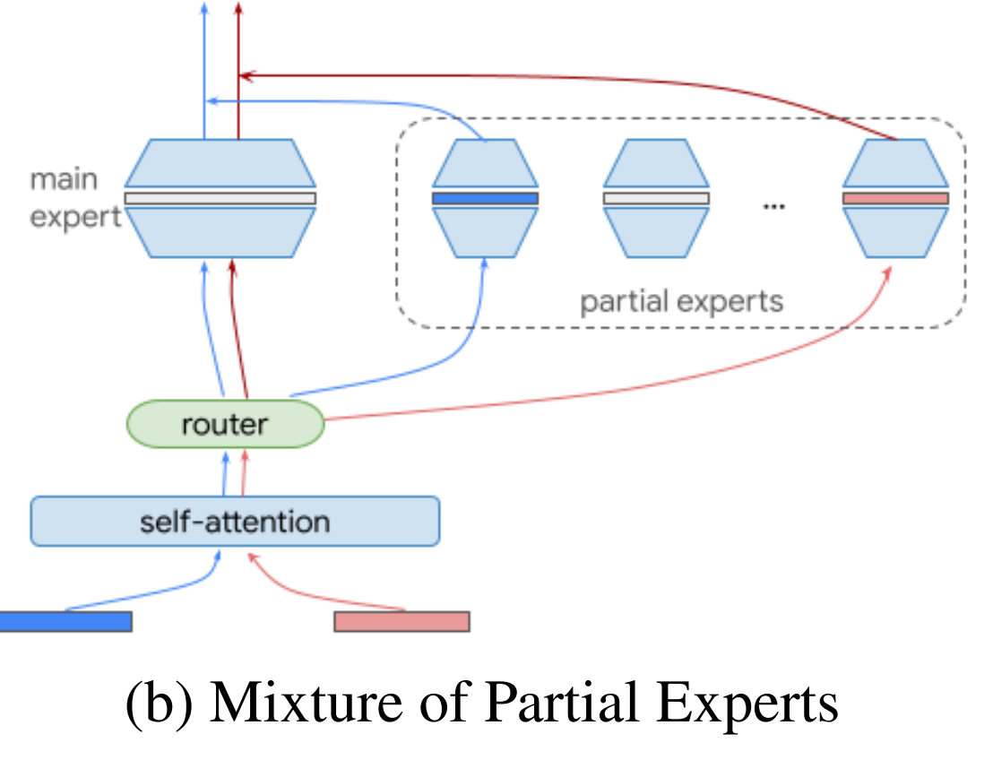
Alternative way to use outputs experts?
The Power of External Memory in Increasing Predictive Model Capacity (ICML-23 submission)
MoE performs weighted-sum on the experts’ output
We can have a main expert focusing on general feature and partial experts on domain specific features

Slide 50
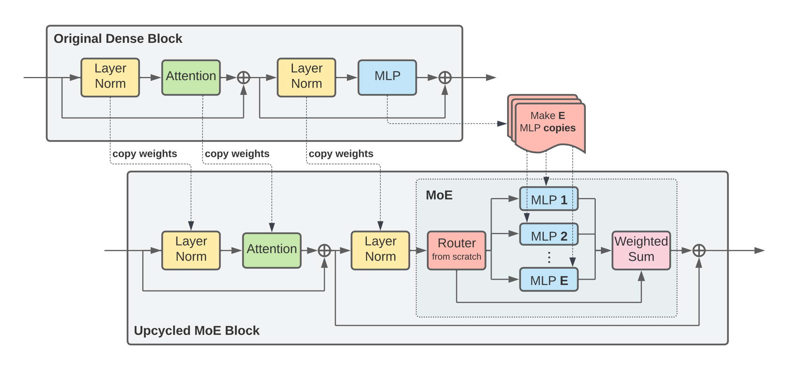
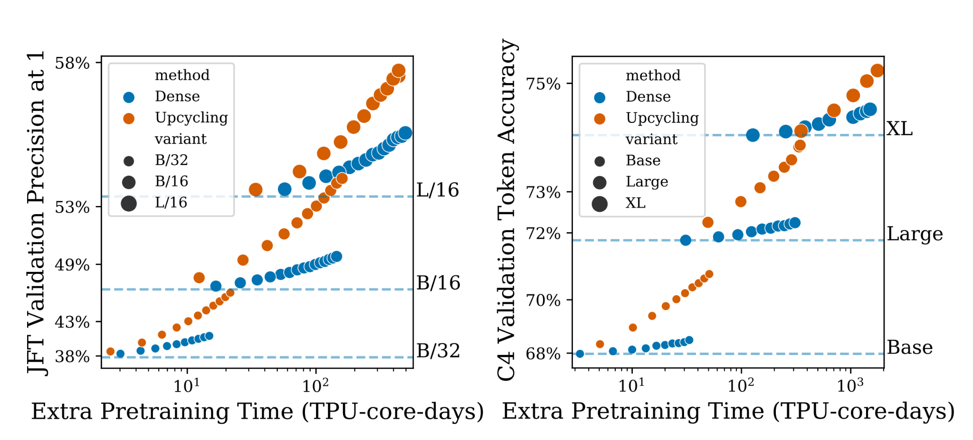
Can we transform a dense model to a sparse one?
Sparse Upcycling: Training Mixture-of-Experts from Dense Checkpoints (ICLR-23)
initializing a sparsely activated Mixture-of-Experts model from a dense checkpoint

Slide 51
Personal opinions: may be wrong
Specialty of experts
Weight initialization
Since the specialty is only based on the initialization of the expert, if you want to explicitly make some expert specialized in some domain, you can embed the domain information into the initialization of each expert.
Auxiliary information
If we have auxiliary information for samples, we can embed the auxiliary information and feed it with the sample(token) embedding to the router

Slide 52
Personal opinions: may be wrong
Parameter efficient transfer learning
If we have a large pre-train MoE model with each expert learning semantic (contexture) information, we just need to learn how to combine these the output of each expert, namely, tuning the router only.
Continual learning
Since experts learns token level information (semantic), V-MoE should be inherently more robust to forgetting
Use some experts to learn similar tasks sequentially
only use new experts when it’s necessary

Slide 53
Personal opinions: may be wrong
Federated learning with pre-trained ViT and tunable MoE (MLPs)
With client specific embedding, each client model can route tokens to more specific experts.
When we perform weight average, only the experts activated frequently for this client will contribute to the main model

Slide 54
Reference
Scaling Vision with Sparse Mixture of Experts (NeurIPS-21)
Learning to Route by Task for Efficient Inference (EMNLP-21)
Mixture-of-Experts with Expert Choice Routing (NeurIPS-22)
Multimodal Contrastive Learning with LIMoE: the Language Image Mixture of Experts (NeurIPS-22)
Towards Understanding the Mixture-of-Experts Layer in Deep Learning (NeurIPS-22)
Sparse Mixture-of-Experts are Domain Generalizable Learners (ICLR-23)
M³ViT: Mixture-of-Experts Vision Transformer for Efficient Multi-task Learning with Model-Accelerator Co-design (NeurIPS-22)
Expert Gate: Lifelong Learning with a Network of Experts (CVPR-17)
DEMIX Layers: Disentangling Domains for Modular Language Modeling (NAACL-22)
A review of sparse expert models in deep learning (Google & Open AI)
Task-customized Masked Autoencoder via Mixture of Cluster-conditional Experts (ICLR-23)
The Power of External Memory in Increasing Predictive Model Capacity (ICML-23 submission)
Sparse Upcycling: Training Mixture-of-Experts from Dense Checkpoints (ICLR-23)

