Slide 1
Diffusion Models & Dataset Bias from Meta
Zheda Mai

Slide 2
Agenda
Scalable Diffusion Models with Transformers, ICCV23
Deconstructing Denoising Diffusion Models for Self-Supervised Learning, arxiv paper
A Decade’s Battle on Dataset Bias: Are We There Yet? ECCV24 submission

Slide 3
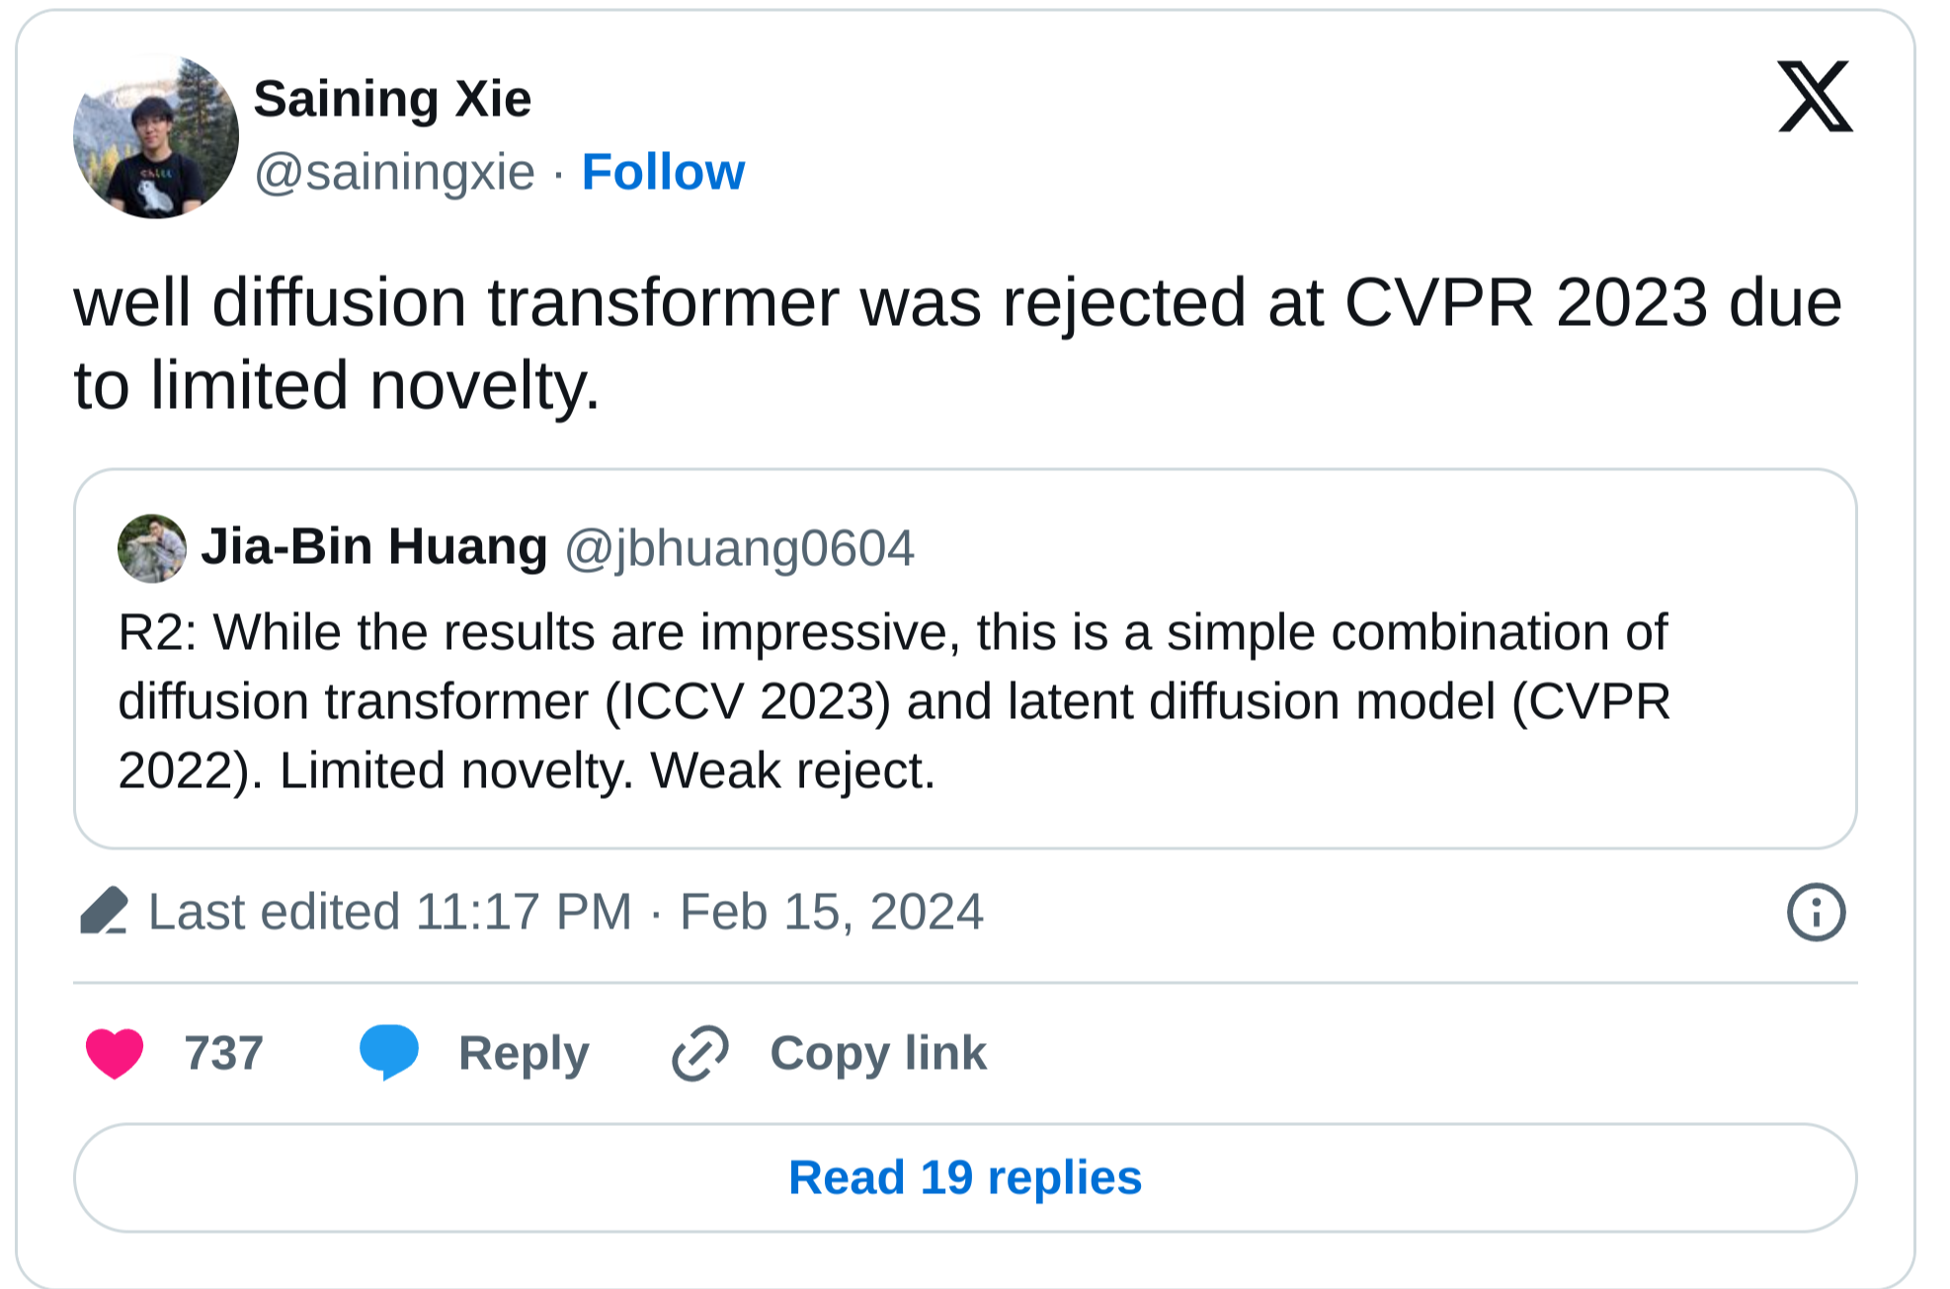
ICCV23
rejected by CVPR 23 due to the lack of novelty
a very popular backbone for generative models due to its scalability
Stable Diffusion 3
Sora

Slide 4
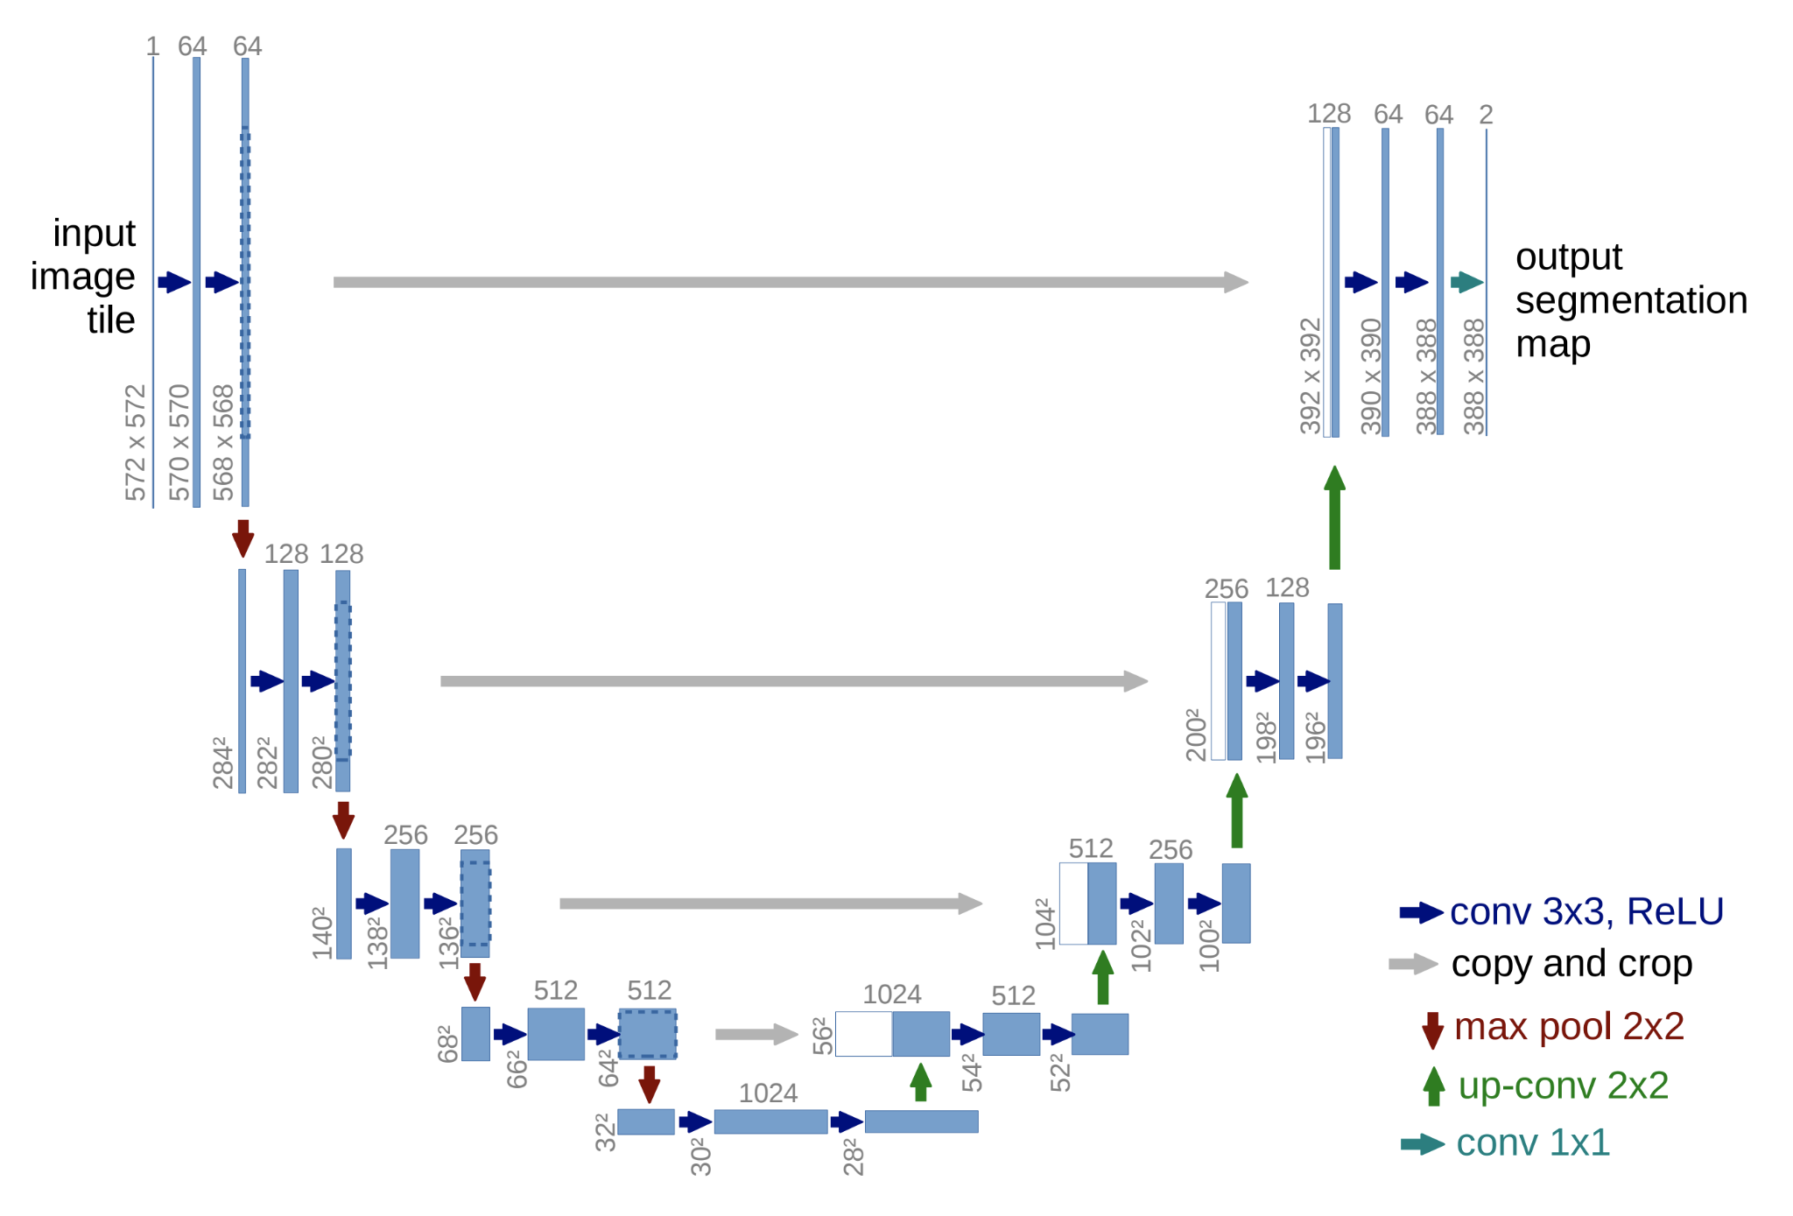
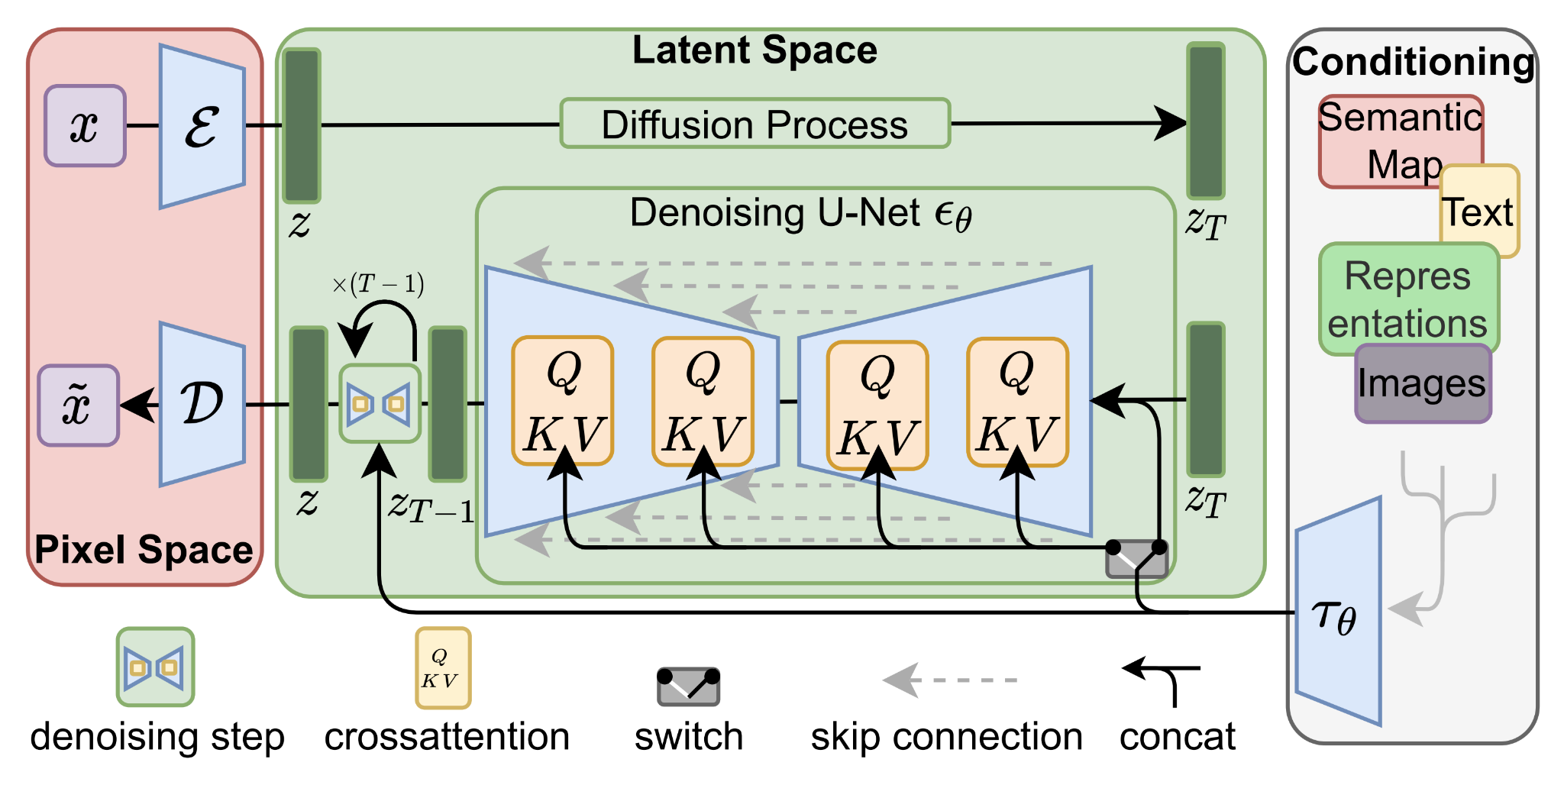
You Can't Spell Diffusion without U!
U-Net is the de-facto backbone for diffusion models
Why U-Net?

Slide 5
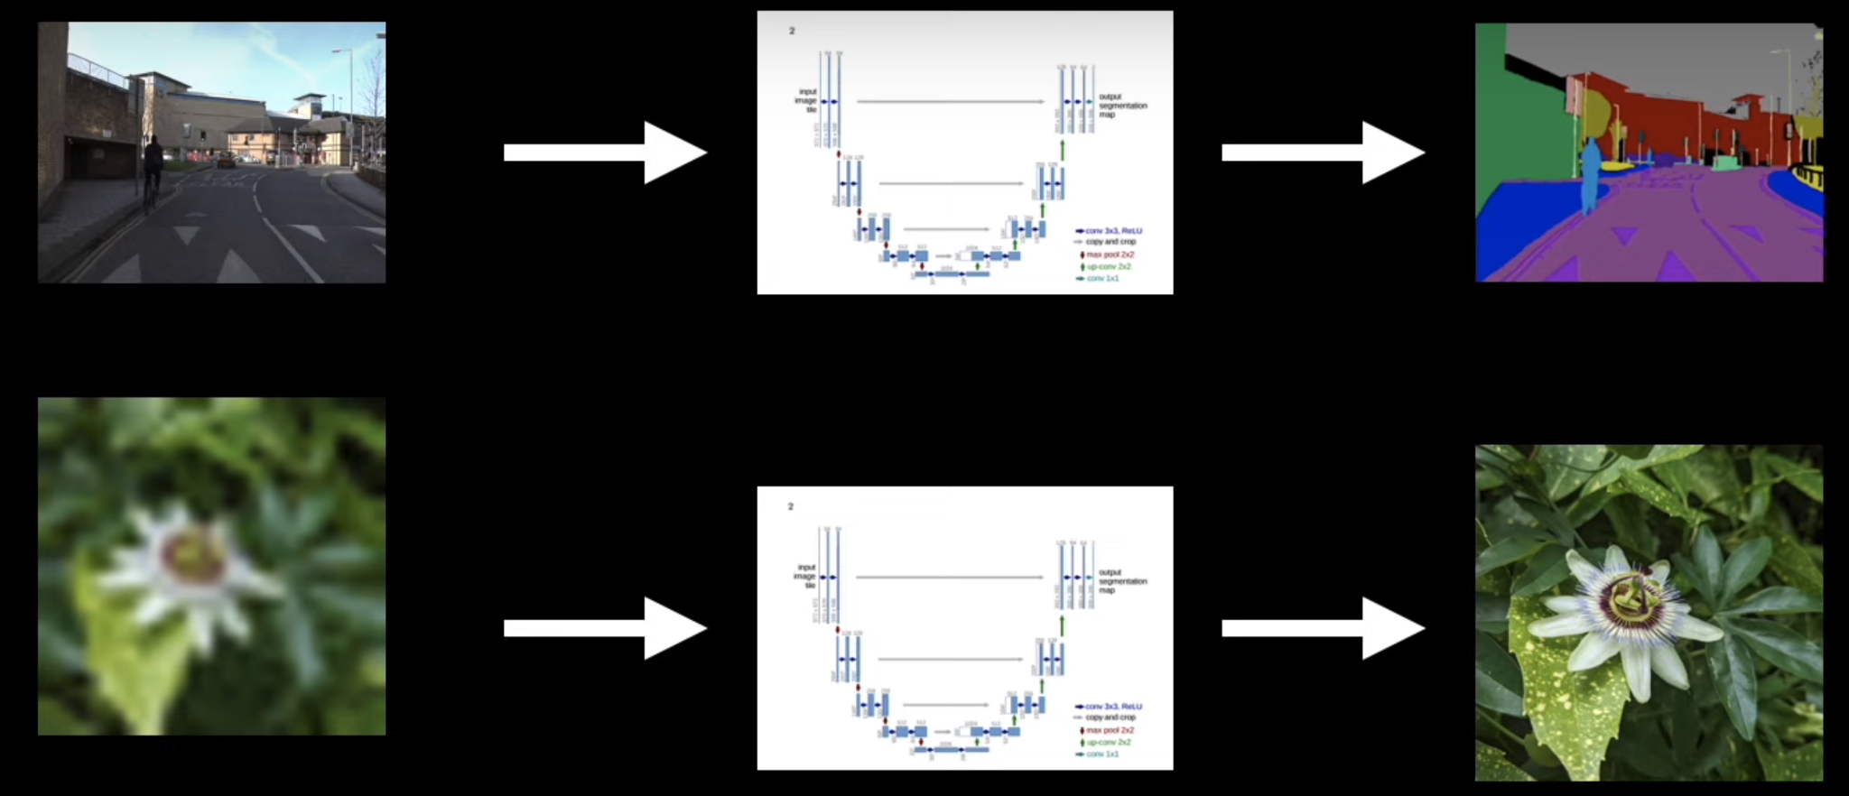
Why U-Net
image segmentation
super-resolution
U-Net is the first-to-try method when input and output have the same size

Slide 6
Why U-Net
decoder features: semantic information
Hierarchical Feature Extraction
capture features at different scales
Skip Connections:
concatenate features between symmetrical layers
use both spatial and semantic information
encoder features: spatial information

Slide 7
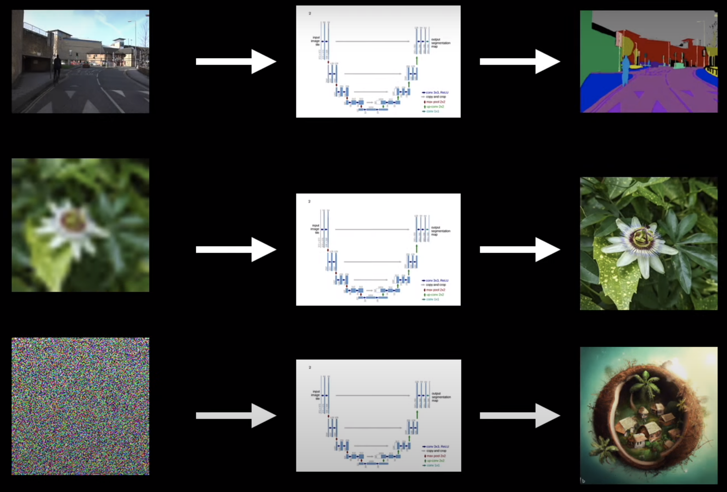
Why U-Net
Is the inductive bias of U-Net crucial to diffusion models?

Slide 8
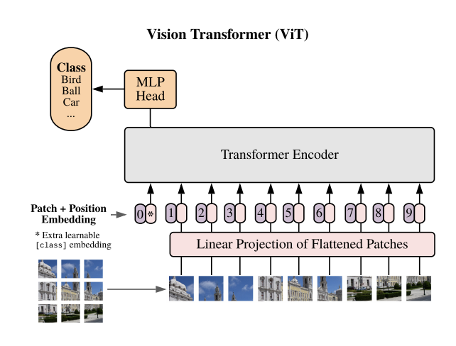
Vision Transformer
ViT’s input and output also have the same size

Slide 9
This is a Meta internship project.
If you took this Meta internship and your project is replacing U-net with the ViT in diffusion models, how will you do it?

Slide 10
My thought process
mean
variance
Input: same as ViT, turn image to patch embedding + positional embeddings, no CLS token
linear layer
Output: different from ViT, mean and diagonal covariance, both have same size as input
add linear layer to predict them with last layer embeddings
Notes:
If we want to replace the U-net with the ViT, how will we do it? How to modify the standard ViT to handle additional conditional information such as timesteps, class labels, natural language etc.

Slide 11
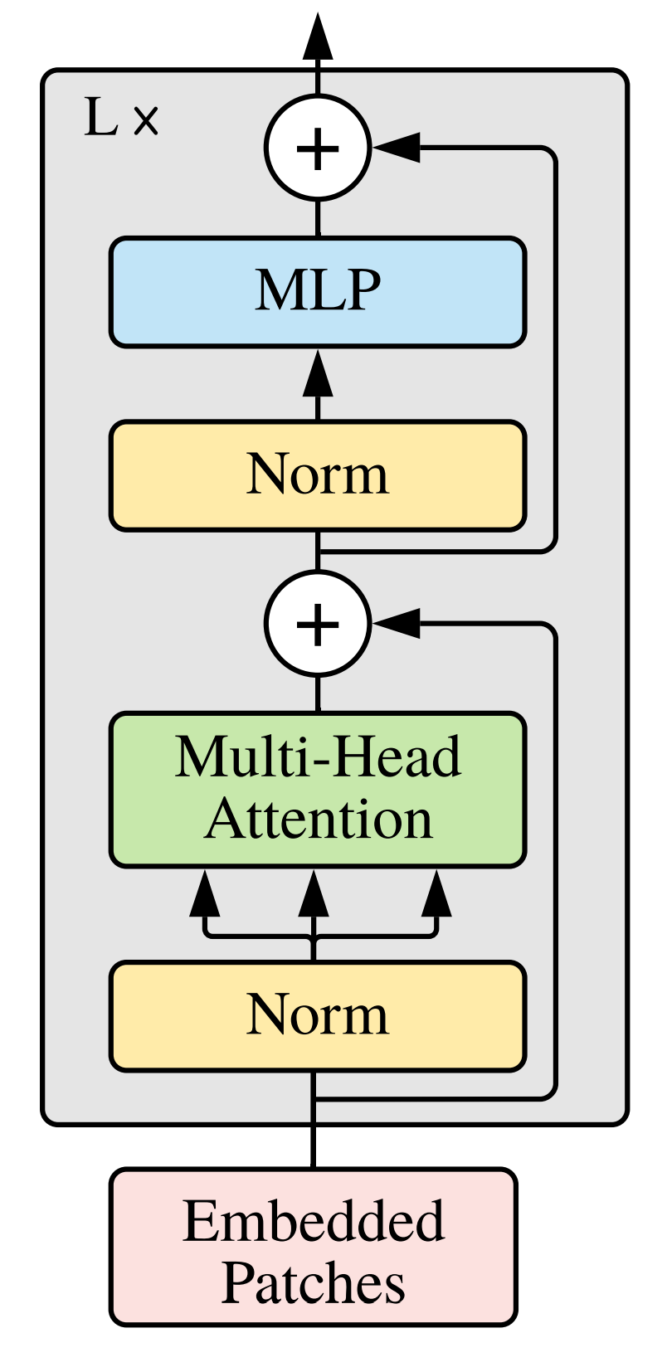
My thought process
How to add conditioning information?
Append conditioning embeddings to input embeddings
cross attention
Q
Cross attention, after self attention
visual embedding as query
conditioning embedding as key, value
K,V
condition

Slide 12
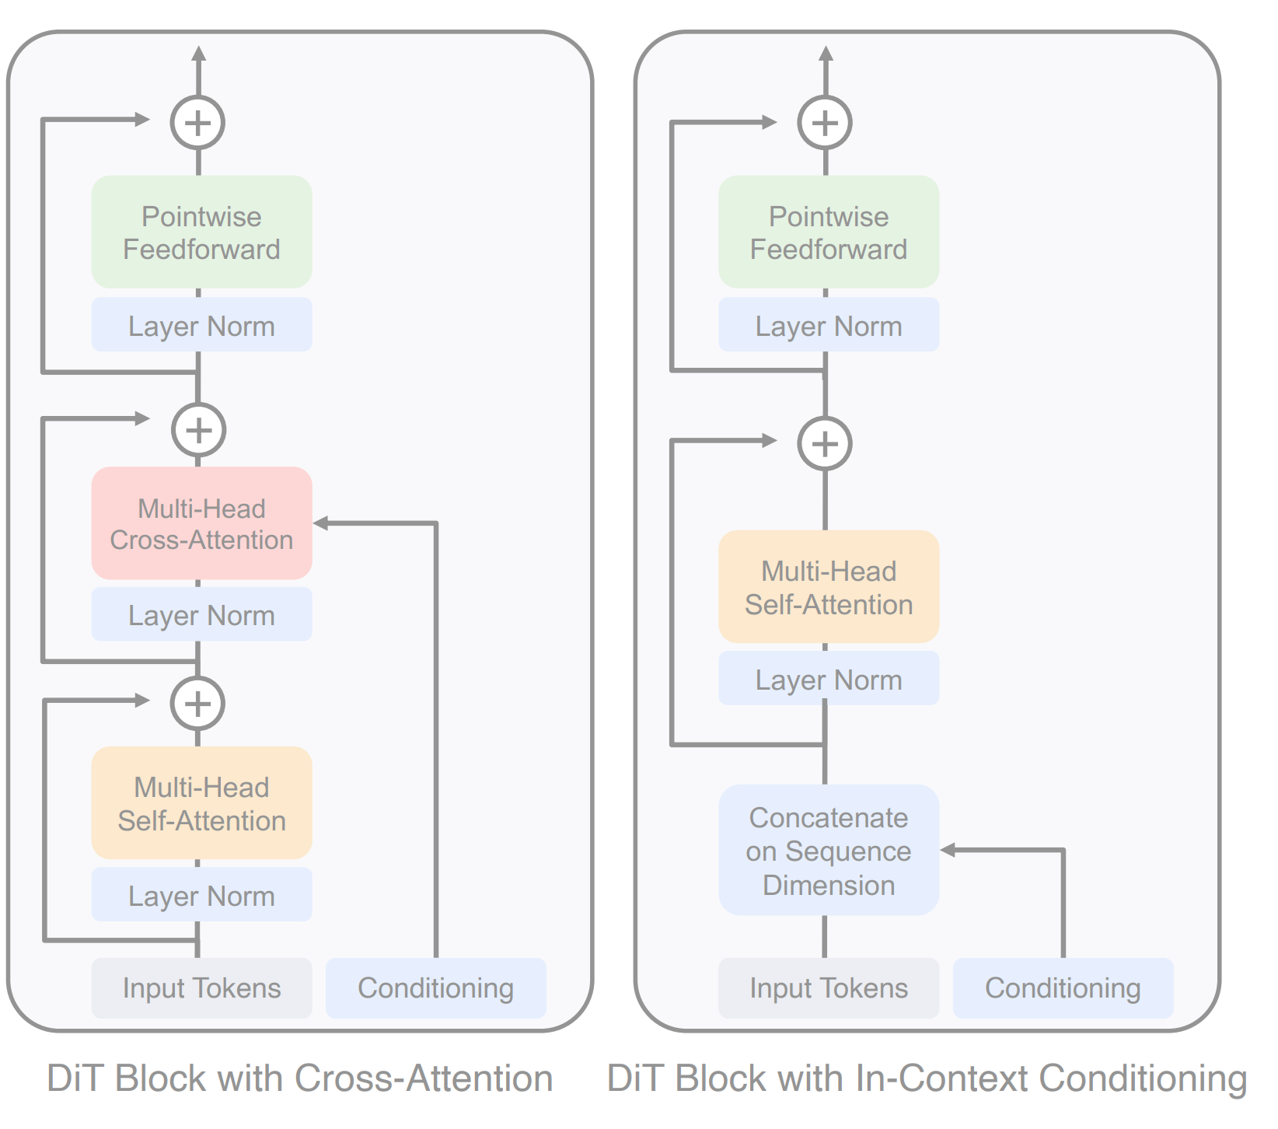
Scalable Diffusion Models with Transformers
My two proposals are two naive ways
Discussed in the paper
Not very effective

Slide 13
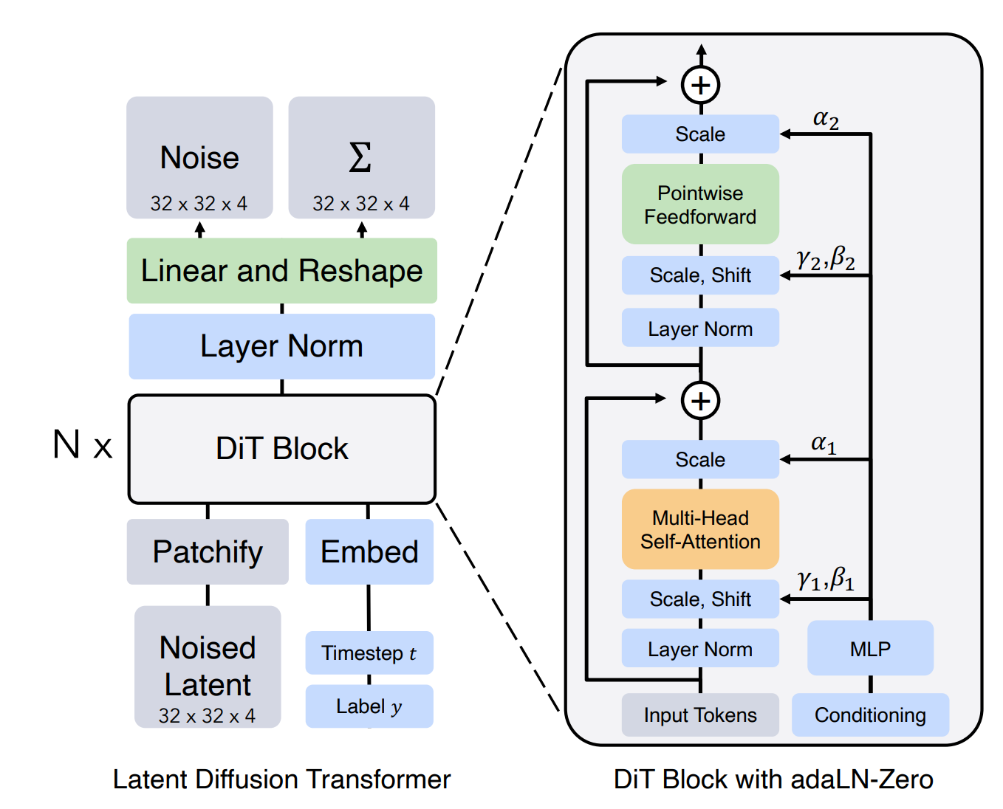
Add a MLP to regress the conditioning embedding to generate scaling factors
least Gflops compare with cross attention and token concatenation
Initialize MLP to output zero for apha
DiT block -> identity block

Slide 14
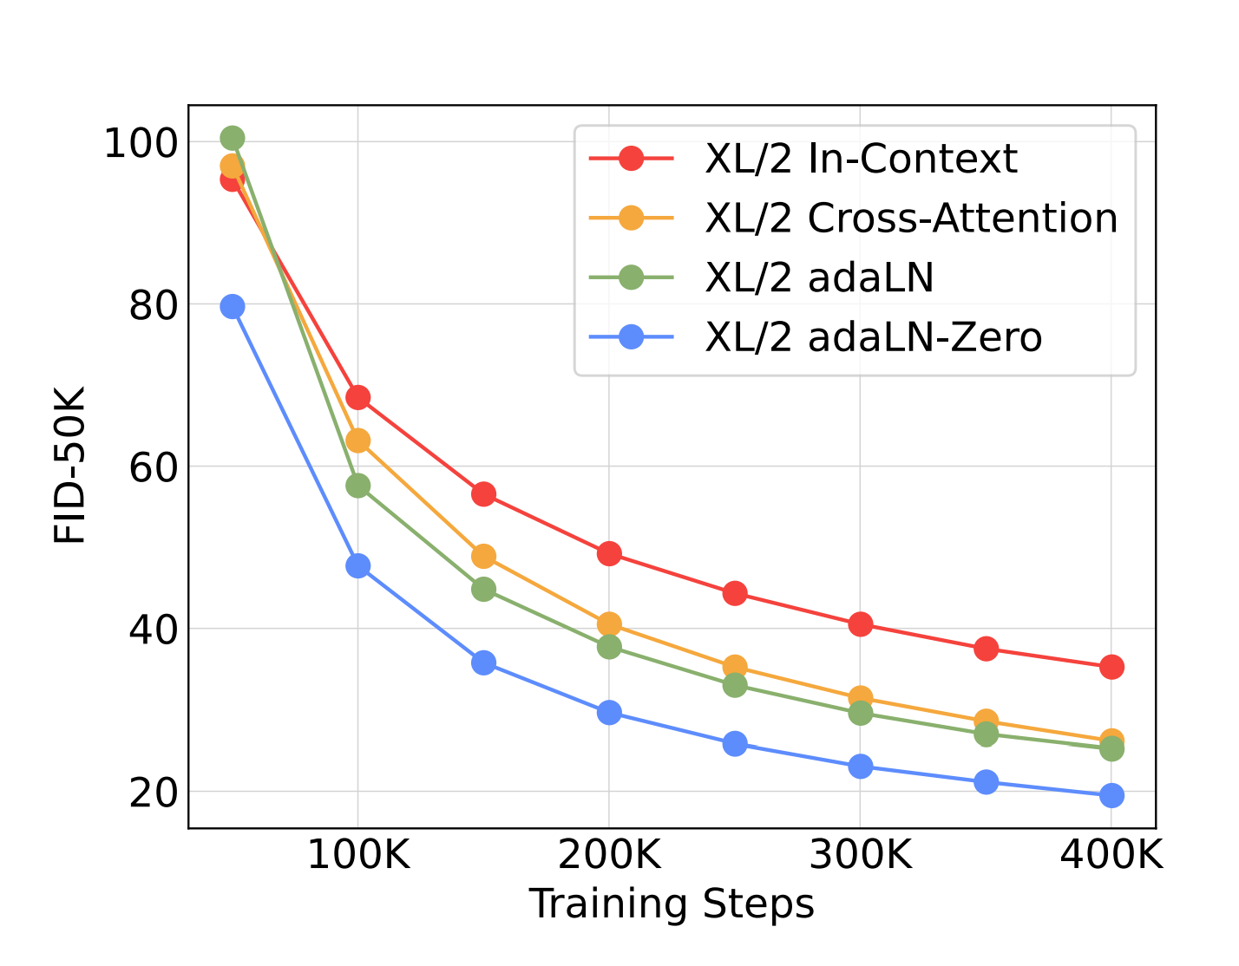

Slide 15
Scalability
model size / patch size
small patch size -> more patches -> more computation
larger model size
more layers
more heads
larger embedding size
Larger models are better

Slide 16
More patches are better

Slide 17
Why DiT becomes popular in generative models
Scalable
larger models and more computation yield better results
Architecture unification
most generative models are multimodal
new techniques that benefit transformer can be easily added
Faster
training converges much faster

Slide 18
Research Ideas?
Research problems with solutions focusing on the U-Net in diffusion models can be re-evaluated in DiT.
Are there any transformer properties that can be used to solve those problems

Slide 20
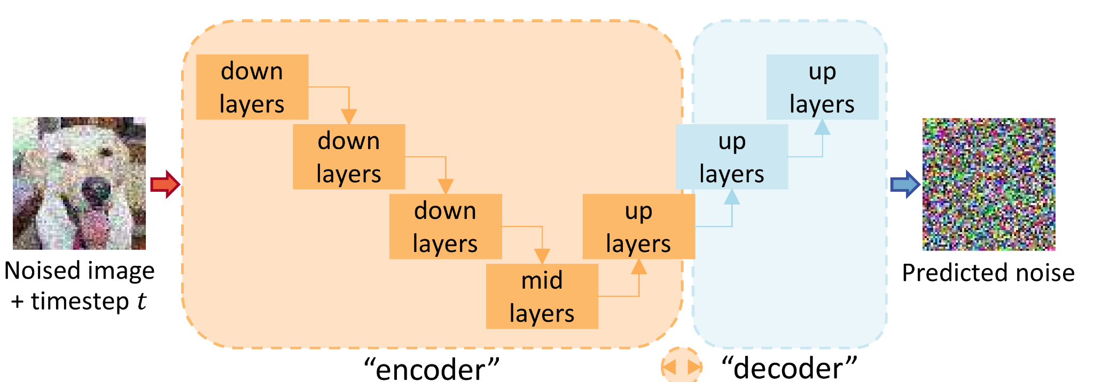
The core component of diffusion models
Denoising: given a noised image and predict the noise.

Slide 21
Denoising Autoencoder (DAE)
ICML 2008
DAE: self-supervised representation learning

Slide 22
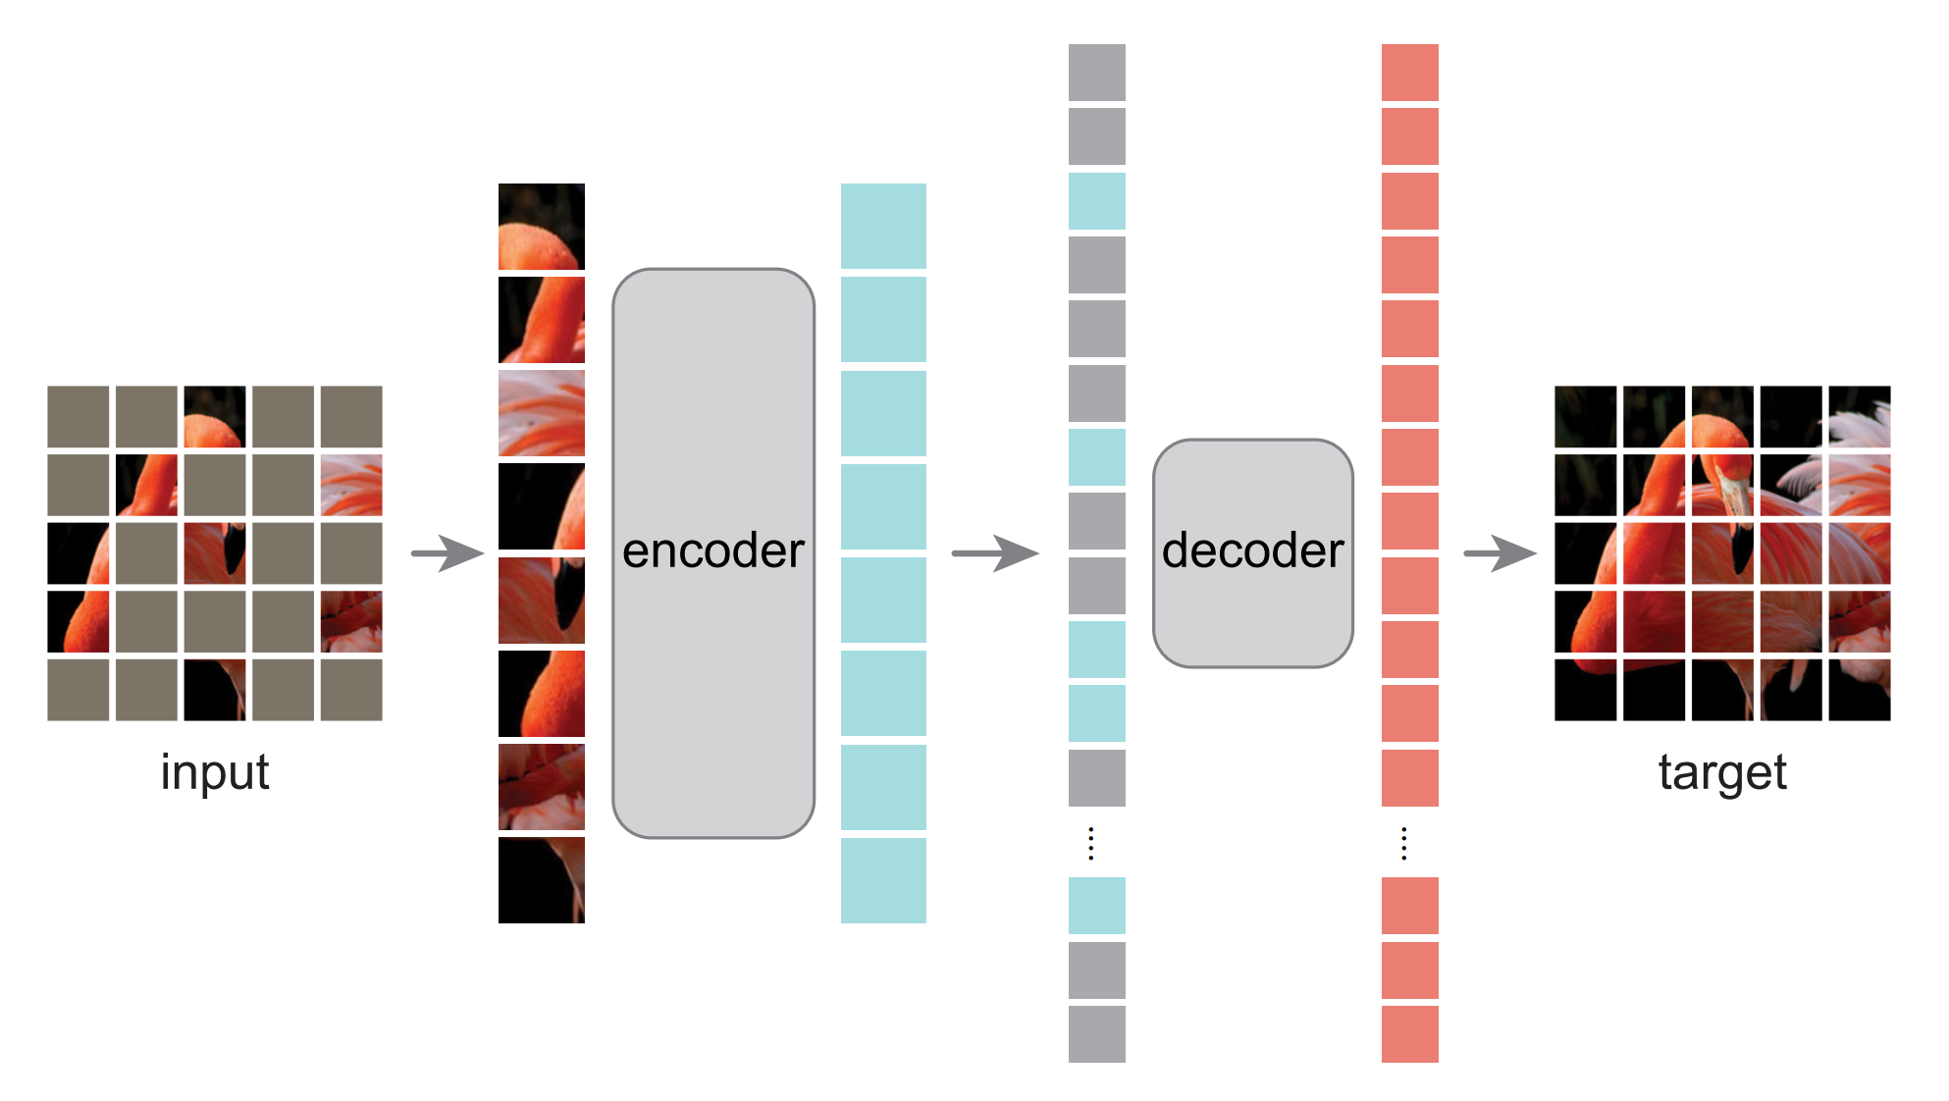
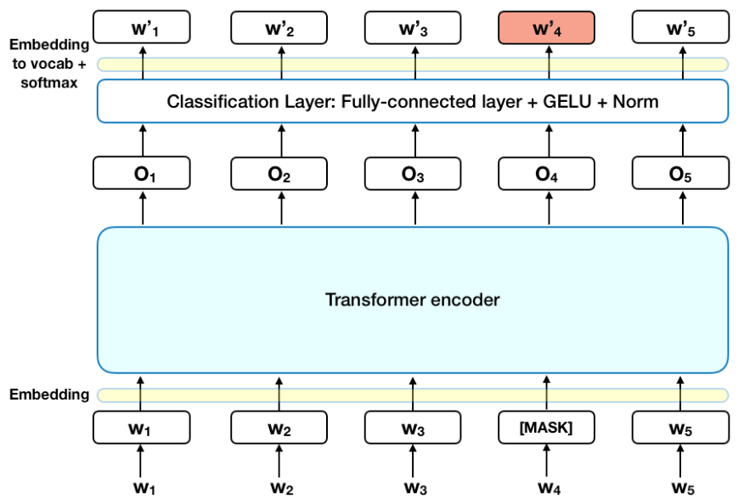
Successful variants of DAE: masking noise
masking noise: predict missing parts
BERT
MAE

Slide 23
Masking Vs additive noise
Masking
masked tokens explicitly specify unknown vs. known content,
Additive (Gaussian noise)
no clean signal is available
Little or no recent research has reported promising results on classical DAE variants with additive noise.
Nowadays generative models are so good that they appear to have strong recognition representations for understanding even without explicit known/unknown signals

Slide 24
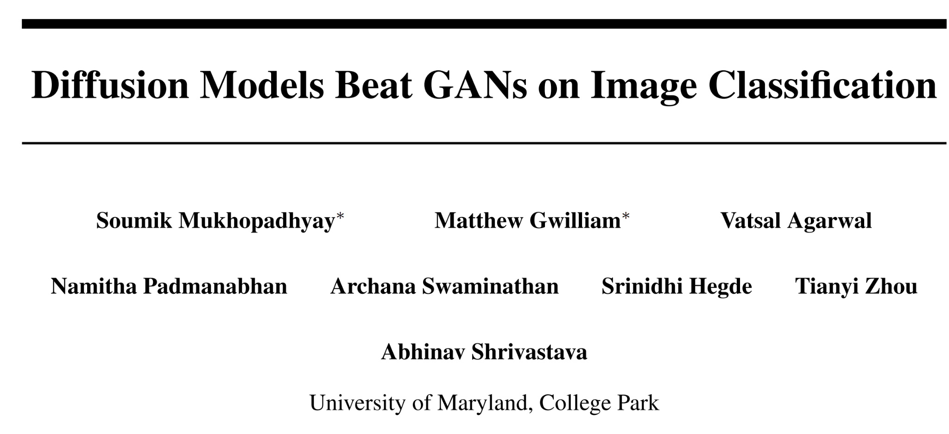
Representation learning ability of diffusion models
off-the-shelf pre-trained DDMs features for classification
Open question: how do DDM gain the representation capability

Slide 25
Goal of this paper
Train a recognition-oriented denoise model instead of generation-oriented
Deconstruct a DDM step by step into a classical DAE
Understand critical components for a DAE to learn good representations

Slide 26
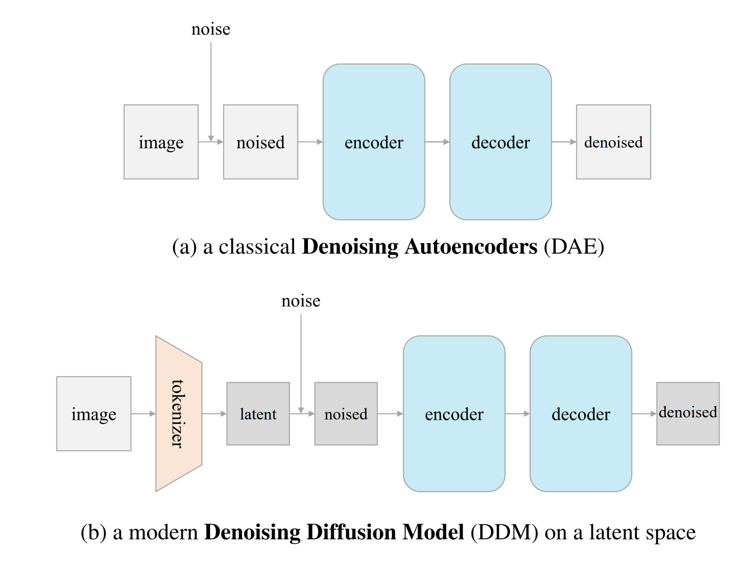
DAE Vs DDM
DAE
noise is added to images
predicts denoised images
DDM
noise is added to latent embeddings
predict denoised embeddings

Slide 27
Deconstructing Denoising Diffusion Models
ImageNet
linear probing
Remove class-conditioning
Using class labels is not legitimate inn SSL
Removing the class-conditioning can force the model to learn more semantics.

Slide 28
Deconstruct VQGAN
VQGAN as tokenizer to embed images to latent space
reconstruction loss
KL divergence
perceptual loss base on supervised VGG
discriminator adversarial loss
distance in VGG feature space
not legitimate in SSL with a supervised pretrained model
The tokenizer ->
VAE

Slide 29
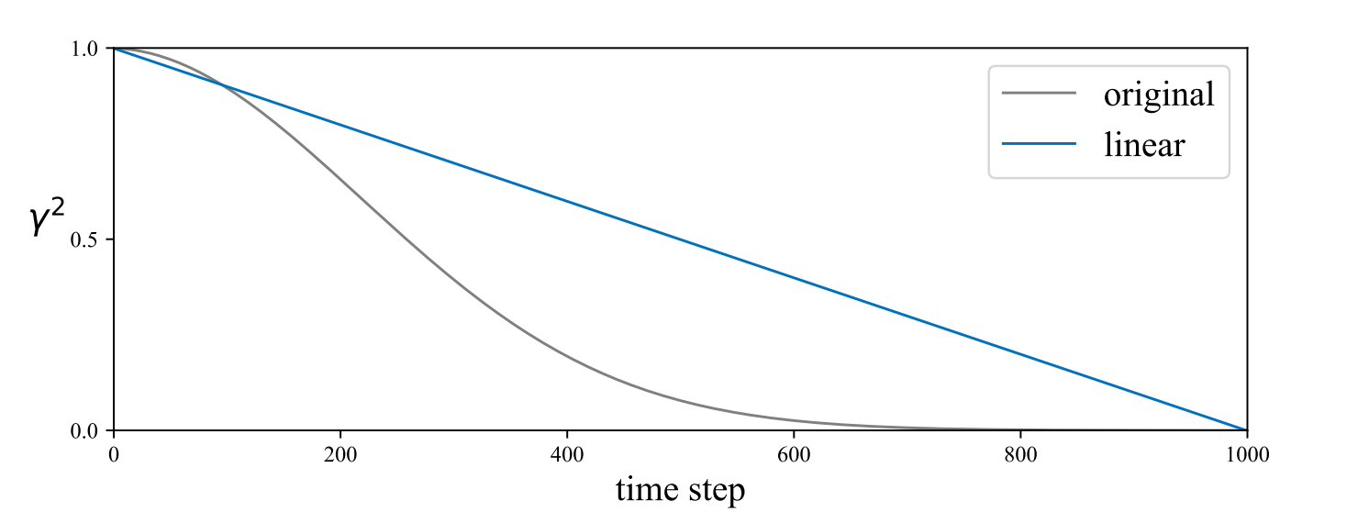
Replace noise schedule
original schedule spends too many steps on VERY NOISY images
Not necessary for recognition
Use linear

Slide 30
Reorienting DDM for Self-supervised Learning
SSL performance is not correlated to generation quality.
The representation capability of a DDM is NOT necessarily the outcome of its generation capability.

Slide 31
Deconstructing (simplify) the Tokenizer
x: image
Convolutional VAE
encoder f and decoder g are deep conv network
Patch-wise VAE
encoder and decoder are linear
x: 16x16 patch
Patch-wise AE
encoder and decoder are linear
Patch-wise PCA
no gradient-based training

Slide 32
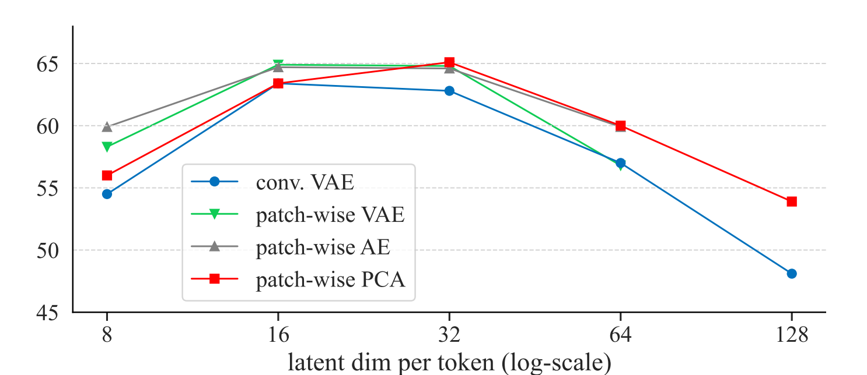
Conv VAE is neither necessary nor favorable
Other tokenizer encode each patch independently outperform conv VAE
Even PCA works well.
No gradient training
analogous to image pre-processing instead of a network

Slide 33
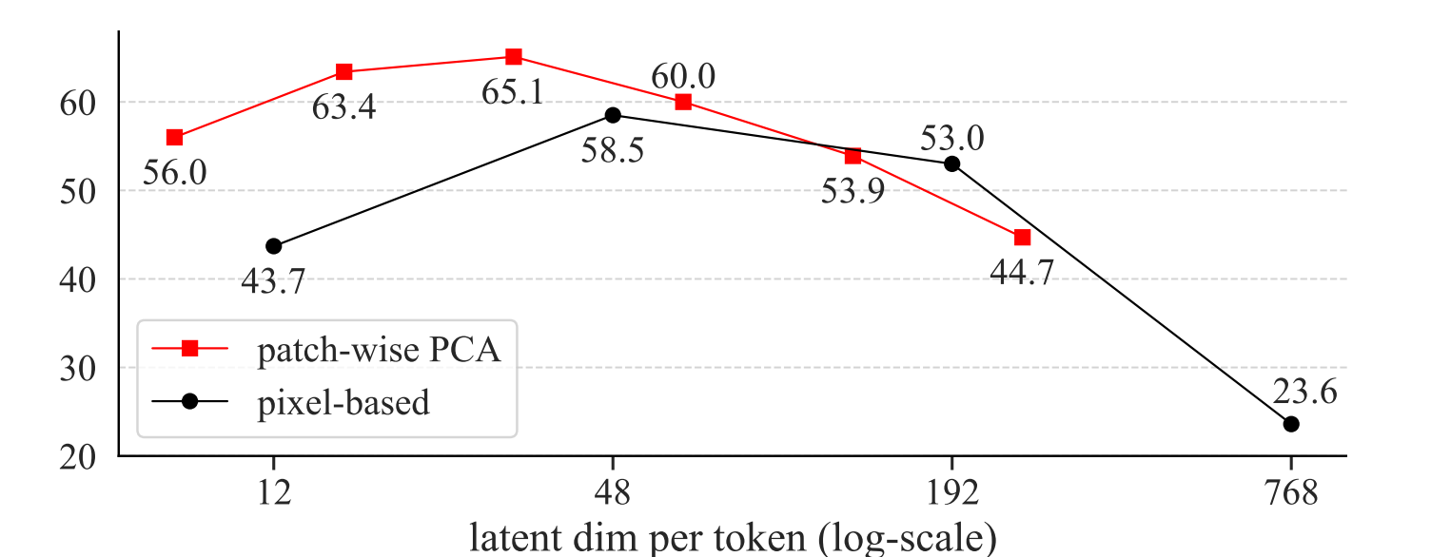
How using image patch directly
Identity tokenizer: use raw-pixel patches directly
Latent dimension of the tokenizer is crucial for DDM to work well in SSL.

Slide 34
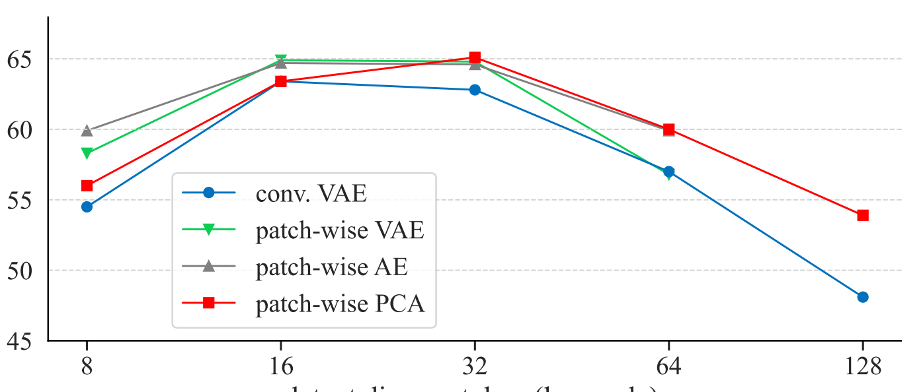
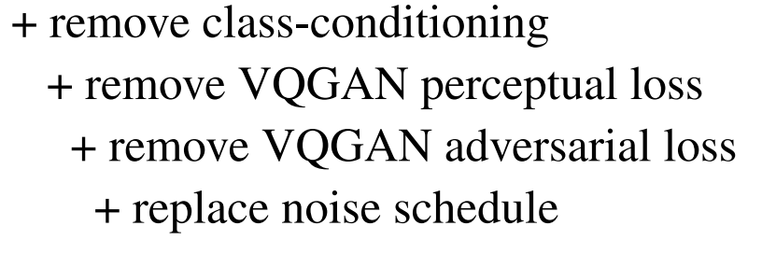
Toward Classical Denoising Autoencoders
Current deconstruction trajectory
Generative DDM
PCA DDM
remove remaining steps
SSL DDM
simplify tokenizer
DAE

Slide 35
Predict clean data (rather than noise)
DDM: predict noise
DAE: predict clean data

Slide 36
Remove input scaling.
DDM: scale input
DAE: no scale

Slide 37
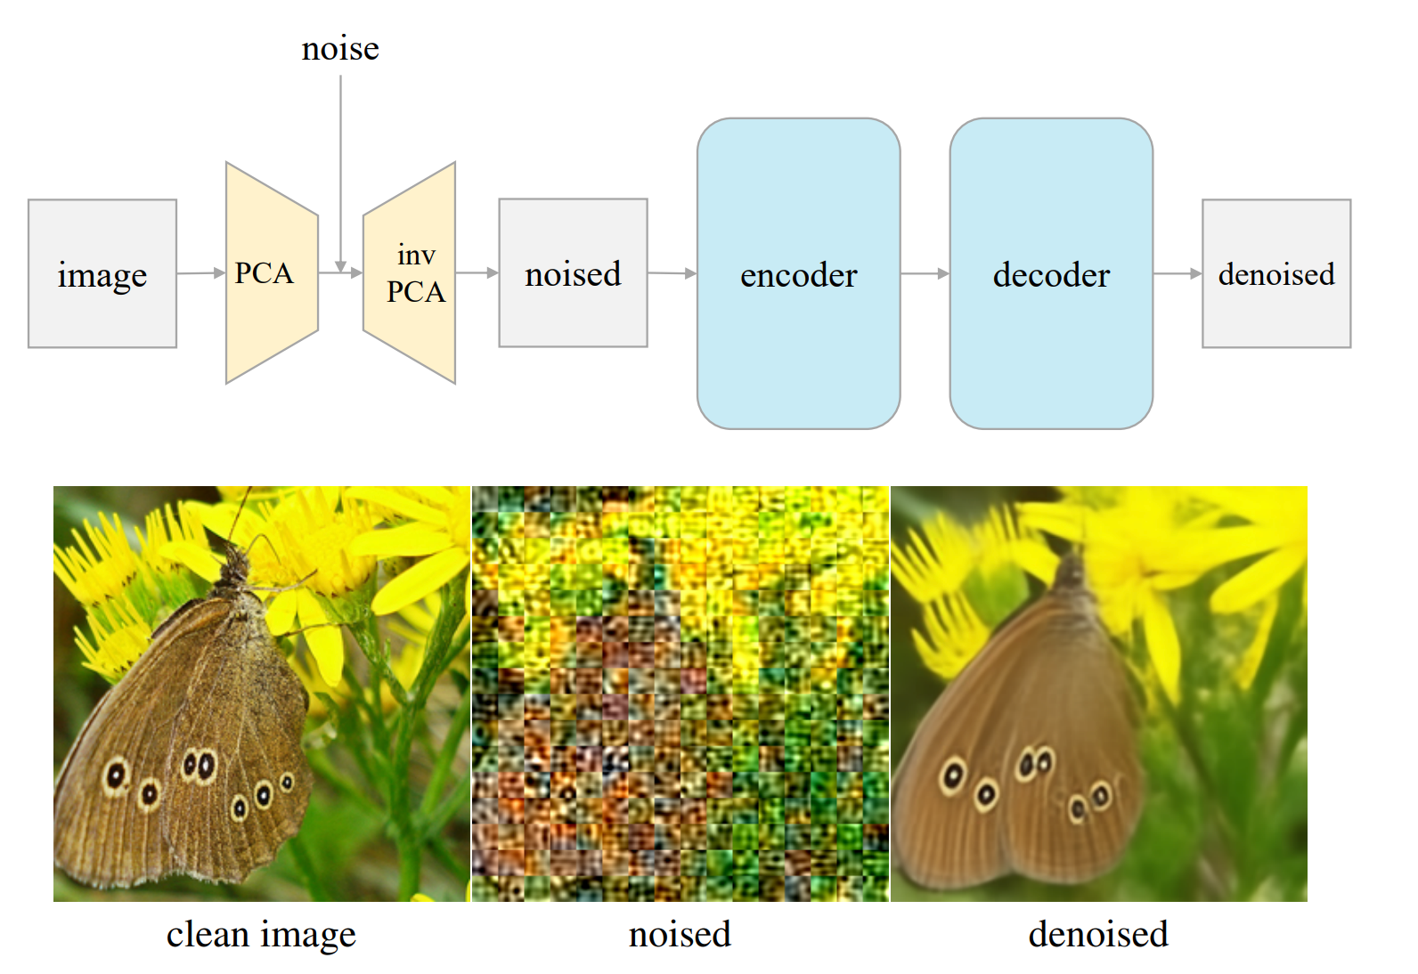
Operate on the image space with inverse PCA
DDM: operate on latent space
DAE: operate on image space

Slide 38
DAE: predict original image
PCA is a lossy encoder
“Noise” comes from
added Gaussian noise
PCA reconstruction error
Down weights reconstruction error
latent Denoising Autoencoder (l-DAE)

Slide 39
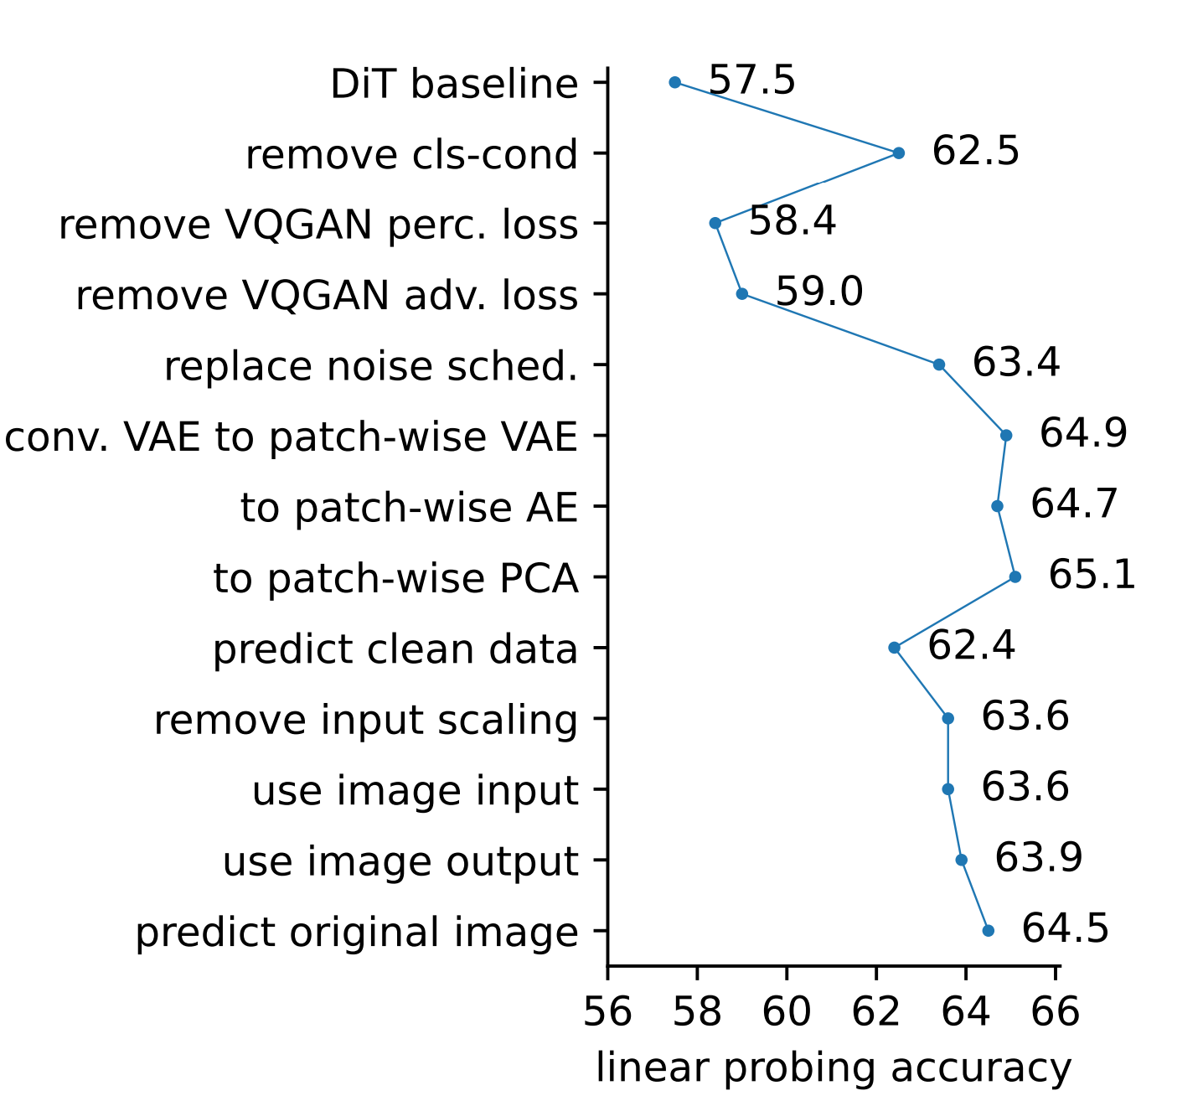
The overall deconstructive trajectory
Only difference between l-DAE and DAE is: noise added to the latent

Slide 40
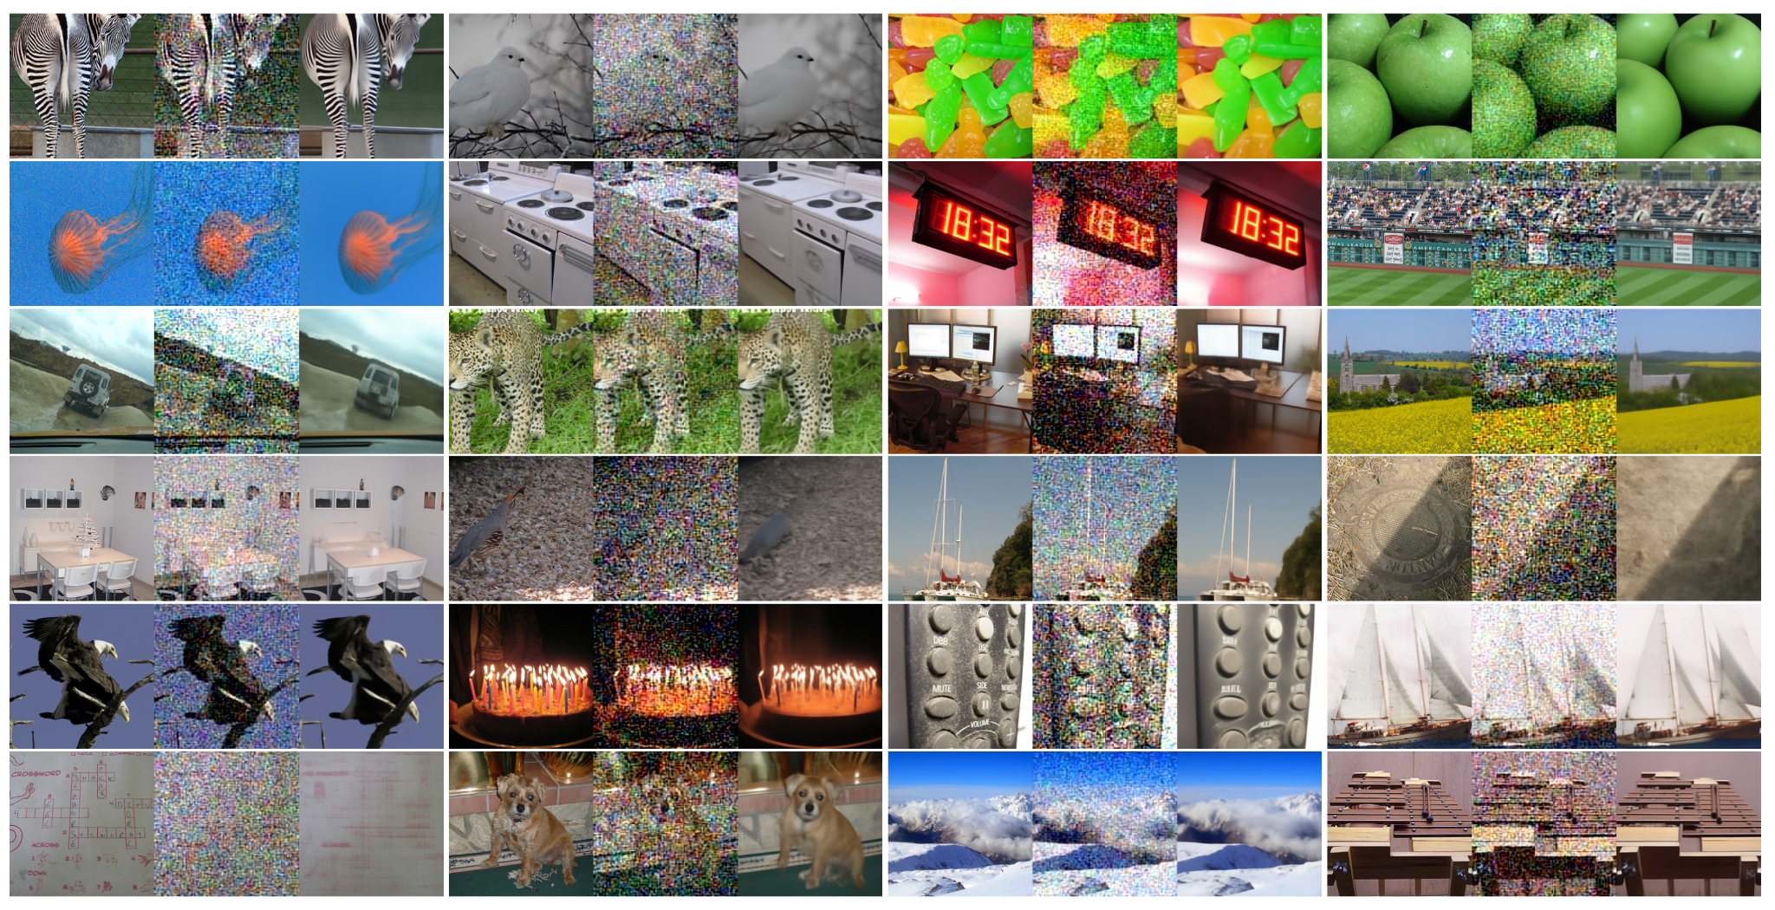
Denoising results.
heavy noise -> pretext task
force model to learn higher-level semantics to make sense of the underlying objects and scenes

Slide 41
Ablation
Strong DA does not help
More epochs help
Larger models help
These properties are similar to MAE but different from MoCo
Can we close this gap?

Slide 42
Conclusion
Low-dimensional latent space, rather than the tokenizer specifics, enables a DAE to achieve good representations
Representation capability of DDM is mainly gained by the denoising-driven process, not a diffusion-driven process.

Slide 43
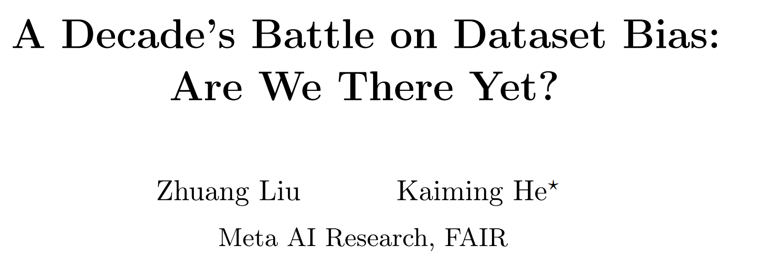

Slide 44
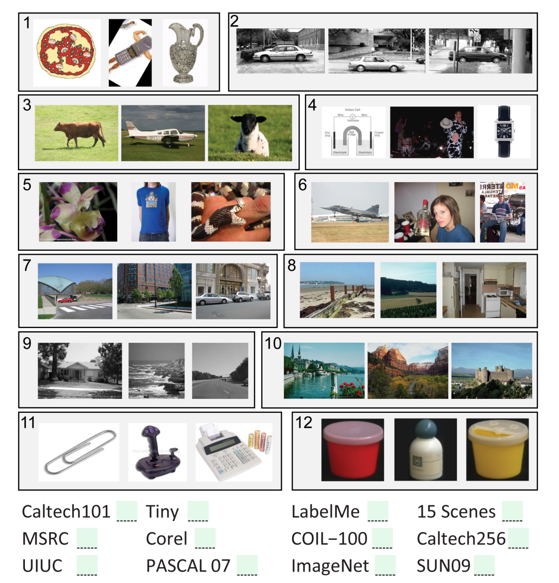
Name That Dataset! game in 2011
Less power models (hand-crafted features with SVM)
Datasets have strong built-in bias — this game is not hard as each dataset has its own goal.
75% accuracy for ML students

Slide 45
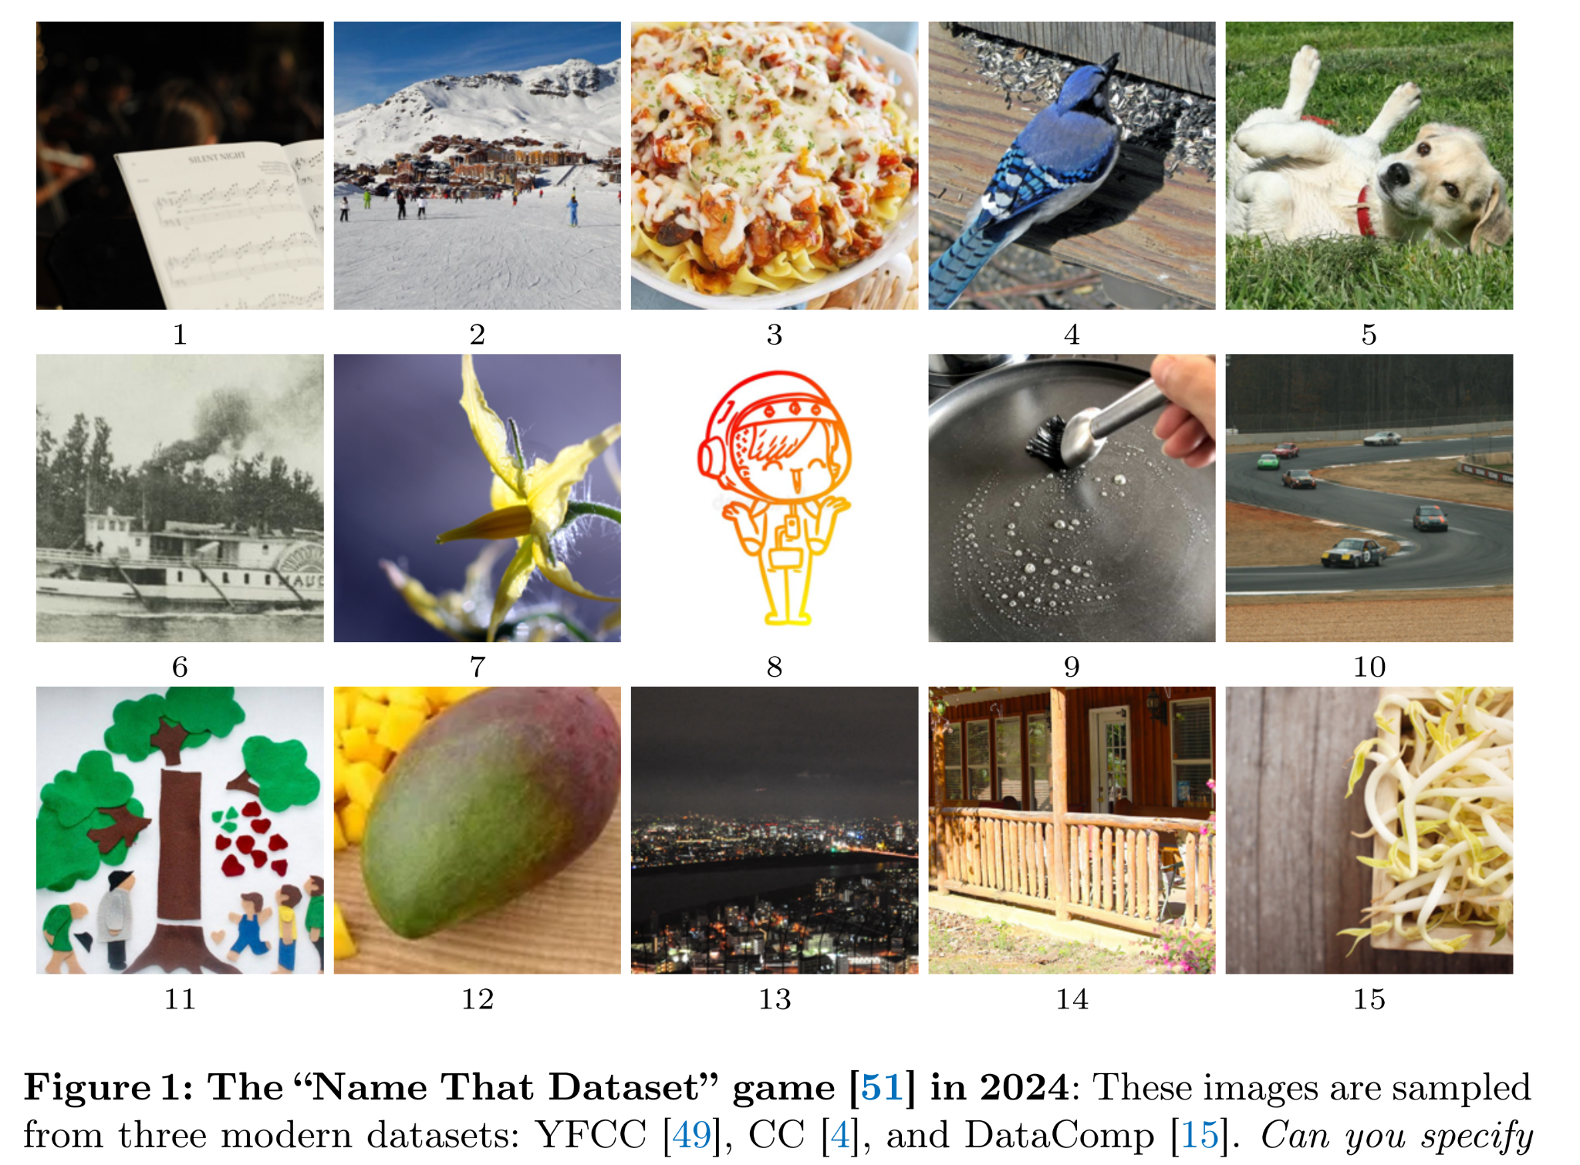
Name That Dataset! game in 2024
More power models
Large scale, more diverse, less built-in bias, less curated datasets

Slide 46
Datasets
Large.
General & diverse. Avoid scenario and domain specific
For pre-training generalizable representation
1M images randomly select from each dataset
ConvNeXt-T
By default, choose 3 datasets

Slide 47
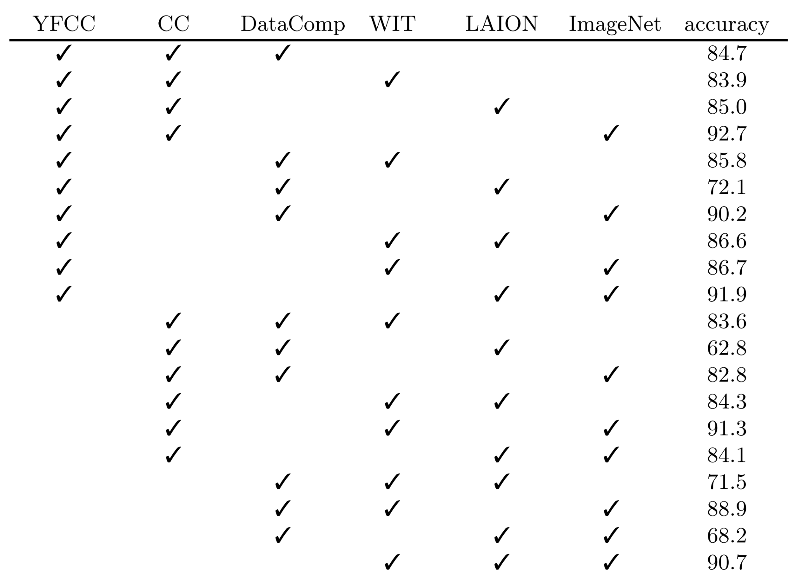
Those combinations with > 90% contains IN
Two combinations < 70% contains LAION & DataComp, both use Common Crawl website.
chance-level guess -> 33.3%

Slide 48
the follow study focuses on these 3
chance-level guess -> 16.7%

Slide 49
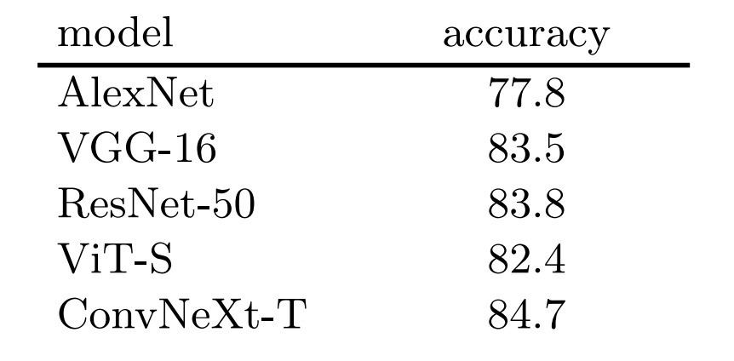
High accuracy is observed across model architectures.
The ability to capture dataset bias may be inherent in deep neural networks, rather than enabled by specific advanced components, e.g. norm layer, residual, attention.

Slide 50
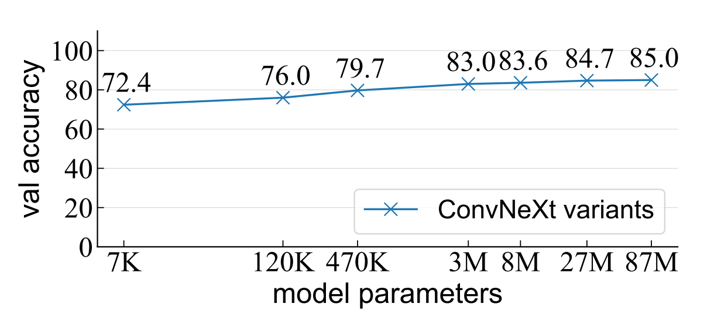
High accuracy is observed across different model sizes
3/10000 of ResNet-50 or a 700-5-700 MLP
Larger models are better (similar to regular recognition tasks)
No overfitting -> exist generalizable patterns instead of memorizing training data

Slide 51
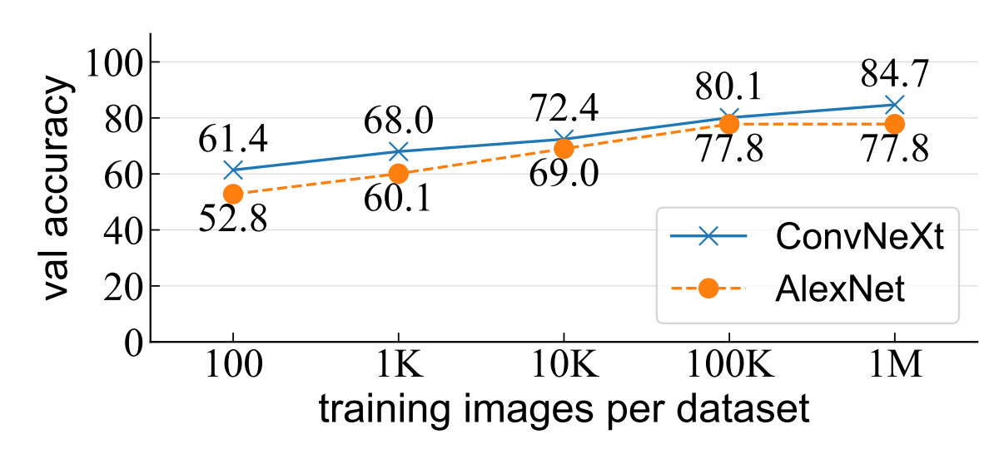
More training data is better
If the model just tries to memorize training data, more data will be worse
model learns certain semantic patterns that are generalizable to unseen data

Slide 52
Data augmentation is useful
DA is similar with increasing data size
Dataset classification is approached not through memorization

Slide 53
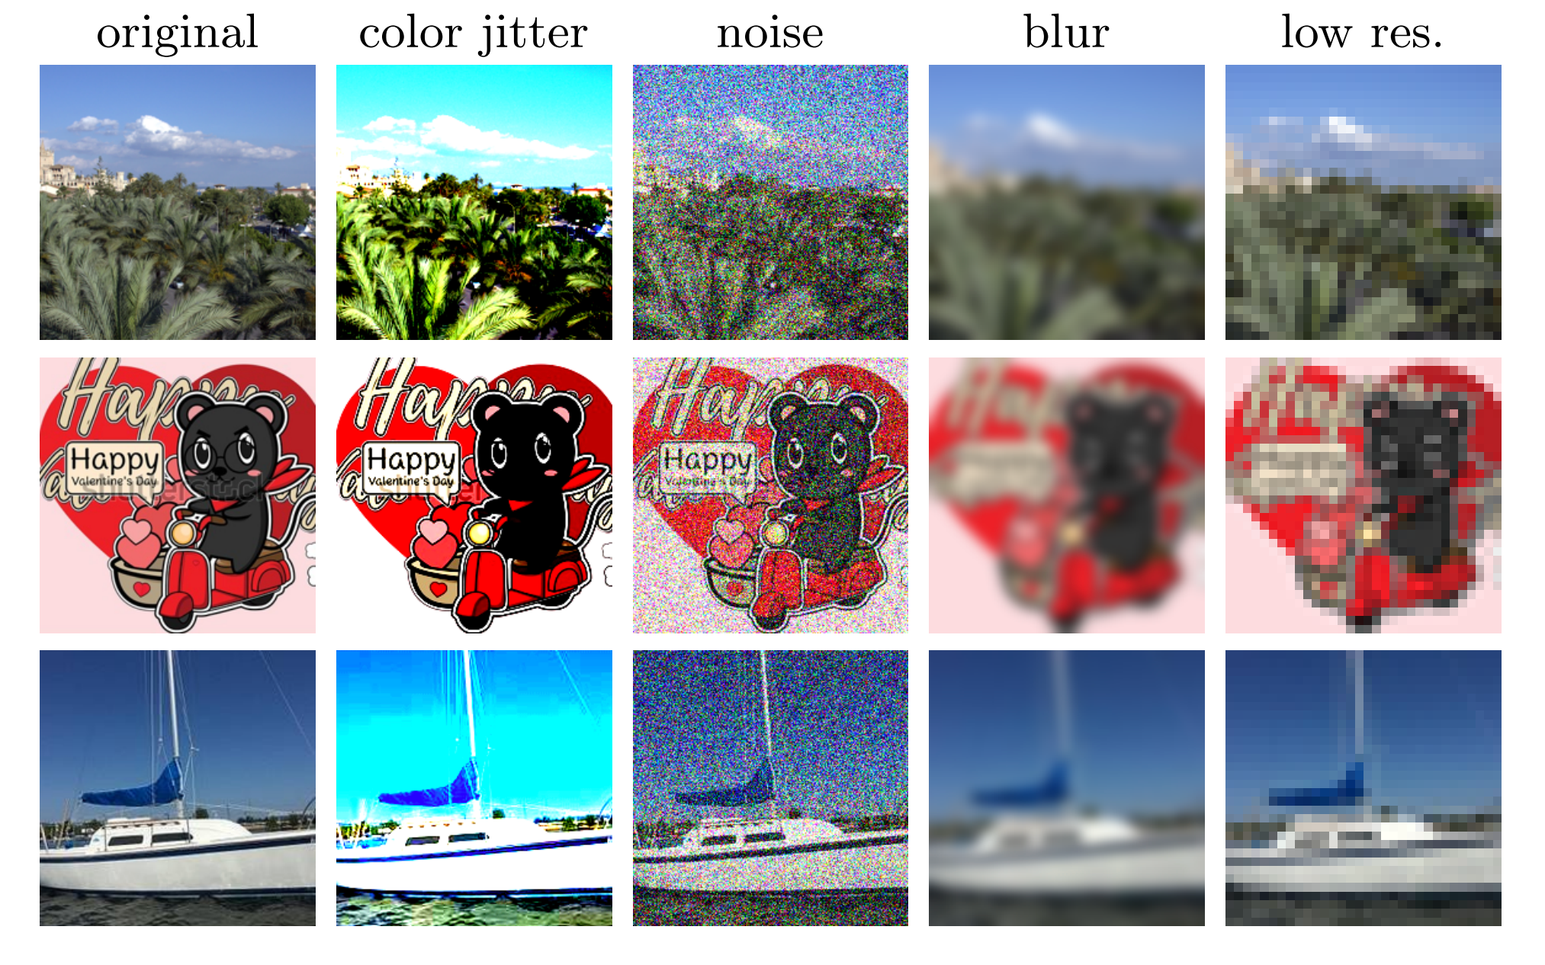
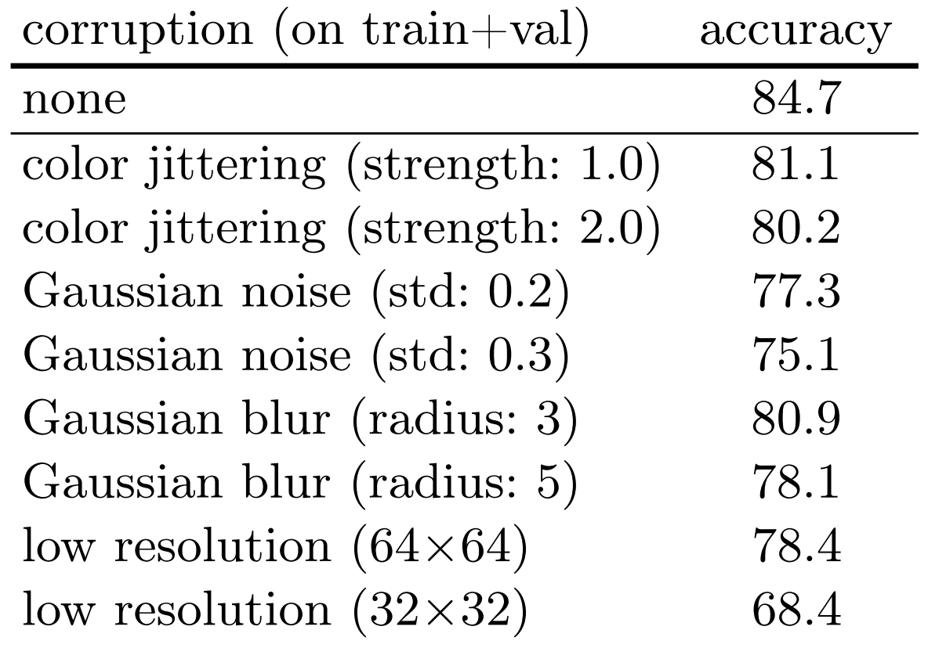
Why? Low-level Signatures?
Low-level Signatures which are less noticeable to humans but are easily identifiable by NN?
Different dataset may have different
JPEG compression artifacts
color quantization artifacts
Apply image corruption to disrupt low-level signatures.
Despite degradation, acc is still good

Slide 54
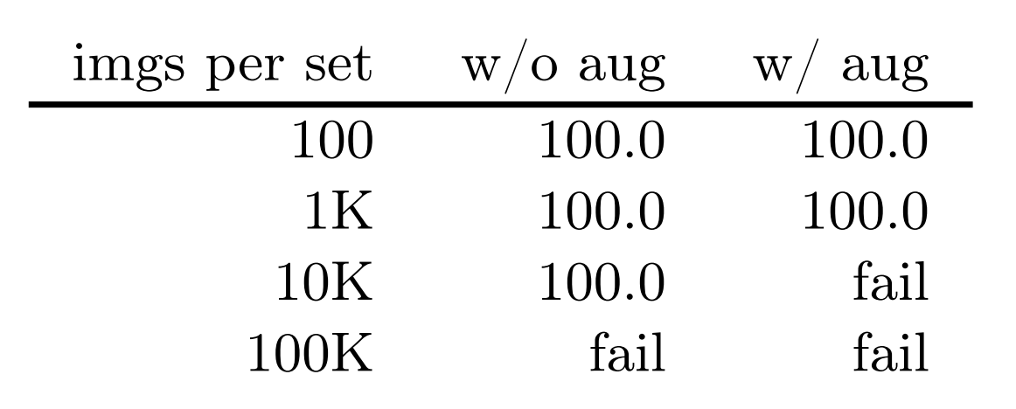
Memorization or Generalization?
pseudo-datasets: create three dataset by sampling without replacement from the SAME source dataset. Truly unbiased.
When training data is small, 100% training acc.
When task -> more difficult, fails.
Pseudo-datasets is unbiased -> no shared patterns to discriminate
-> Model is forced to memorize data.
Validation accuracy is ∼33% as no transferrable pattern is learned

Slide 55
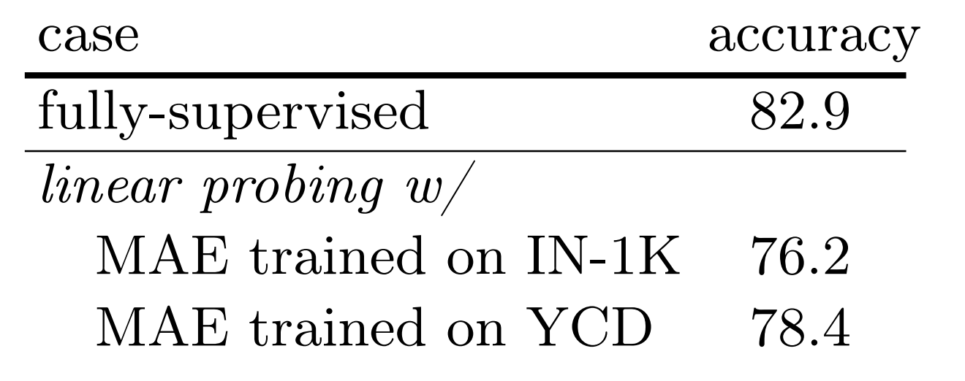
Self-supervised Learning
MAE (no label) + Linear probing
Predicting missing patches can learn features that are discriminative for dataset classification.
Transfer learning resembles semantic classification

Slide 56
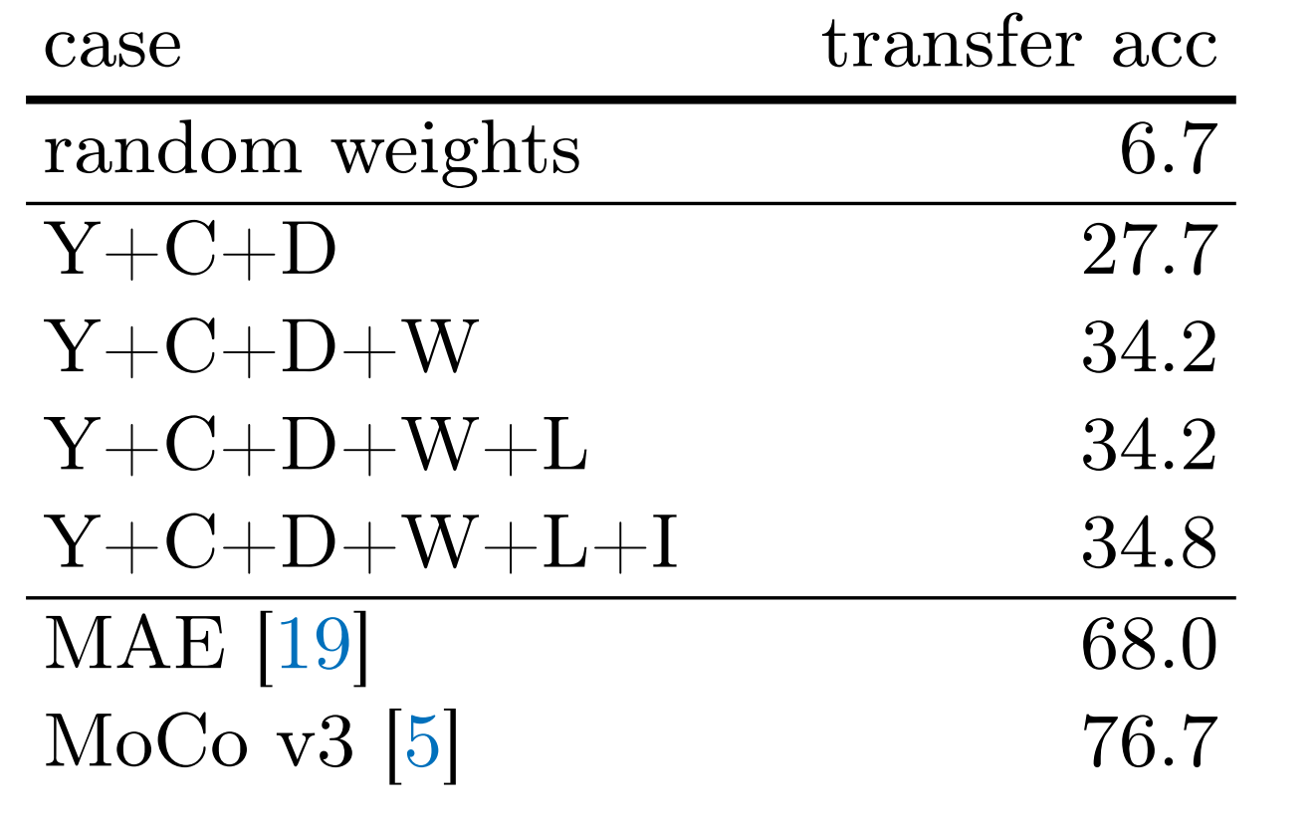
Features Learned by Classifying Datasets
Dataset classification as a pretext task
Linear probing on IN-1k classification
achieve non-trivial ImageNet-1K linear probing accuracy
more datasets -> better
-> better features are learned by discovering the dataset biases across more datasets
the dataset bias discovered by NN are relevant to semantic features that are useful for image classification.

Slide 57
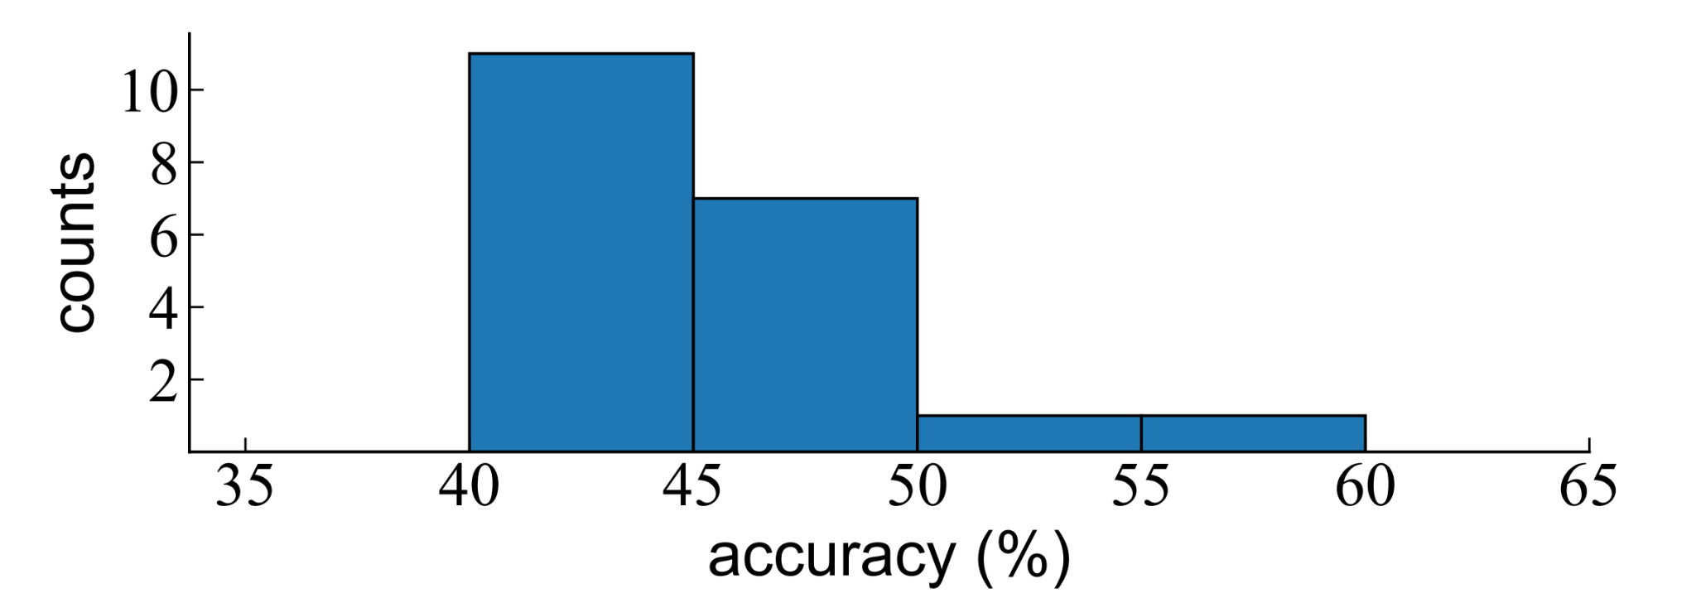
User study
20 ML researchers (14 CV)
unlimitedly browse training data
chance-level guess -> 33.3%
NN -> 84.7%

Slide 58
Conclusion & Questions
Datasets bias can still be easily captured by modern NN
Such bias may contain some generalizable and transferrable patterns,
Such bias is not be easily noticed by human beings. W
Concrete forms of the bias captured by NN remain largely unclear
Is such bias harmful?

Slide 59
Takeaways from 3 papers
They identify very interesting projects that seem not too hard to find but we always miss them.
The way they analyze tasks, identify problems, investigate issues are very systematic.
There is no apparent logica hole in their papers. You can follow their whole story smoothly including motivations, analyses and solutions.
Whenever at some points, I have questions like “why don’t they do this?”, “is it because xxx?”, they will answer these questions in the following sections.

